Slide 1
HyperNetworks
Engın denız usta
1819630

Slide 2
Outline
Introduction
Background
  Evolving Neural Networks: NEAT and HyperNEAT
  Pattern Producing: CPPN and DPPN
  Compression Weight Search
General Approach of HyperNetworks
  Static vs Dynamic
Implementation
Experiments
Conclusion

Slide 3
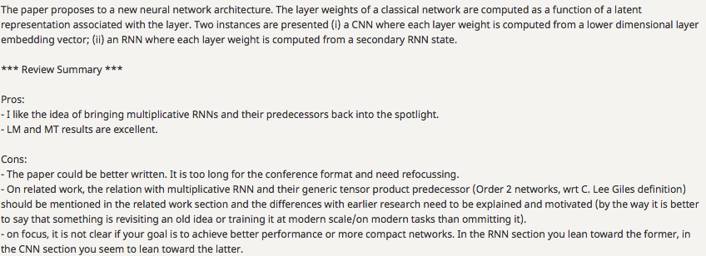
Introduction
ICLR 2017 Review

Slide 4
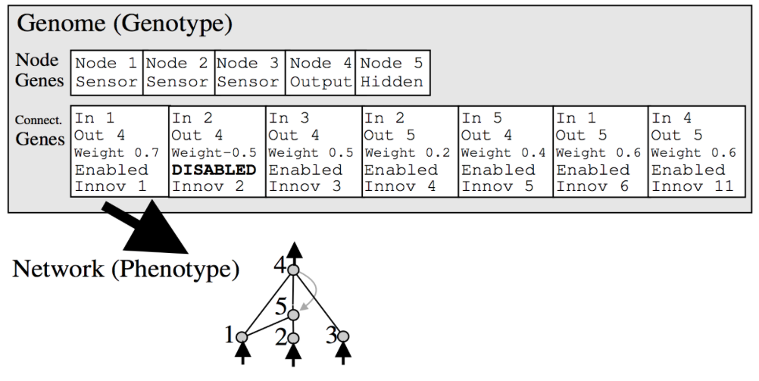
NEAT: NeuroEvolution of Augmenting Topologies
Source: Evolving Neural Networks through Augmenting Topologies (Stanley, 2016)

Slide 5
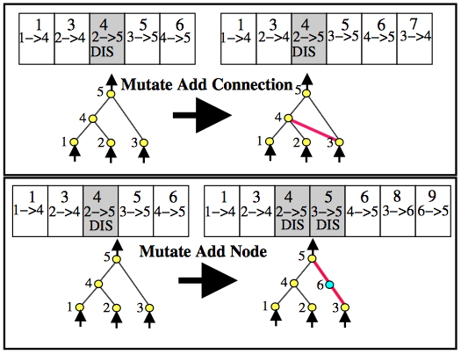
NEAT: NeuroEvolution of Augmenting Topologies
Evolving new types of neural networks based on genetic algorithms.
Selection with Fitness
Mutation
Crossover
Source: Efficient Evolution of Neural Network Topologies (Stanley, 2002)

Slide 6
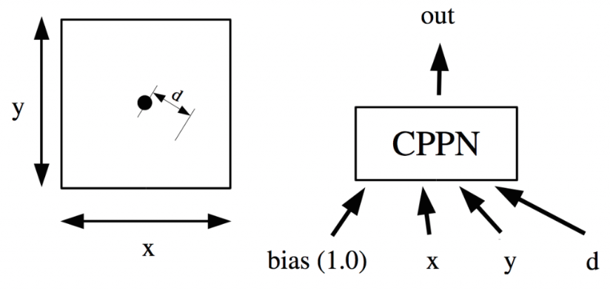
Compositional Pattern Producing Networks
Inputs:
  Coordinates (x, y)
  Distance to origin (d)
  Bias
Output:
  Intensity of pixel (grayscale)
Source: Compositional Pattern Producing Networks: A Novel Abstraction of Development
(Stanley, 2007)

Slide 7
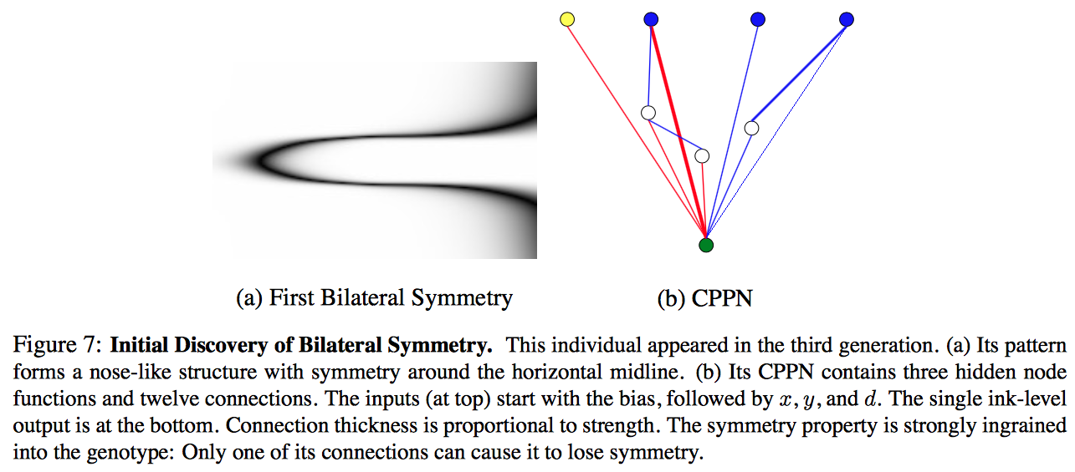
Compositional Pattern Producing Networks
Source: Compositional Pattern Producing Networks: A Novel Abstraction of Development
(Stanley, 2007)

Slide 8
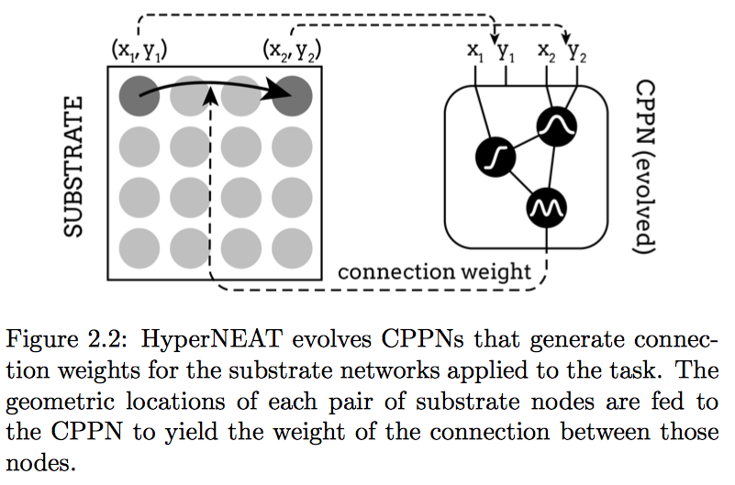
HyperNEAT: Hypercube-based NEAT
CPPN is evolved by NEAT
Substrate == Weight Matrix
Source: An Empirical Analysis of HyperNEAT
(van der Berg, 2013)

Slide 9
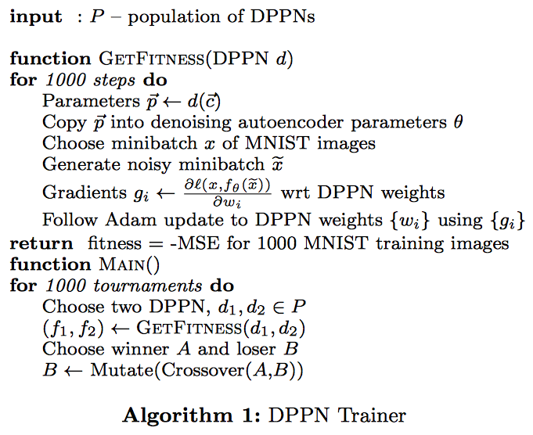
Differentiable Pattern Producing Networks
Evolves the Network
Learns the weights
Source: Convolution By Evolution (Fernando et al, 2016)

Slide 10
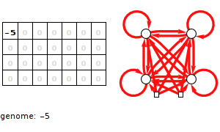
Compressed Weight Search
Genes: Fourier series coefficients
Weight Matrix : Inverse Fourier-type Transform of Genes
Discrete Cosine Transform:
Just like JPEG Compression
Source: Evolving Neural Networks in Compressed Weight Space (Koutnik et al, 2016)

Slide 11
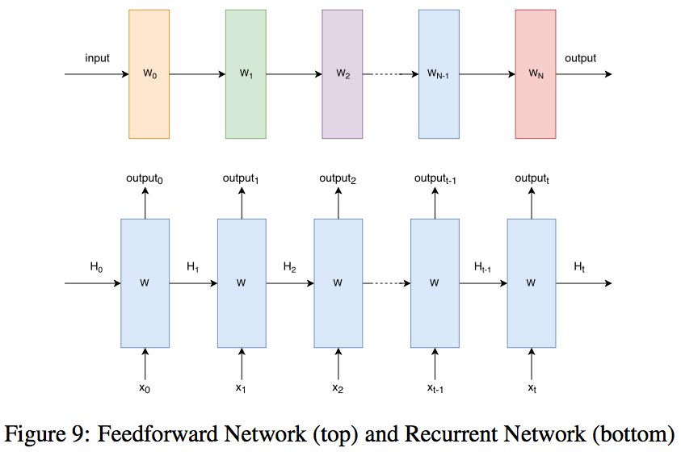
Neural Networks

Slide 12
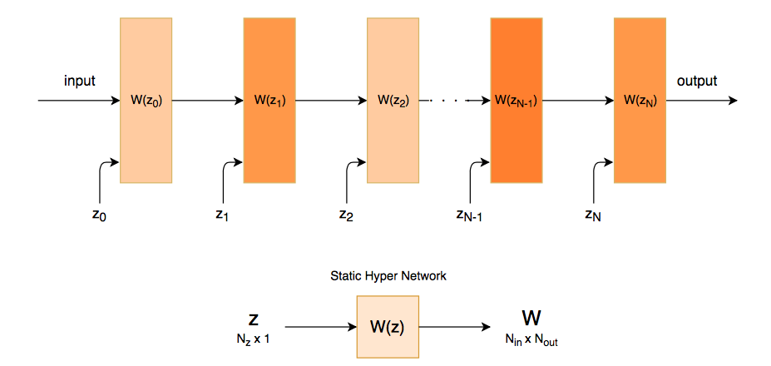
Static HyperNetworks

Slide 13
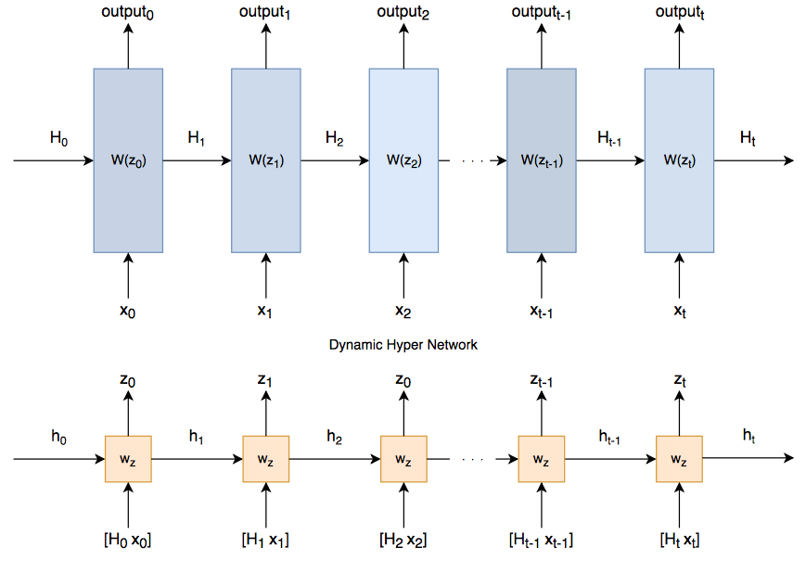
Dynamic HyperNetworks

Slide 14
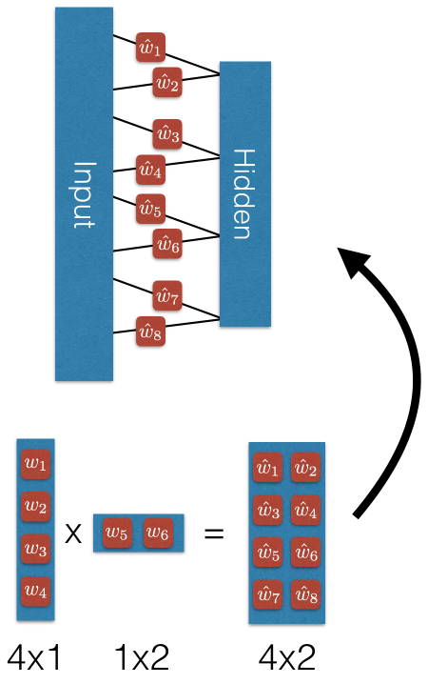
Implementation - Static
Reducing number of parameters by factorization
Accuracy vs Parameters tradeoff
Source: Hypernetworks (Mike Brodie, 2016)

Slide 15
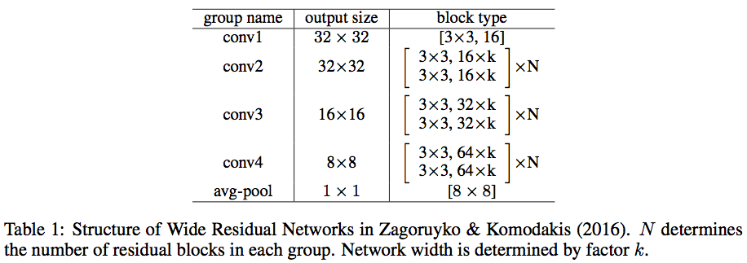
Implementation - Static

Slide 16
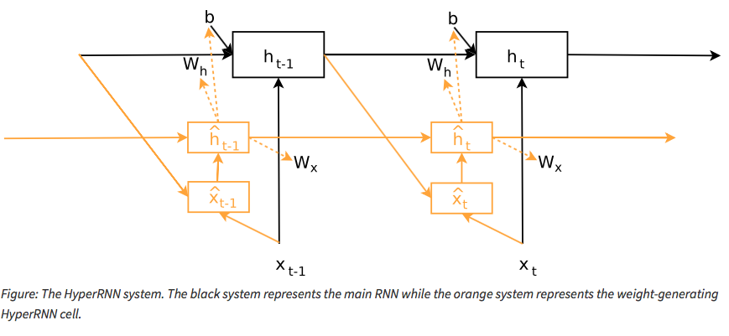
Implementation - Dynamic

Slide 17
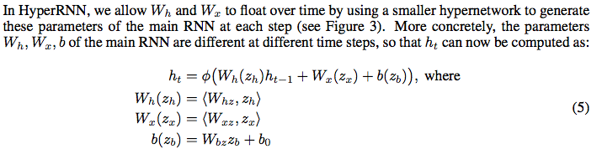
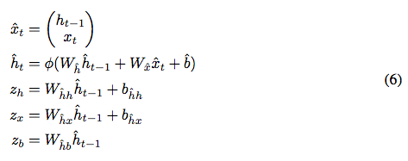
Implementation - Dynamic

Slide 18
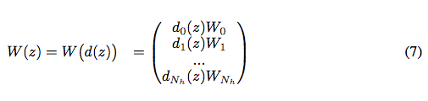
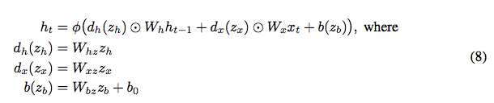
Implementation - Dynamic
Memory Problems!
Solution?
* Linear Scaling of the Matrix

Slide 19
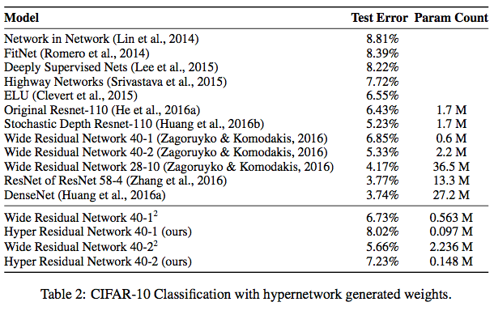
Experiments - Static

Slide 20
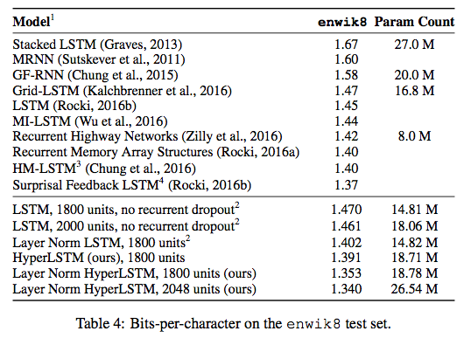
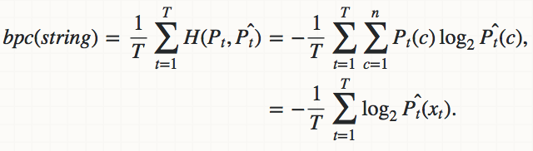
Experiments - Dynamic
Bits per Character: Similar to average cross entropy
Lower == Better
Source: Generating Sequences With Recurrent Neural Networks (Graves, 2013)

Slide 21
Conclusion
For CNN’s, with a tradeoff of accuracy, parameter count can be reduced drastically.
For RNN’s, “generating the generative model” is very powerful, and beats previous records in character-level prediction datasets.

