Slide 1

Course Overview
CENG331 - Computer Organization
1st Lecture
Instructor:
Erol Sahin (Section 2)
Adapted from slides of the textbook: http://csapp.cs.cmu.edu/
Notes:
Welcome to CENG331 - Computer Organization
This is Erol Sahin, and I’m going to teach you how computers work in this course.
A computer, in a way, is much like a car, and you, as a programmer being its driver.

Slide 2

Notes:
I bet many of you know how to drive. After all the fundamentals are pretty simple. You press the gas pedal to accelerate.
You press the break to slow down. The steering wheel changes the direction of the car. Then you need to how to switch gears.
In a car with a manual gearbox you may also need to use the clutch when you are switching gears. In a car with automatic gearbox,
You don’t’ even need that and only use the stick to switch between forward and rear direction.
Of course, there are the turn signals, wipers , etc. but those are the extra add-on that are not really essential to get going.
Once you know the basics of driving, nothing can hold you back. You can drive a car.
Once you know how to drive a car, You can drive ANY car! Because they all share the very same user interface.

Slide 3
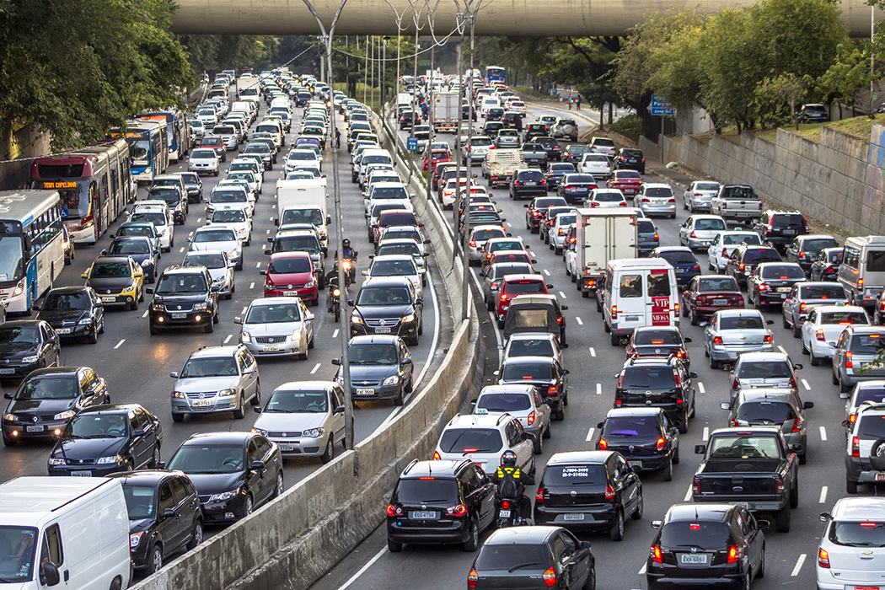
Notes:
As a matter of fact there are billions of people who can drive.
It’s proof that EVERYBODY can drive a car.
There is nothing fancy about it.
Putting it on your resume is much like saying “I can walk!” nowadays.
It’s shame if you don’t but if you do, it doesn’t get you any extra points.
At this point, as someone who learnt driving quite late, let me advise you to learn driving in the summer.
It just takes few hours a week. The earlier you learn, the more time you have to master it.
Based on my confession, let me warn those, who already know to drive and smile at me while thinking,
what a noobie driver I may be. Cause I’m not. I have drivens 20-30 different cars have picked up hundreds of thousands
of kilometers under my belt, in as many cities and coutries that you cannto image.
I could have made my living as a truck driver, bus alas here I am teaching you! ;)

Slide 4
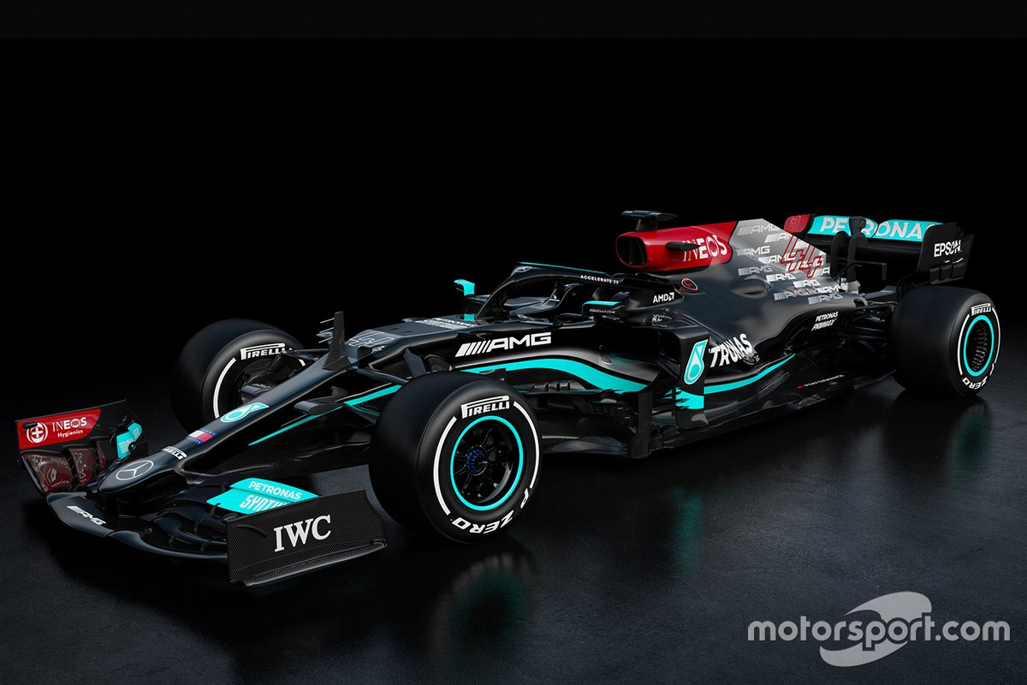
Notes:
OK, where were we?
I was talking about how everybody could drive.
Yet, I’ve put on this guy on the first slide. Who is he?
For those who are not interested in cars, this guy is Lewis Hamilton. He is one of the best drivers racing in Formula I.
He is a guy who may only put the sentence
“I can drive” in his resume, and would easily get a job paying more than you can image.
I bet you can all drive the car he’s leaning onto, of course only if your parent’s have bought it for you!
But not like this guy. This guy doesn’t just drive. HE drives the hell out of a car.

Slide 5
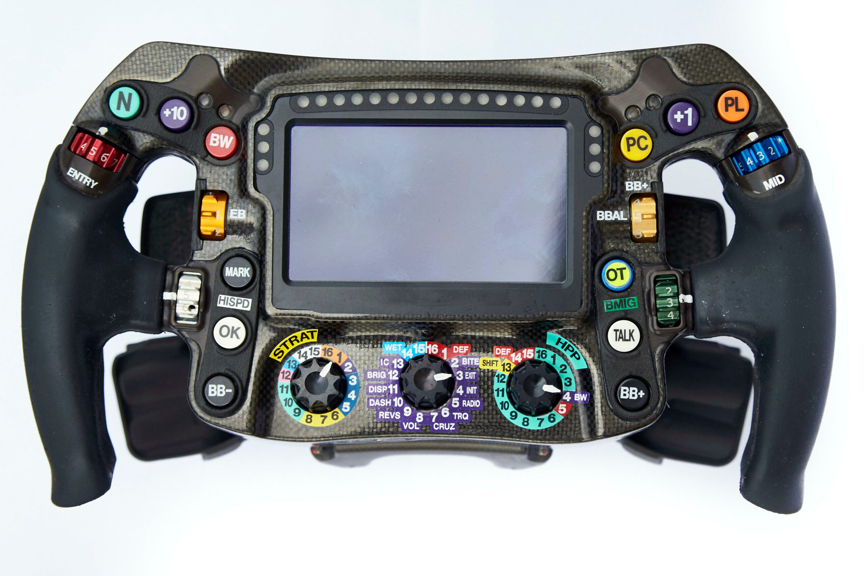
Notes:
When you get in this car, you may realize that the steering wheel is a bit different. You can drive it like a regular car, but then
there are all those colorfull buttons on it.
I would bet that you would mistake the steering wheel with game console if I hadn’t put the car in the background.
Sure they must be useful for something.
And you bet Hamilton is busy pressing those buttons as he drives.
But what are they. What do they do?
Well, Hamilton knows what these buttons do, and when to push them so that he would make the most out of his car, accelerate fast, make turns without rolling, and break without slipping.
And, that’s what makes him special.

Slide 6
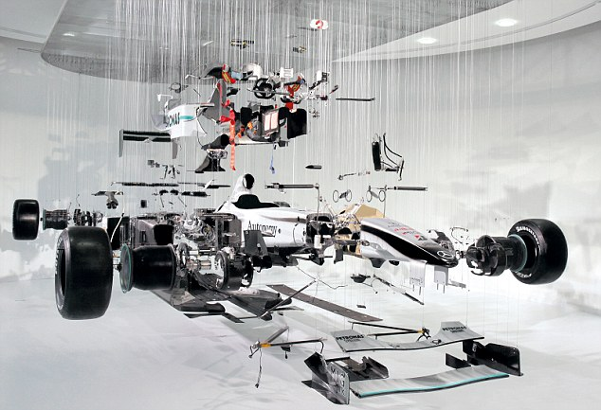
Notes:
Those knobs control different parts of the car that he drives. And in order to be able to use them, Hamilton needs to know how the car works.
How the tires react under different weather conditions and speeds, how the aerodynamics affects the car, how the engine responds to pressing the gas pedal,
how switching gears would change the traction that his car has on a wet race track, etcetera.
Obviously Hamilton is no engineer. He is not the one designing the car’s engine, its tires etc. But he needs to understand how these subsystems work, and
interact with each other and the track. And those buttons allows him to set the parameters of these subsystems in order to get the maximum
performance from his car.

Slide 7
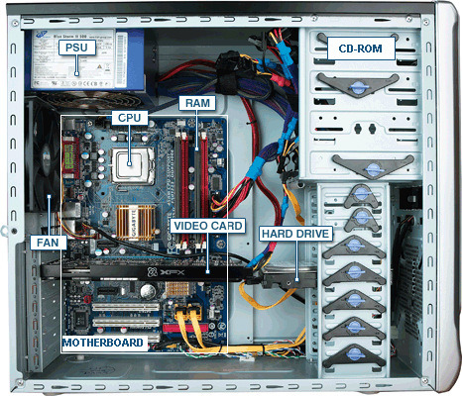
Notes:
Guess what! The computer that you have been programming so far, also had all those colorful buttons.
Yet you did not see them. You were blind all the way, and I’m going to open up your eyes.
You have been driving it like a regular car, to get from point A to point B, without knowing how to make the most our of your it.
In this course we will cover how a computer works, how its subsystems, such as the CPU is designed from a bunch of logic gates, how the memory consists of a hierarchy of different technologies, how your programs get translated into machine code, and etc.

Slide 8
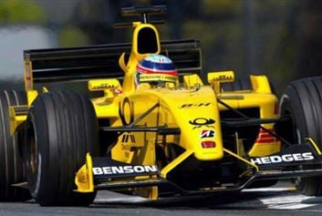
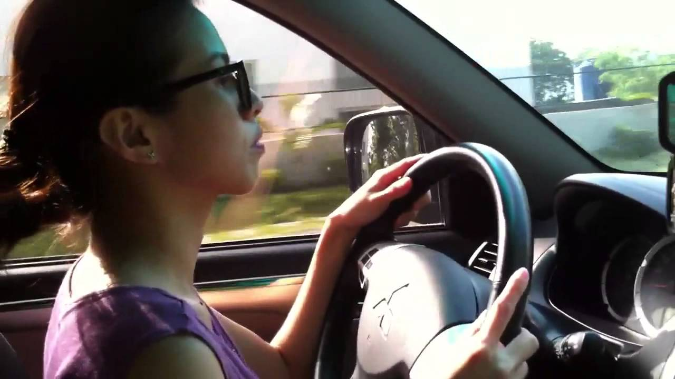
From Noob to Pro in just 16 weeks!
Notes:
In short, this course will transition you from a noob programmer into a pro programmer in just 16 weeks.
After which you will have the power to make the hell out of your computer, when you need to.
Of course, when others dare to tell you that “everybody knows programming”, you will put a Hamilton smile and
respond “But I know how to program!”, and walk away.
Please signup to my channel and don’t forget to turn on the notifications!

Slide 9
Overview
Course theme
Five realities
How the course fits into the CENG curriculum
The specifics of the course
Academic integrity
Notes:
So, now that we get you excited, let’s get started
We will first discuss the course theme, and the five realities of computers.
Then we will talk about how the course fits in the CENG curriculum, and discuss the specifics of the course.
Finally we will discuss academic integrity, which we assume no background knowledge, and will set the rules from the ground up.

Slide 10

Course Theme:
Abstraction Is Good But Don’t Forget Reality
Notes:
The world is way too complex for our brains to handle. As a result, we simplify our understanding of the world to its basics, and discard its details.
We also design our devices such that they have an easy-to-understand interface. The car is our prime example, with its simple gas/pedal/steering wheel/gear interface.
In order to drive we don’t need to know what type of an engine the car has, how much gas is injected when we press the pedal for half a centimer etc.
In the case of a lock and key, we know that every lock comes with a specific key, and that only the ones holding the key can open it, and nobody else can.
With abstractions in place, it’s easy to do high-level thinking and make plans around them. However these abstractions have limits and when we cross them our devices act in unexpected ways.

Slide 11
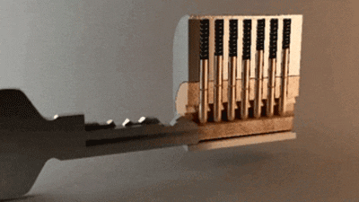
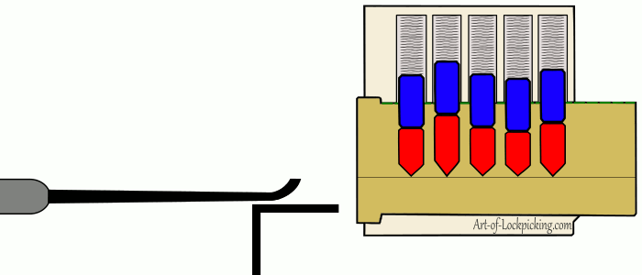
Lock/key abstraction/hacking
Notes:
Consider the lock. When you lock yourself out of your house, and call a locksmith, you will realize that he can open the door without having access to your key. He can do this, since he knows the inner workings of the lock and use alternative means to open it.
Essentially he HACKS the lock.

Slide 12
Abstraction Is Good But Don’t Forget Reality
Most CENG courses emphasize abstraction
  Abstract data types
  Asymptotic analysis
These abstractions have limits
  Especially in the presence of bugs
  Need to understand details of underlying implementations
Notes:
As a matter of fact, being one of the most most complex artefact that humans have built, computer systems are built with abstractions from the very start. And the concept of abstraction forms one of the pillars of computer science.
We define abstract data types, such as structures and arrays that do not exist in hardware.
We analyze the computational complexity, which you should be learning now, based on our abstracted view of algorithms neglecting the fine details.
However, just like the key/lock abstraction, all these abstractions have limits.
These abstractions surface only when we go beyond the assumptions that are associated with them, especially in the presence of bugs.
In order to become a computer scientist, you need to be aware of these abstractions and their boundaries such that we can have full control over our computer.

Slide 13
Computer Systems: A Programmer’s Perspective (CS:APP)
Also known as Computer Architecture
  Cover topics about how one can build a computer from scratch
  Older/alternative coverage was a continuation of CENG232
  Designing circuits for CPU, cache, memory etc.
CS:APP: Useful outcomes from taking CENG331
  Become more effective programmers
    Able to find and eliminate bugs efficiently
    Able to understand and tune for program performance
  Prepare for later “systems” classes in CS/CENG
    Compilers, Operating Systems, Networks, Embedded Systems, etc.
Notes:
This course, which is sometimes called as Computer Architecture, covers topics on the “architectural design and implementation of CPU, cache memories etcetera. In older versions of this course, it was a continuation of CENG232, and had focused on the design of the hardware towards building a computer.
Although useful, such an approach had left most students, who mostly take jobs in programming and not hardware design, what it was useful for.
This course, base on the book Computer Systems: A Programmer;s Perspective, shortly CS:APP, takes a programmer’s perspective to cover these topics.
Although we will be designing CPU’s and cache memories from logic gates, we will focus on how these designs would affect your programs.
What you’ll be learning will enable you to eliminate bugs more efficiently, tune your program for better performance.
It will also open the way to hack or to prevent being hacked!
After that it will be your call to go over the dark side, or remain here with us.
Finall the course will also prepare you to other systems classes, foremost Operating systems, networks, embedded systems and compilers.
Now I will go over five great realities of computer systems.

Slide 14
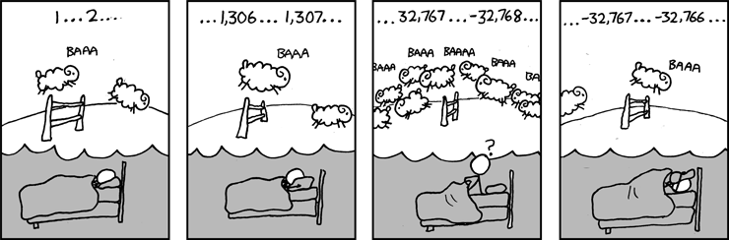
Great Reality #1:
Ints are not Integers, Floats are not Reals
Example 1: Is x² ≥ 0?
  Float’s: Yes!
  Int’s:
    40000 * 40000 --> 1600000000
    50000 * 50000 --> ??
Example 2: Is (x + y) + z = x + (y + z)?
  Unsigned & Signed Int’s: Yes!
  Float’s:
    (1e20 + -1e20) + 3.14 --> 3.14
    1e20 + (-1e20 + 3.14) --> ??
Source: xkcd.com/571
Notes:
Great Reality# 1: Int’s are not Integers and Floats are not reals.
Integer and Real numbers are mathematical concepts.
Whereas Int and Float’s are binary fixed-size representations that are designed to represent integer and real numbers.
In example 1, Consider the simple mathematical property that the square of all numbers are greater or equal to zero.
This property holds for float numbers.
However when we have an int representation this is no longer true.
When you take multiply 40,000 with 40,000 you will get a positive and correct answer.
However, when you do the same to 50,000 then you will be surprised to get negative number.
Having taken CENG232, you know that this happens due to overflow, but nevertheless we will cover this in detail shortly.
In example two consider the associativity rule of addition, which means rearranging the parenthesis in an expression should not change the result.
This property holds for unsigned and int representation. Note that, we are not considering whether the result being mathematically correct in this property. It’s about getting the same result, which may be wrong.
When test this property with float representsion, you will realize that it may not hold in some case, such as the example shown here. The first expression yields the correct 3.14 as the result, while rearranging the parenthesis would yield to zero, due to rounding.
Note that we are merely demonstrating that the abstraction that ints are being integers and floats being reals have their limits. They provide correct results when we operate within their limits, but surprise us giving unexpected and wrong results when we go beyond.
The bottom line for this slide is that if you count your sheeps using int’s you may get some interesting results once in a while and fail to fall asleep.

Slide 15
Computer Arithmetic
Does not generate random values
  Arithmetic operations have important mathematical properties
Cannot assume all “usual” mathematical properties
  Due to finiteness of representations
  Integer operations satisfy “ring” properties
    Commutativity, associativity, distributivity
  Floating point operations satisfy “ordering” properties
    Monotonicity, values of signs
Observation
  Need to understand which abstractions apply in which contexts
  Important issues for compiler writers and serious application programmers
Notes:
Note that computer arithmetic does not generate random values. Even if we get mathematically wrong results, we will get them consistently.
Moreover, the int and float representations and operations have some mathematical properties, which are different from the “usual” mathematical properties of integer and real numbers due to the finiteness of the representation.
Integer operations satisfy the ring properties, which include commutativity, associativity and distributivity.
Float operations satisfy ordering properties where we have guarantees about the monotonicity of operations and values of signs. We will cover them in detail soon.
We need to know the boundaries of our int and float abstractions and how they apply in different contexts. Failure to do, would result in confusion in your understanding of your programs behavior and intorduce bugs. If you are working on compilers, or developing real-world applications,you need to know them

Slide 16
Great Reality #2:
You’ve Got to Know Assembly
Chances are, you’ll never write programs in assembly
  Compilers are much better & more patient than you are
But: Understanding assembly is key to machine-level execution model
  Behavior of programs in presence of bugs
    High-level language models break down
  Tuning program performance
    Understand optimizations done / not done by the compiler
    Understanding sources of program inefficiency
  Implementing system software
    Compiler has machine code as target
    Operating systems must manage process state
  Creating / fighting malware
    x86 assembly is the language of choice!
Notes:
The second great reality is that you’ve got to know the Assembly Leanguage which contains only simple commands that map one-to-one to the instructions implemented on the CPU.
The early days of programming in assembly are long gone, with the availability of high-level languages such as C, C++, Java and Python.
The programs that we write in these languages are translated into assembly and into machine code by compilers, which are much better and patient than we are.
However, understanding how this translation is done, is important for you to understand the machine-level execution.
Knowing this translation process would allow you
To understand the behavior of your programs in the presence of bugs where your high-level language model breaks down.
Tune your program performance, understand optimizations that can and cannot be done by the compiler, and locate sources of program inefficieiny
Implement system software, where the

Slide 17
Great Reality #3: Memory Matters
Random Access Memory Is an Unphysical Abstraction
Memory is not unbounded
  It must be allocated and managed
  Many applications are memory dominated
Memory referencing bugs especially pernicious
  Effects are distant in both time and space
Memory performance is not uniform
  Cache and virtual memory effects can greatly affect program performance
  Adapting program to characteristics of memory system can lead to major speed improvements
Notes:
Great reality number 3 says that Random Access Memory is merely an abstraction.

Slide 18
Memory Referencing Bug Example
typedef struct {
int a[2];
double d;
} struct_t;
double fun(int i) {
volatile struct_t s;
s.d = 3.14;
s.a[i] = 1073741824; /* Possibly out of bounds */
return s.d;
}
fun(0) => 3.14
fun(1) => 3.14
fun(2) => 3.1399998664856
fun(3) => 2.00000061035156
fun(4) => 3.14
fun(6) => Segmentation fault
volatile keyword indicates that a value may change between different accesses, even if it does not appear to be modified. This keyword prevents an optimizing compiler from optimizing away subsequent reads or writes and thus incorrectly reusing a stale value or omitting writes
  Result is system specific

Slide 19
Memory Referencing Bug Example
typedef struct {
int a[2];
double d;
} struct_t;
fun(0) => 3.14
fun(1) => 3.14
fun(2) => 3.1399998664856
fun(3) => 2.00000061035156
fun(4) => 3.14
fun(6) => Segmentation fault
Explanation:
Critical State | 6
? | 5
? | 4
d7 ... d4 | 3
d3 ... d0 | 2
a[1] | 1
a[0] | 0
Location accessed by fun(i)
struct_t

Slide 20
Memory Referencing Errors
C and C++ do not provide any memory protection
  Out of bounds array references
  Invalid pointer values
  Abuses of malloc/free
Can lead to nasty bugs
  Whether or not bug has any effect depends on system and compiler
  Action at a distance
    Corrupted object logically unrelated to one being accessed
    Effect of bug may be first observed long after it is generated
How can I deal with this?
  Program in Java, Ruby, Python, ML, …
  Understand what possible interactions may occur
  Use or develop tools to detect referencing errors (e.g. Valgrind)

Slide 21
Great Reality #4: There’s more to performance than asymptotic complexity
Carnegie Mellon
Constant factors matter too!
And even exact op count does not predict performance
  Easily see 10:1 performance range depending on how code written
  Must optimize at multiple levels: algorithm, data representations, procedures, and loops
Must understand system to optimize performance
  How programs compiled and executed
  How to measure program performance and identify bottlenecks
  How to improve performance without destroying code modularity and generality

Slide 22
Memory System Performance Example
void copyij(int src[2048][2048],
int dst[2048][2048])
{
int i,j;
for (i = 0; i < 2048; i++)
for (j = 0; j < 2048; j++)
dst[i][j] = src[i][j];
}
void copyji(int src[2048][2048],
int dst[2048][2048])
{
int i,j;
for (j = 0; j < 2048; j++)
for (i = 0; i < 2048; i++)
dst[i][j] = src[i][j];
}
4.3ms
81.8ms
2.0 GHz Intel Core i7 Haswell
Hierarchical memory organization
Performance depends on access patterns
  Including how step through multi-dimensional array

Slide 23
Why The Performance Differs
copyij
copyji

Slide 24
Great Reality #5:
Computers do more than execute programs
They need to get data in and out
  I/O system critical to program reliability and performance
They communicate with each other over networks
  Many system-level issues arise in presence of network
    Concurrent operations by autonomous processes
    Coping with unreliable media
    Cross platform compatibility
    Complex performance issues

Slide 25
Course Perspective
Computer Architecture
  Older versions of the course had focus from a designers perspective
Most Systems Courses are Builder-Centric
  Operating Systems
    Implement sample portions of operating system
  Compilers
    Write compiler for simple language
  Networking
    Implement and simulate network protocols

Slide 26
Course Perspective (Cont.)
Our Course is Programmer-Centric
  Purpose is to show that by knowing more about the underlying system, one can be more effective as a programmer
  Enable you to
    Write programs that are more reliable and efficient
    Incorporate features that require hooks into OS
      E.g., concurrency, signal handlers
  Cover material in this course that you won’t see elsewhere
  Not just a course for dedicated hackers
    We bring out the hidden hacker in everyone!

Slide 27
Role within CENG Curriculum
CENG351
Databases
CENG334
Operating
Systems
CENG444
Language
Processors
CENG371
Scientific
Computing
CENG336
Embedded
Systems
CENG478
Parallel
Computing
Data Reps.
Memory Model
Processes
Mem. Mgmt
Machine
Code
Execution Model
Memory System
& Pipelining/multithreading
Arithmetic
CENG331
CENG232
Logic Design

Slide 28
Textbook
Randal E. Bryant and David R. O’Hallaron,
  Computer Systems: A Programmer’s Perspective, Third Edition (CS:APP3e), Pearson, 2016
  http://csapp.cs.cmu.edu
  This book really matters for the course!
    How to solve labs
    Practice problems typical of exam problems

Slide 29
Course Components
Lectures (online)
  Higher level concepts
Take-home labs (4)
  The heart of the course
  Provide in-depth understanding of an aspect of systems
  Programming and measurement
Exams (midterm + final)
  Test your understanding of concepts & mathematical principles
Quizzes
  Simple questions to test your understanding within that lecture

Slide 30

Communication
ODTUClass [Also has a mobile app]
    Announcements
    Resource sharing
    Discussions
    E-mail: erol@metu
      Subject Line: CENG331
  Web page (to be updated until Add/drop period is over)
    https://kovan.ceng.metu.edu.tr/~erol/Courses/CENG331/
  ODTUClass
    https://odtuclass2021f.metu.edu.tr/course/view.php?id=3485
  (Google) Course Calendar - you can add it to your own calendar
    https://calendar.google.com/calendar/u/0?cid=MXBzZTRtamo5ZmJiZnV0aGZycDdnbDZrc3NAZ3JvdXAuY2FsZW5kYXIuZ29vZ2xlLmNvbQ
QR code for Moodle App

Slide 31
Take-home Labs
  Bomb lab
    Followed by an online quiz after submission
    Lab submission grade will be modulated with the quiz grade
  Attack lab
    Followed by an online quiz after submission
    Lab submission grade will be modulated with the quiz grade
  Architecture lab
    Similarity will be evaluated using MOSS
    Oral exams will be conducted in suspicious cases
  Performance lab
    Similarity will be evaluated using MOSS
    Oral exams will be conducted in suspicious cases

Slide 32
Teaching Assistants
Çağrı Utku Akpak.
  E-mail: cakpak@ceng
Merve Taplı.
  E-mail: mtapli@ceng
Deniz Sayin
  E-mail: sayin@ceng
Cem Önem
  E-mail: onem@ceng
Office hours:
  All: By appointment

Slide 33
Policies: Assignments And Exams
Work groups
  You must work alone on all assignments unless otherwise announced
Exams
  Face-to-face exams in person
  Midterm → To-be-announced later
  Final → will be announced by METU

Slide 34
Policies: Grading
Midterm: 30%
Take-home Labs: 24%
Attendance/Quizzes: 10%
Final Examination: 36%

Slide 37
Programs and Data
Topics
  Bits operations, arithmetic, assembly language programs
  Representation of C control and data structures
  Includes aspects of architecture and compilers
Assignments
  L1 (bomblab): Defusing a binary bomb
  L2 (attacklab): The basics of code injection attacks

Slide 38
Processor Architecture
Topics
  Y86-64 architecture
    Pipelining and hazards
    Control structures
Assignments
  L3 (architecturelab): performance improvement in a pipelined processor architecture

Slide 39
Code optimization and Memory Hierarchy
Topics
  Code optimization
  Memory technology, memory hierarchy, caches, disks, locality
  Includes aspects of architecture and OS
Assignments
  L4 (performancelab): Improve the performance of a kernel which is a bottleneck in an application

Slide 40
Virtual Memory
Topics
  Virtual memory, address translation
  Includes aspects of architecture and OS

Slide 41
Lab Rationale
Each lab has a well-defined goal such as solving a puzzle or winning a contest
Doing the lab should result in new skills and concepts
We try to use competition in a fun and healthy way
  Set a reasonable threshold for full credit
  Post intermediate results (anonymized)

Slide 42
Cheating: Description
What is cheating?
  Sharing code: by copying, retyping, looking at, or supplying a file
  Describing: verbal description of code from one person to another.
  Coaching: helping your friend to write a lab, line by line
  Searching the Web for solutions
  Copying code from a previous course or online solution
    You are only allowed to use code we supply, or from the CS:APP website
What is NOT cheating?
  Explaining how to use systems or tools
  Helping others with high-level design issues
See the course syllabus for details.
  Ignorance is not an excuse

Slide 43
Cheating: Consequences
Penalty for cheating:
  Disciplinary action
Detection of cheating:
  We have sophisticated tools for detecting code plagiarism
  And other forms of cheating
Don’t do it!
  Start early
  Ask the staff for help when you get stuck

Slide 46
FAILURES
… are part of life.
If you don’t fail, you don’t learn.
If you don’t learn, you’ll never change.

Slide 47
Welcome and Enjoy!

