Slide 1
Files and Filesystems
Some slides are from Tanenbaum, Modern Operating Systems 3e, (c) 2008 Prentice-Hall, Inc. All rights reserved. 0-13-6006639

Slide 2
Filesystems (FS)
A disk (CD-ROM, flash-drive etc.) is a linear sequence of fixed-size blocks and supporting reading and writing of blocks.
The user/application views the disk in terms of directories and files.
How do you implement a file?
How do you implement a directory?
How do you find information?
How do you keep one user from reading another’s data?
How do you know which blocks are free?

Slide 3
Filesystem as a structure
A filesystem is
essentially a data structure designed for secondary storage.
that keeps allocation information in same storage, as well as
extra information about files;
such as security, access right, timestamps, etc.
Moreover;
support storage of large amount of data
Data should persist after termination
Concurrently accessible, keeping integrity of data

Slide 4
Filesystem as abstraction
Provide an abstraction over block based raw data access on storage devices. A filesystem is essentially built around
The concept of a file
The concept of directory - essentially a specific type of file
Both the directory structure and the files reside on disk
Mask the details of low-level sector-based I/O operations
Actual I/O: fragmented, distributed blocks on different areas of storage.
Caches recently-accessed data in memory

Slide 5
Filesystem abstraction levels
User Process
Library calls: fopen(), fseek(), fread()
USER
C library
System calls: open(), lseek(), read()
Kernel File Structures
struct file, struct inode, struct vnode
Virtual File System
KERNEL
FS specific calls: fat_lookup, fat_open, fat_read
Specific Filesystem
Device driver calls: dev_open, dev_read
Disk device Driver
Low level I/O instructions (e.g. SCSI protocol)
HW
Disk

Slide 6
File operations - 1
Standard operations:
Write, Read – often via position pointer
Seek – adjust position pointer for next access
Truncate - Trim some data from end of file (common case: all data)
Append – write at the end of file
Directory based:
Create – locate space, enter into directory
Delete – remove from directory, release space
Rename - Change name of file inside a directory
Move a file between two directories

Slide 7
File operations - 2
Change attributes:
Change owner,
permissions,
type,
timestamps
Extra operations:
Lock file/regions,
map to memory

Slide 8
Filesystem Design - Issues and constraints
Design issues:
File to block mapping
Metadata representation (attributes)
Directory organization
Free block management
Design constraints:
Storage media constraints: read-only, once writable, block size. (DVD, Flash disk, Hard disk, RAM disk)
Size constraints: 1.4MB vs Petabytes
Storage organization: single disk, multiple disks, cluster of disks, network accessed storage

Slide 9
A FS should also support..
Integrity of data (after a reboot, or power-off)
Efficient file operations that minimize overhead and delays.
Minimize fragmentation
Maximize the maximum size for files on a disk.
Recovery, repair facilities.
Dynamic grow/shrink/change of storage.
Snapshots and versioning.
Some filesystems, such as MacOS time machine, Solaris zfs, support rollback to a past state
Accounting and quota support
Indexing and search
Encryption
Automatic compression of infrequently used files

Slide 10

File Concept
From the user point of view, file is the only unit through which data can be written onto storage devices.
File is a logical storage unit abstraction.
Hide details of storage devices
sector addressing/ SCSI vs. IDE
Hide details of allocation/location on a storage device
The information in a file as well as the attributes of the file is determined by its creator.
Data: Numeric/character/binary
Program
When a file is created, it becomes independent of the process, the user and even the system that created it.
Notes:
10
13/03/07

Slide 11
File Block Management
Files are “logically continuous” storage regions.
However, actual data blocks may or may not be distributed in different regions of disk.
They can grow, shrink, or be deleted.
File blocks can be accessed
sequentially (text files) or
randomly (indexed files)
File -> Block Allocation
Contiguous allocation
Linked-list allocation
File Allocation table
Indexed allocation
Note that spatial locality of files, keeping blocks of the file consecutive on disk, has advantages in some storage types, such as hard disks.

Slide 12
File->Block: Contiguous Allocation
File data is stored in contiguous blocks on the disk
FILE X
[0-6]
FILE Y
[7-A]
FILE Z
[B-C]
FILE Q
[D-F]
Disk
Block #:
0 1 2 3 4 5 6 7 8 9 A B C D E F

Slide 13
File->Block: Contiguous Allocation
Harder to manage. Avoiding external fragmentation is a challenge.
For main memory: buddy system, free lists of various sizes are used.
Harder problem for slower devices like disks.
File growth is harder to control.
Size is not known in advance.
File grows in increments of blocks, not like memory (first allocate and fill later).
Fixed size allocation, easier to implement.
Fast sequential access
FILE X
[0-6]
FILE Y
[7-A]
FILE Z
[B-C]
FILE Q
[D-F]
Disk
Block #:
0 1 2 3 4 5 6 7 8 9 A B C D E F

Slide 14
File->Block: Linked list allocation
Link information part of data block:
4096 byte block 4092 bytes data, 4 bytes next. 4092 as block size?
Traversing link chain requires full read/write block.
Cache does not help much since data blocks are large in total.
FILE A
Data
Data
Data
Data
Next block no
Next block no
Next block no
NULL

Slide 15
File->Block: File Allocation Table (FAT)
Free list and file chain is separated.
FAT, a table of next page pointers.
FAT[i] corresponds to data block i.
Initial condition:
All pages are free,
Freelist starts at 0.
After a while:
Free list starts at 2. 2, 3, 7, 8, 9, 10,… are free
File A is at data blocks 0 and 6
File B is at data blocks 1, 4 and 5
-1 denotes termination.
freelist
1
FILE A
6
2
FILE B
4
3
freelist
3
4
7
5
5
6
-1
7
-1
8
8
9
9
10
10

Slide 16
FAT
FAT requires a pointer for each data block: Size/Block size * Pointer size
i.e. 4TB disk with 4K blocks: 4TB/4K*4 bytes = 4GBytes Large but also keeps file to data mapping. Increase block size to make it smaller → internal fragmentation.
Typical operations:
Finding a free page: Just use the first page in free list. Constant time
Marking a page free or allocated: Add or remove from the chain. A number update.
Contiguous allocation is difficult, List may contain block size too however block id to FAT entry mapping is lost.
Relies on caching as well. Only efficient when FAT blocks are cached.

Slide 17
FAT: File to Block Mapping
Each file is a sub-list in FAT.
Sequential access = link list sequential traversal
Direct access to n^{th} block? Linear scan of list n times.
Only feasible when FAT is in main memory

Slide 18
File->Block: Indexed Mapping
Keep an index of data blocks per file.
Unix/Linux: keep a tree of block pointers in i-node (index block)
NTFS: kept in a database area together with other file attributes.
Random access requires given file and offset return data address quick.
XFS, reiserfs uses a B+ tree for file,offset to data block mapping.

Slide 19
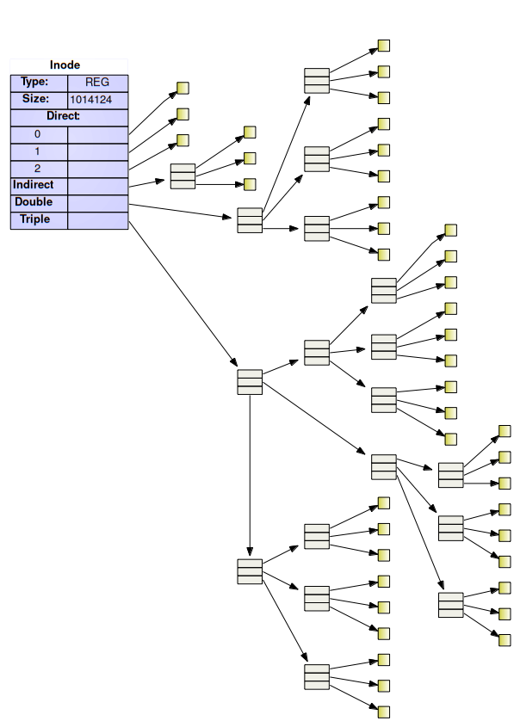
File->Block: Indexed Mapping
For small data, direct blocks are used
An indirect block contains an array of data block pointers
If file is larger, double indirect block contains array of pointers to indirect blocks
For larger files, triple indirect pointers contains pointers to double indirect pointers

Slide 20
Fragmentation
Unused and useless areas on disk causing bad utilization.
Internal Fragmentation: Unused space within allocated blocks. Small unused areas when required area is smaller than the block size.
External Fragmentation: Unused space between allocated blocks. No useful contiguous area left on disk whereas the total amount of free area is large.
Wasted: 3K
Internal
fragmentation
%75 of the block wasted
Used: 1K
12K
12K
External
fragmentation
24K free but no contiguous free area larger than 8K.
4K
No External fragmentation,
A large contiguous area is free.
4K
16K
Block size: 4K
12K
16K
12K
4K
4K
Physical
Memory
Physical
Memory

Slide 21
Block/Cluster Size
Block size affects and is affected by:
Storage device native block size. (no smaller read, smaller writes require, read, update in mem, write)
VM page size (caching)
Filesystems may choose a cluster of blocks as unit to support larger disks and file sizes.
Large cluster size → Internal fragmentation
Small cluster size bad → locality.

Slide 22
Free Block Management: Bitmaps
Free block bitmaps
Each block needs a single bit of information 0 for free, 1 for in use.
Very compact. TotSize/BlockSize/8 bytes For 4TBytes with 4K blocks → 128MBytes
Typical operations:
Finding a free page: May require a full scan of the bitmap in the worst case
Marking a page free or allocated: A complete block needs to be read and written.
Contiguous allocation requires full scan of bitmaps in the worst case.

Slide 23
Free Block Management: Bitmaps
Relies on caching. Most operations are carried in main memory and written afterwards.
Fixed size structure
The size of the bitmap is the same for a free disk as the bitmap for a full disk.
Integrity alert!!!!
Improper shutdown and some bitmap changes are lost!!

Slide 24
Free Block Management: Free Lists
Free blocks are kept as a linked list.
Pointers on disk: number of the target block
For allocated blocks, same list can be used as the file block to data block mapping .i.e. next file block follows the link for next data block.
FREELIST
FILE B
FILE A

Slide 25
Free List
FREE LIST
Free block no
Free block no
Free block no
Free block no
Free block no
Free block no
Free block no
Free block no
…
…
…
…
Free block no
Free block no
Free block no
Free block no
Next Free block
Next Free block
Next Free block
NULL
4 TB disk with 4 KB blocks.
2³⁰ disk blocks,
Disk block id: 30 bits which can be represented as 4 bytes
1 block can contain 2¹²/4 -1 = 1023 Free block numbers.
If all blocks are empty initially, the Free List would require
2³⁰/1023 = 1049602 disk blocks
If the disk is mostly full, with, only 1 free block, the Free List would require
1 disk block.

Slide 26
File Attributes
Name – only information kept in human-readable form
Identifier – unique tag (number) identifies file within file system
Type – needed for systems that support different types
Location – pointer to file location on device
Size – current file size
Credentials: who owns the file? User/group
Permissions: which type of accesses granted for different groups.
Timestamps: Last access, modification and attribute change times of the file
File attributes are kept separately from its data on the disk

Slide 27
File Type/Extension
File type provides information on what can be done with that file to the OS.
Windows uses a three letter code following a dot as extension to determine file type.
*.exe are executable, *.c are C source files
Unix like systems do not rely on extension, but look at first group of bytes to determine the file type (ELF binary vs. a script)
See “man file”, “man magic”
Mac OS TEXT/APPL is used for all files.
Creator application is stored as an attribute.

Slide 28
File Attributes - Where do we keep them?
FAT: keep in directory structure. A directory entry also contains files attributes along with its entry point in FAT.
Unix/Linux: i-node, a block containing all attributes of a file. An i-node per file is maintained. i-node also contains pointers for data block tree.
NTFS: Master File Table database contains file attribute mapping.

Slide 29

Directories
A directory is
A means of organizing files
Typically in a tree structure
A special file that links filenames to their filesystem internal identifiers.
Arbitrary changes on directory files are not allowed
Integrity of directory tree has to be preserved.
Special set of system calls for accessing/updating directories only:
mkdir, chdir, rmdir, opendir, readdir, file lookup (internal), …

Slide 30
Operations Performed on Directory
Search for a file
Given a name or a pattern of names, we should be able to find all the files that use it.
Create a file
touch assignment3.c
Delete a file
rm assignment3.c
List a directory
ls
Rename a file
mv assignment3.c odev3.c
Traverse the file system
cd include
Notes:
30
13/03/07

Slide 31
Directory requirements
Efficiency – locating a file quickly
Naming – convenient to users
Two users can have same name for different files
The same file can have several different names
Grouping – logical grouping of files by properties, (e.g., all Java programs, all games, …)

Slide 32
Directory Organization
Early mainframes used a flat structure
no nesting but “Cylinders”, virtual containers for files
Modern systems use N-ary tree in directories as intermediate nodes, and any other file type on leaves.

Slide 33
Links
Links: Two or more paths accessing same node.
Transforms the tree structure into DAG (Directed Acyclic Graph) structure
Pros:
Provides a more natural categorization
/Photos/Places/METU/ceng334.jpg
/Photos/Years/2020/ceng334.jpg
Cons:
Caution needed during file removal
Caution needed during backups not to create unintentional duplicates

Slide 34
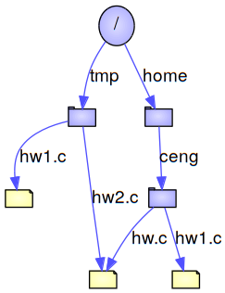
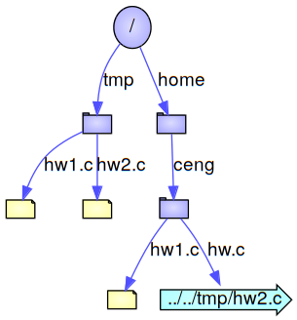
Links
Hard links:
Completely transparent, directory entry points to same file position.
No distinction between original and the link
ln ../../tmp/hw2.c hw.c
Soft links (shortcuts in Windows, or symbolic links):
Special file implemented as a redirection.
OS opens, expands and follows its content. Still transparent but link and the original file differs.
ln –s ../../tmp/hw2.c hw.c

Slide 35
Links - discussion
Hard links:
more efficient,
cannot span multiple filesystems,
cannot link directories.
Soft links:
can span multiple filesystems,
can link directories, but may dangle (link may exist without its target), when relative (i.e. ../../dir/file.txt) it can be moved with the original file.
Directory linking may cause cycles.
Cycles causes no problems for the OS but programs accessing filesystem recursively may end up in infinite loops.
OS’s can break cycles of soft links by limiting total number of link expansions in a path.

