Slide 1
Virtualization

Slide 2
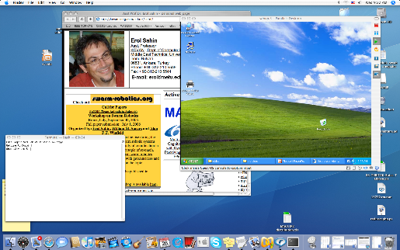
Virtualization
A single computer system hosting multiple virtual machines each potentially running a different OS.
A 40 year old technology dating back to IBM/370 that is making a come-back in the recent years.
Robustness against software failures
Able to run legacy applications on OS’s that are not supported on current hardware or available OS’s.
Good for software development that targets different OS’s.
Tanenbaum, Modern Operating Systems 3 e, (c) 2008 Prentice-Hall, Inc. All rights reserved. 0-13-6006639

Slide 3
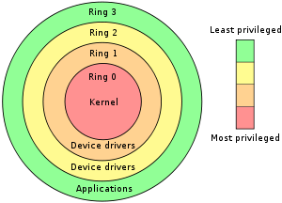
Protection Rings – x86
Protection rings
APPS
User space (lower privilege: ring 3)
System call/ trap
Kernel space (high privilege: ring 0)
Have rights to access some special CPU instructions
OS
(supervisor mode)
interrupt
Hardware

Slide 4
Requirements for virtualization
Approach: trap the “privileged instructions” in the user mode
typically related to kernel functions, such as I/O instructions or instructions that changes MMU settings
emulate them within the guest OS
Requires help from hardware
AMD and Intel CPU’s have created virtualization support after 2005
Containers in which virtual machines can run
The program runs until it creates a trap
Traps handled by the hypervisor to emulate the desired behavior

Slide 5
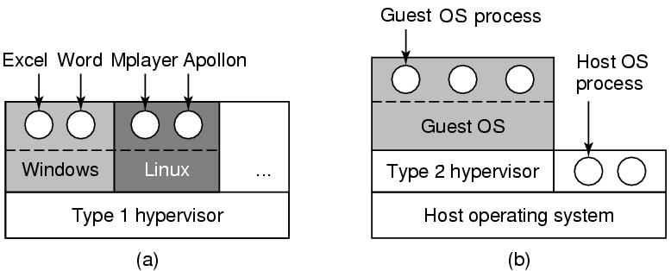
Two approaches
Hardware
Hardware
Virtualization is implemented by hypervisors that act just like the real hardware.
Type 1 hypervisor
Virtualization is implemented as part of the hosting OS at the kernel level.
Support multiple copies of the actual machine, called virtual machines.
Type 2 hypervisor
Virtualization is implemented as a user program running at the user level.
It “interprets” the machine’s instruction set which also creates a virtual machine.
https://www.youtube.com/watch?v=FZR0rG3HKIk

Slide 6
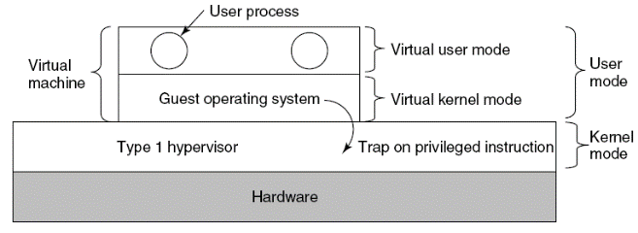
Type 1 Hypervisors
The hypervisor runs on the bare hardware as part of the OS.
The virtual machine runs as a user process in user mode.
Is not allowed to execute “privileged instructions”.
The guest OS thinks it is running in kernel mode, although it is in user mode. (virtual kernel mode)
When the guest OS executes a “privileged instruction”, it generates a trap (thanks to the VT support from hardware) in the host OS kernel.
The hypervisor inspects the instruction if it was issued by the guest OS running in the virtual machine.
If so, the hypervisor emulates what the real hardware would do when confronted with that “privileged instruction” executed in user mode.
Tanenbaum, Modern Operating Systems 3 e, (c) 2008 Prentice-Hall, Inc. All rights reserved. 0-13-6006639

Slide 7
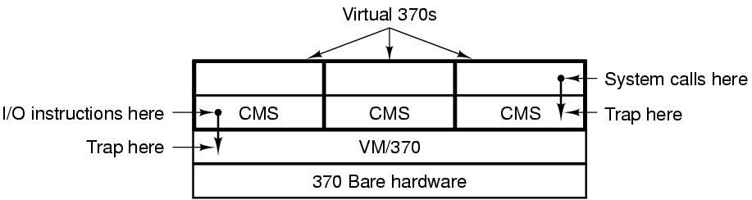
Type I: The structure of IBM VM/370
When a CMS program executed a system call, the call is trapped by the CMS (guest OS)
CMS then issued the normal hardware I/O instructions for reading its virtual disk, etcetera.
These I/O instructions were trapped by the VM/370, which then performed them as part of its simulation of the real hardware.
In its modern incarnation, z/VM can run multiple OS’s such as AIX’s or Linux.
Tanenbaum, Modern Operating Systems 3 e, (c) 2008 Prentice-Hall, Inc. All rights reserved. 0-13-6006639

Slide 8
Type 2 Hypervisors
The hypervisor runs as a user process on the host OS.
The virtual machine runs as a user process in user mode.
Is not allowed to execute “privileged instructions”.
The guest OS thinks it is running in kernel mode, although it is in user mode. (virtual kernel mode)
When the guest OS executes a “privileged instruction”, the hypervisor emulates it.
Tanenbaum, Modern Operating Systems 3 e, (c) 2008 Prentice-Hall, Inc. All rights reserved. 0-13-6006639

Slide 9
x86 virtualization
APPS
User space (ring 3)
System call/ trap
Privilege (ring 1/2)
Have rights to access some special instructions
OS (VM)
Hypervisor
Privilege: ring 0
Have rights to access
some special instructions
interrupt
Hardware

Slide 10
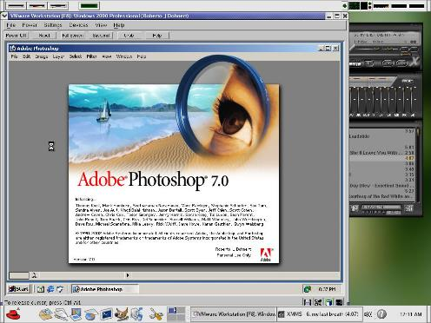
Type II: VMware: A case study
VMware runs as a user program on the host OS, such as Windows or Linux.
When it starts it acts like a newly booted computer, and expects to find a CD-ROM containing an OS. It then installs the (guest) OS on a virtual disk.
Once the guest OS is installed on the virtual disk, it can be booted to run.

Slide 11
VMware: A case study
When executing a binary program, it scans the code looking for basic blocks, that is straight runs of instructions ending in a jump, call, trap or other instructions that change the flow of execution.
The basic block is inspected if it contains any “privileged instructions”. If so, each one is replaced with a call to VMware procedure that handles it. The final instruction is also replaced with a call into VMware.
Once these steps are made, the basic block is cached inside VMware, and then executed.
A basic block not containing any “privileged instructions” will execute as fast as it will on a bare machine, because it is running on the bare machine.
“Privileged instructions” that are caught in this way are emulated. This is known as binary translation.

Slide 12
VMware: A case study
After the execution of a basic block is completed, the control returns back to VMware, which picks its successor that comes next.
If the successor is already translated, it can be executed immediately.
Eventually, most of the program will be in cache and will run at close to full speed.
There is no need to replace sensitive instructions in user programs. The hardware will ignore them any way.

Slide 13
Type I vs Type 2 hypervisors
Unlike what you would expect, Type 1 is not a winner at all times.
It turns our that trap-and-emulate approach creates a lot of overhead due to the handling of the traps (including context switches) and that the binary translation approach (combined with caching of translated blocks) can run faster.
For this reason, some type 1 hypervisors also perform binary translation for speeding up.

Slide 14
Paravirtualization
Both type 1 and type 2 hypervisors work with unmodified guest OS’s.
A recent approach is to modify the source code of the guest OS such that it makes hypervisor calls instead of executing “privileged instructions”.
For this the hypervisors have to define an API, as an interface to the guest OS’s.
But this approach is similar to the microkernel approach.
A guest OS whose “privileged instructions” are replaced with hypervisor calls is said to be paravirtualized.

Slide 15
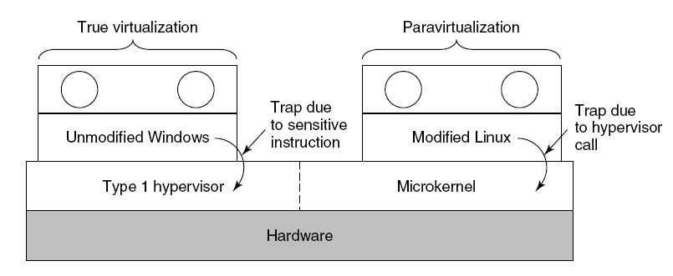
Paravirtualization
A hypervisor supporting both true virtualization and paravirtualization.
Tanenbaum, Modern Operating Systems 3 e, (c) 2008 Prentice-Hall, Inc. All rights reserved. 0-13-6006639

Slide 16
Virtualization issues
Memory virtualization
How to integrate the paging of the host OS with the paging of the guest OS
I/O virtualization
Do we use the device drivers of the host OS or the guest OS?
Multi-core
Each core can run a number of virtual machines
Sharing memory among virtual machines?
Licensing
Some software is licensed per-CPU basis.
What is you run multiple virtual machines?

Slide 17
For those who are curious…
Virtualization
https://www.youtube.com/watch?v=FZR0rG3HKIk
Cgroups
https://en.wikipedia.org/wiki/Cgroups
Container
https://www.youtube.com/watch?v=EnJ7qX9fkcU
Containers versus Containers
https://www.youtube.com/watch?v=L1ie8negCjc

