Slide 1
Synchronization
Deadlocks and prevention
Some of the slides are adapted from from Operating System Concepts (Silberschatz, Galvin, Gagne).

Slide 2
Preemption - recall
Preemption is to forcefully take a resource from a thread/process
  Resources can be CPU/lock/disk/network etc.
  Resources can be
    Preemptible (e.g. CPU)
    Non-preemptible (e.g. mutex, lock, virtual memory region)
e.g. CPU is a preemptible resource
  A preemptive OS can stop a thread/process at any time
    i.e. forcefully take the CPU from the current thread/process and give it to another.
  A non-preemptive OS can’t stop a thread/process at any time
    The OS has to wait for the current thread/process to yield (give away the CPU) voluntarily.
e.g. a lock is not a preemptible resource. The OS;
    cannot forcefully take away the lock and give it to another,
    has to wait for the current thread/process to voluntarily release it.
  Why isn't it safe to forcibly take a lock away from a thread?

Slide 3
What’s a deadlock?

Slide 4
Deadlock
A set of blocked threads/processes each holding a resource and waiting to acquire a resource held by another process in the set.
A deadlock happens when
  Two (or more) threads waiting for each other
  None of the deadlocked threads ever make progress
holds
Mutex 1
Thread 1
waits for
waits for
Mutex 2
Thread 2
holds

Slide 5
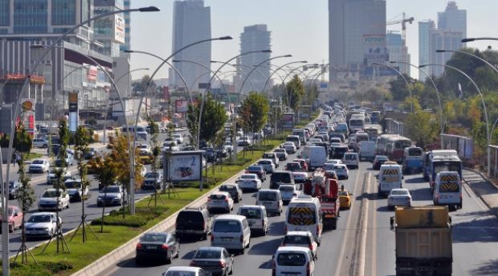
Starvation
A thread/process not making any progress since other threads/processes are using the resources that it needs.
  CPU as a resource: A thread/process not getting the CPU, since other the scheduler is giving the CPU to other “higher priority” thread/processes.
    More on this in the upcoming lecture on scheduling.
  Lock as a resource: : A thread/process not getting a lock that it has requested, since others have it.
Starvation ≠ Deadlock
  Deadlock => Starvation
  Starvation ≠> Deadlock
Pedestrians who wants to cross Eskişehir Yolu
are likely to “starve” due to traffic!

Slide 6
Methods for Handling Deadlocks
Ensure that the system will never enter a deadlock state.
Allow the system to enter a deadlock state and then recover.
Ignore the problem and pretend that deadlocks never occur in the system; used by most operating systems, including UNIX.

Slide 7



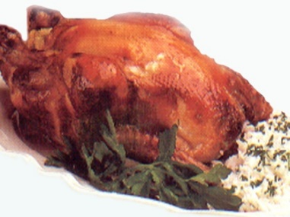


Dining Philosophers
Classic deadlock problem
  Multiple philosophers trying to lunch
  One chopstick to left and right of each philosopher
  Each one needs two chopsticks to eat

Slide 8
Dining Philosophers
What happens if everyone grabs the chopstick to their right?
  Everyone gets one chopstick and waits forever for the one on the left
  All of the philosophers starve!!!

Slide 9
Deadlock Characterization
Mutual exclusion: only one process at a time can use a resource.
Hold and wait: a process holding at least one resource is waiting to acquire additional resources held by other processes.
No preemption: a resource can be released only voluntarily by the process holding it, after that process has completed its task.
Circular wait: there exists a set {P₀, P₁, …, P₀} of waiting processes such that
  P₀ is waiting for a resource that is held by P₁,
  P₁ is waiting for a resource that is held by P₂, …,
  P_{n–1} is waiting for a resource that is held by P_{n}, and
  P_{n} is waiting for a resource that is held by P₀.
  Deadlock can arise if all four conditions hold simultaneously!

Slide 10
Deadlock Prevention
Ensure that at least one of the four conditions do not hold!
Mutual Exclusion
    not required for sharable resources;
    must hold for non-sharable resources (e.g. a printer).
Hold and Wait
    must guarantee that whenever a process requests a resource, it does not hold any other resources.
    Require process to request and be allocated all its resources before it begins execution,
    Allow process to request resources only when the process has none.
      low resource utilization;
      starvation possible.

Slide 11
Deadlock Prevention (Cont.)
No Preemption
  If a process that is holding some resources requests another resource that cannot be immediately allocated to it, then all resources currently being held are released.
  Preempted resources are added to the list of resources for which the process is waiting.
  Process will be restarted only when it can regain its old resources, as well as the new ones that it is requesting.
  Can be applied to resources whose state can be saved such as CPU, and memory. Not applicable to resources such as printer and tape drives.
Circular Wait
  impose a total ordering of all resource types, and
  require that each process requests resources in an increasing order of enumeration.

Slide 12
Circular Wait - 1
Each resource is given an ordering:
  F(tape drive) = 1
  F(disk drive) = 2
  F(printer) = 3
  F(mutex1) = 4
  F(mutex2) = 5
  …….
Each process can request resources only in increasing order of enumeration.
A process which decides to request an instance of Rj should first release all of its resources that are F(Ri) >= F(Rj).

Slide 13
Circular Wait - 2
For instance an application program may use ordering among all of its synchronization primitives:
  F(semaphore1) = 1
  F(semaphore2) = 2
  F(semaphore3) = 3
  …….
After this, all requests to synchronization primitives should be made only in the increasing order:
  Correct use:
    down(semaphore1);
    down(semaphore2);
  Incorrect use:
    down(semaphore3);
    down(semaphore2);
Keep in mind that it’s the application programmer’s responsibility to obey this order.

Slide 14
Dining Philosophers
How do we solve this problem??
  (Apart from letting them eat with forks.)‏

Slide 15
How to solve this problem?
Solution 1: Don't wait for chopsticks
  Grab the chopstick on your right
  Try to grab chopstick on your left
  If you can't grab it, put the other one back down
  Breaks “no preemption” condition – no waiting!
Solution 2: Grab both chopsticks at once
  Requires some kind of extra synchronization to make it atomic
  Breaks “multiple independent requests” condition!
Solution 3: Grab chopsticks in a globally defined order
  Number chopsticks 0, 1, 2, 3, 4
  Grab lower-numbered chopstick first
    Means one person grabs left hand rather than right hand first!
  Breaks “circular dependency” condition
Solution 4: Detect the deadlock condition and break out of it
  Scan the waiting graph and look for cycles
  Shoot one of the threads to break the cycle

Slide 16
Deadlock Avoidance
Requires that the system has some additional a priori information available.
  Simplest and most useful model requires that each process declare the maximum number of resources of each type that it may need.
    Is this possible at all?
  The deadlock-avoidance algorithm dynamically examines the resource-allocation state to ensure that there can never be a circular-wait condition.
    When should the algorithm be called?
  Resource-allocation state is defined by the number of available and allocated resources, and the maximum demands of the processes.

Slide 17
System Model
Resource types R₁, R₂, . . ., R_{m}
  CPU,
  memory,
  I/O devices
    disk
    network
Each resource type R_{i} has W_{i} instances.
  For instance a quad-core processor has
    4 CPUs
Each process utilizes a resource as follows:
  request
  use
  release

Slide 18
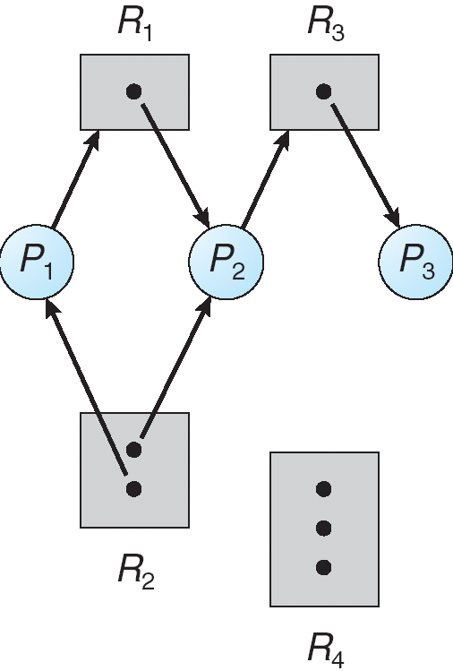
Resource-Allocation Graph
A set of vertices V and a set of edges E.
V is partitioned into two types:
  P = {P₁, P₂, …, P_{n}}, the set consisting of all the processes in the system.
  R = {R₁, R₂, …, R_{m}}, the set consisting of all resource types in the system.
request edge – directed edge P₁ −> R_{j}
assignment edge – directed edge R_{j} <− P_{i}

Slide 19
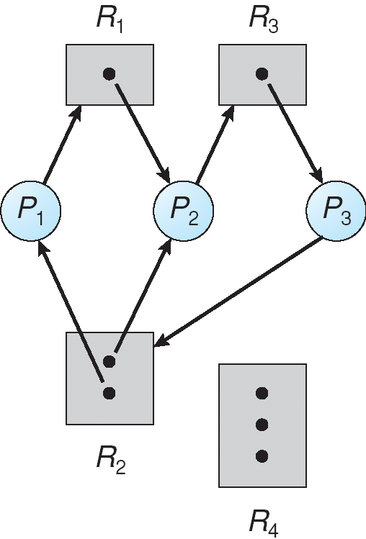
Resource Allocation Graph With A Deadlock
If there is a deadlock
  => there is a cycle in the graph.
However the reverse is not true!
If there is a cycle in the graph
  =/> there is a deadlock

Slide 20
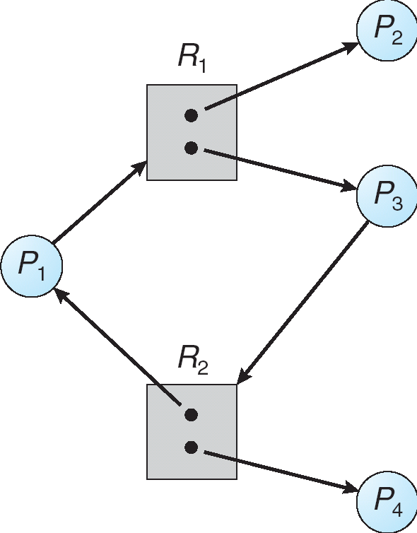
Resource Allocation Graph With A Cycle But No Deadlock
However the existence of a cycle in the graph does not necessarily imply a deadlock.
Overall message:
If graph contains no cycles =>
  no deadlock.
If graph contains a cycle =>
  if only one instance per resource type, then deadlock.
  if several instances per resource type, possibility of deadlock.

Slide 21
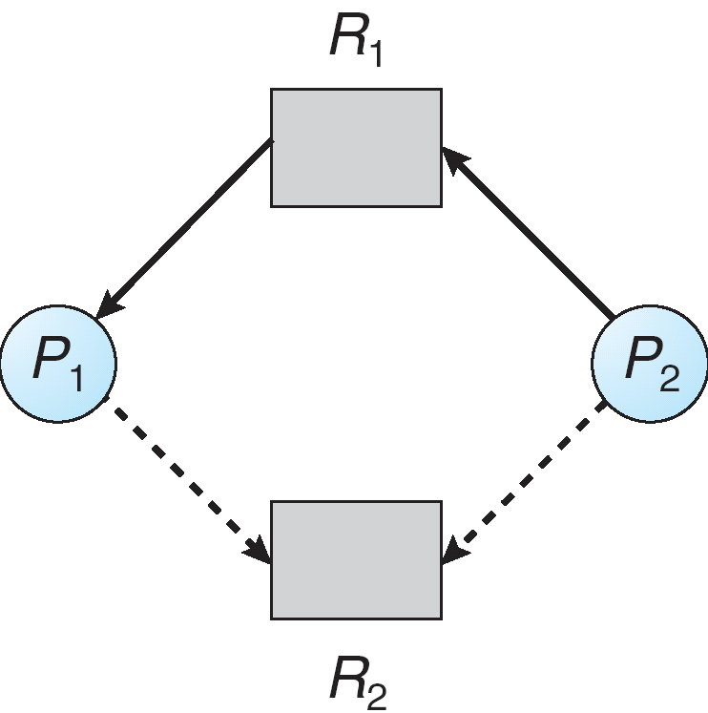
Resource-Allocation Graph Algorithm
Claim edge P_{i} -> R_{j} indicated that process P_{j} may request resource R_{j}; represented by a dashed line.
Claim edge converts to request edge when a process requests a resource.
When a resource is released by a process, assignment edge reconverts to a claim edge.

Slide 22
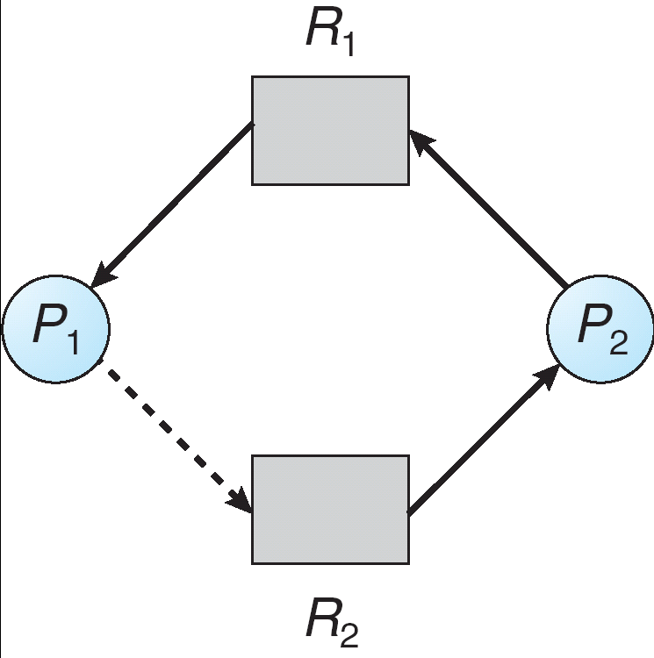
Resource-Allocation Graph Algorithm
Claim edge P_{i} -> R_{j} indicated that process P_{j} may request resource R_{j}; represented by a dashed line.
Claim edge converts to request edge when a process requests a resource.
When a resource is released by a process, assignment edge reconverts to a claim edge.
Resources must be claimed a priori in the system.
Note that the cycle detection algorithm does not work with resources that have multiple instances.
Cycle => Unsafe

Slide 23
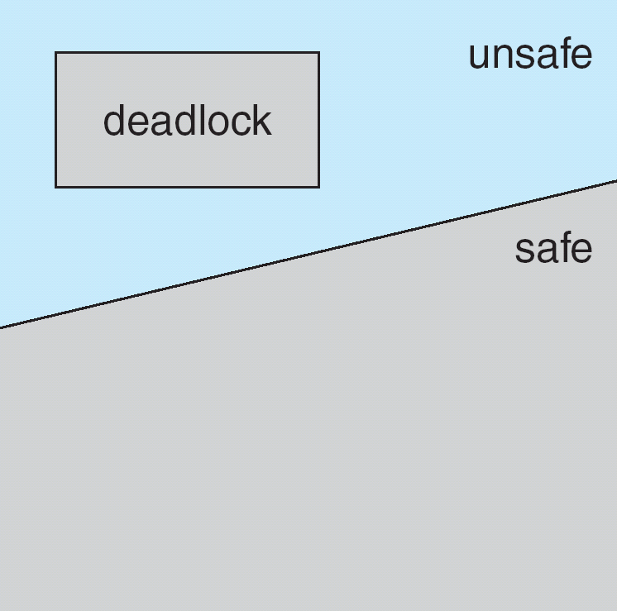
Safe, unsafe and deadlock states
If a system is in safe state => no deadlocks.
If a system is in unsafe state => possibility of deadlock.
Avoidance: ensure that a system will never enter an unsafe state.

Slide 24
Safe State
When a process requests an available resource, system must decide if immediate allocation leaves the system in a safe state.
System is in safe state if there exists a safe sequence of all processes.
Sequence <P₁, P₂, …, P_{n}> is safe if for each P_{i}, the resources that P_{i} can still request can be satisfied by currently available resources + resources held by all the P_{j}, with j < i.
  If P_{i} resource needs are not immediately available, then P_{i} can wait until all P_{j} have finished.
  When P_{j} is finished, P_{i} can obtain needed resources, execute, return allocated resources, and terminate.
  When P_{i} terminates, P_{i+1} can obtain its needed resources, and so on.

Slide 25
Resource Allocation Graph: Dining Philosopher’s example - 1
Initial configuration:
  4 philosophers
  4 sticks.
R
P₄
P₁
R
R
P₃
P₂
R

Slide 26
Resource Allocation Graph: Dining Philosopher’s example - 2
P₁ gets right stick
R
P₄
P₁
R
R
P₃
P₂
R

Slide 27
Resource Allocation Graph: Dining Philosopher’s example - 3
P₂ gets right stick
R
P₄
P₁
R
R
P₃
P₂
R

Slide 28
Resource Allocation Graph: Dining Philosopher’s example - 4
P₃ gets right stick
R
P₄
P₁
R
R
P₃
P₂
R

Slide 29
Resource Allocation Graph: Dining Philosopher’s example – 5
P₄ requests right stick.
  Cycle!!
  Rejected.
R
P₄
P₁
X
R
R
P₃
P₂
R

Slide 30
Monitors: Finite resource problem
5 instances of a resource
N processes.
Only 5 processes can use the resources simultenously.
Process code
Monitor code
Allocate MA; //resource allocation monitor.
….
MA.acquire();
// use the resource
MA.release();
....
Monitor Allocate
{
int count=5;
condition c;
void acquire(){
if (count == 0)
c.wait();
count--;
}
void release(){
count++;
c.signal(); //i.e. notify()
}
}

Slide 31
Monitors: Dining Philosophers
#define LEFT (i+4)%5
#define RIGHT (i+1)%5
Monitor DiningPhilosophers
{
enum{THINKING,
HUNGRY,
EATING
}state[5];
condition cond[5];
void pickup(int i){
state[i] = HUNGRY;
test(i);
if (state[i] != EATING)
cond[i].wait();
}
void putdown(int i){
state[i]=THINKING;
// test left and right neighbors
test(LEFT);
test(RIGHT);
}
void test(int i){
if( (state[LEFT] != EATING) &&
(state[RIGHT] != EATING) &&
(state[i] == HUNGRY))
{
state[i] = EATING;
cond[i].signal();
}
}
void initialize(){
for (int i=0l i<5; i++)
state[i] = THINKING;
}
} // end Monitor
DiningPhilosopher DP;
…
while(1){
// THINK..
DP.pickup(i);
// EAT (use resources)
DP.putdown(i);
// THINK..
}

Slide 32
Monitors: Dining Philosophers
What are the ID’s to access neighbor philosophers?
#define LEFT ???
#define RIGHT ???
state=
THINKING?
HUNGRY?
EATING?
state[LEFT] = ?
state[i] = ?
state[RIGHT] = ?
Process
???
Process
i
Process
???
…
…

Slide 33
Monitors: Dining Philosophers
What are the ID’s to access neighbor philosophers?
#define LEFT (i+4)%5
#define RIGHT (i+1)%5
state=
THINKING?
HUNGRY?
EATING?
state[LEFT] = ?
state[i] = ?
state[RIGHT] = ?
Process
(i+4) % 5
Process
i
Process
(i+1) % 5
…
…
test((i+4)%5)
test(i)
test((i+1)%5)

Slide 34
Banker’s Algorithm
Suppose “worst case/maximum” resource needs of each process is known in advance
  E.g. limit on your credit card
Observation: If we give a process the maximum of its resources
  Then it will execute to complete
  After that it will give back all the resources
When a process request a new resource during its execution
  The OS decides whether to give it the resource at that time or not
A request is delayed if there does not exist a sequence of processes that would ensure the successful completion of all the processes, even if they need the “maximum” of their resources.
Why Banker’s Algorithm? While giving credits, a banker should ensure that it never allocates all of its cash in such a way that none of its creditors can finish their work and pay back the loan.

Slide 35
Banker’s algorithm - example – 1
System:
  5 processes P1-P5
  3 resource types: A (10), B (5), C(7)
Maximum
 | A | B | C
P1 | 7 | 5 | 3
P2 | 3 | 2 | 2
P3 | 9 | 0 | 2
P4 | 2 | 2 | 2
P5 | 4 | 3 | 3

Slide 36
Banker’s algorithm - example - 2
System:
  5 processes P1-P5
  3 resource types: A (10), B (5), C(7)
System state at t0
 | Allocated |  |  | Max |  |  | Needs
 | A | B | C | A | B | C | A | B | C
P1 | 0 | 1 | 0 | 7 | 5 | 3 | 7 | 4 | 3
P2 | 2 | 0 | 0 | 3 | 2 | 2 | 1 | 2 | 2
P3 | 3 | 0 | 2 | 9 | 0 | 2 | 6 | 0 | 0
P4 | 2 | 1 | 1 | 2 | 2 | 2 | 0 | 1 | 1
P5 | 0 | 0 | 2 | 4 | 3 | 3 | 4 | 3 | 1
Available
A | B | C
3 | 3 | 2
The system is in a safe state since the sequence <P2,P4,P5,P3,P1> would guarantee
the completion of all processes.

Slide 37
Banker’s algorithm - example - 3
P2 request (1,0,2)
Check that request <= Available
  (1,0,2) <= (3,3,2)
Look for a safe sequence:
  <P2,P4,P5,P1,P3> is possible!
 | Allocated |  |  | Max |  |  | Needs
 | A | B | C | A | B | C | A | B | C
P1 | 0 | 1 | 0 | 7 | 5 | 3 | 7 | 4 | 3
P2 | 3 | 0 | 2 | 3 | 2 | 2 | 1 | 2 | 2
P3 | 3 | 0 | 2 | 9 | 0 | 2 | 6 | 0 | 0
P4 | 2 | 1 | 1 | 2 | 2 | 2 | 0 | 1 | 1
P5 | 0 | 0 | 2 | 4 | 3 | 3 | 4 | 3 | 1
Available
A | B | C
2 | 3 | 0

Slide 38
Banker’s algorithm - example - 4
P5 requests (3,3,0)
Check that request <= Available
  ???
Look for a safe sequence:
  ???
 | Allocated |  |  | Max |  |  | Needs
 | A | B | C | A | B | C | A | B | C
P1 | 0 | 1 | 0 | 7 | 5 | 3 | 7 | 4 | 3
P2 | 3 | 0 | 2 | 3 | 2 | 2 | 1 | 2 | 2
P3 | 3 | 0 | 2 | 9 | 0 | 2 | 6 | 0 | 0
P4 | 2 | 1 | 1 | 2 | 2 | 2 | 0 | 1 | 1
P5 | 0 | 0 | 2 | 4 | 3 | 3 | 4 | 3 | 1
Available
A | B | C
2 | 3 | 0

Slide 39
Banker’s algorithm - example - 5
P1 requests (0,2,0)
Check that request <= Available
  ???
Look for a safe sequence:
  ???
 | Allocated |  |  | Max |  |  | Needs
 | A | B | C | A | B | C | A | B | C
P1 | 0 | 1 | 0 | 7 | 5 | 3 | 7 | 4 | 3
P2 | 3 | 0 | 2 | 3 | 2 | 2 | 1 | 2 | 2
P3 | 3 | 0 | 2 | 9 | 0 | 2 | 6 | 0 | 0
P4 | 2 | 1 | 1 | 2 | 2 | 2 | 0 | 1 | 1
P5 | 0 | 0 | 2 | 4 | 3 | 3 | 4 | 3 | 1
Available
A | B | C
2 | 3 | 0

Slide 40
Banker’s Algorithm – Dining Philosophers - 1
System resources:
  1 chopsticks in 5 positions
  Total resources: (1, 1, 1, 1, 1)
5 “philosopher” processes
Maximum resources table is:
Maximum
 | C1 | C2 | C3 | C4 | C5
P1 | 1 | 1 | 0 | 0 | 0
P2 | 0 | 1 | 1 | 0 | 0
P3 | 0 | 0 | 1 | 1 | 0
P4 | 0 | 0 | 0 | 1 | 1
P5 | 1 | 0 | 0 | 0 | 1

Slide 41
Banker’s Algorithm – Dining Philosophers - 2
Safe state:
<P4, P3, P2, P1, P5> is feasible.
 | Allocated |  |  |  |  | Needs
 | C1 | C2 | C3 | C4 | C5 | C1 | C2 | C3 | C4 | C5
P1 | 1 | 0 | 0 | 0 | 0 | 0 | 1 | 0 | 0 | 0
P2 | 0 | 1 | 0 | 0 | 0 | 0 | 0 | 1 | 0 | 0
P3 | 0 | 0 | 1 | 0 | 0 | 0 | 0 | 0 | 1 | 0
P4 | 0 | 0 | 0 | 1 | 0 | 0 | 0 | 0 | 0 | 1
P5 | 0 | 0 | 0 | 0 | 0 | 1 | 0 | 0 | 0 | 1
Available
C1 | C2 | C3 | C4 | C5
0 | 0 | 0 | 0 | 1

Slide 42
Banker’s Algorithm – Dining Philosophers - 3
P5 is given the C5
None of the processes get their need.
Unsafe. Rejected.
 | Allocated |  |  |  |  | Needs
 | C1 | C2 | C3 | C4 | C5 | C1 | C2 | C3 | C4 | C5
P1 | 1 | 0 | 0 | 0 | 0 | 0 | 1 | 0 | 0 | 0
P2 | 0 | 1 | 0 | 0 | 0 | 0 | 0 | 1 | 0 | 0
P3 | 0 | 0 | 1 | 0 | 0 | 0 | 0 | 0 | 1 | 0
P4 | 0 | 0 | 0 | 1 | 0 | 0 | 0 | 0 | 0 | 1
P5 | 0 | 0 | 0 | 0 | 1 | 1 | 0 | 0 | 0 | 0
Available
C1 | C2 | C3 | C4 | C5
0 | 0 | 0 | 0 | 0

