Slide 1
Memory Management and Virtual Memory - 2
Some of the slides are adapted from Matt Welsh’s.
Some slides are from Tanenbaum, Modern Operating Systems 3 e, (c) 2008 Prentice-Hall, Inc. All rights reserved. 0-13-6006639
Some slides are from Silberschatz, and Gagne.

Slide 2
Page Replacement
How do we decide which pages to page-out (a.k.a kick out) of physical memory when memory is tight?
How do we decide how much memory to allocate to a process?

Slide 3
Disk
PPN
21
11
10
3
2
1
0
Physical
Memory
15
42
32
15
42
32
VPN
V
PTE
9
8
7
6
5
4
3
2
1
0
Page
Table

Slide 4
Basic Page Replacement
How do we replace pages?
Find the location of the desired page on disk
Find a free frame:
If there is a free frame, use it
If there is no free frame, use a page replacement algorithm to select a victim frame
Read the desired page into the (newly) free frame. Update the page and frame tables.
Restart the process

Slide 5
Evicting the best page
Goal of the page replacement algorithm:
Reduce page fault rate by selecting the best page to evict
The “best” pages are those that will never be used again
However, it's impossible to know in general whether a page will be touched
If you have information on future access patterns, it is possible to prove that evicting those pages that will be used the furthest in the future will minimize the page fault rate
What is the best algorithm for deciding the order to evict pages?
Much attention has been paid to this problem.
Used to be a very hot research topic.
These days, widely considered solved (at least, solved well enough)

Slide 6
Locality
Exploiting locality
Temporal locality: Memory accessed recently tends to be accessed again soon
Spatial locality: Memory locations near recently-accessed memory is likely to be referenced soon
Locality helps to reduce the frequency of paging
Once something is in memory, it should be used many times
This depends on many things:
The amount of locality and reference patterns in a program
The page replacement policy
The amount of physical memory and the application footprint

Slide 7
Page Replacement Basics
Most page replacement algorithms operate on some data structure that represents physical memory:
Free list

Slide 8
Page Replacement Basics
Most page replacement algorithms operate on some data structure that represents physical memory:
Might consist of a bitmap, one bit per physical page
Might be more involved, e.g., a reference count for each page (remember Shared memory/CoW?)
Free list consists of pages that are unallocated
Several ways of implementing this data structure
Scan all process PTEs that correspond to mapped pages (valid bit == 1)
Keep separate linked list of physical pages
Inverted page table: One entry per physical page, each entry points to PTE
Free list

Slide 9
Inverted Page Tables
Inverted Page Table is a mapping from frame to Virtual Page.
Stores which process and page table refers a physical page.
During page replacement, replaced page should have its existing address translation invalidated.
Other uses:
For copy-on-write, number of references to a frame needs to be stored.
Some architectures use them for address translation without HW help.
A hash table for (pid, virtual page no) pair points to inverted page table entry.
If IPT entry points to process address space back, it is success.
Otherwise hash chain is followed, if miss, page is invalid, page fault is invoked.

Slide 10
Free List
Bitmap representation: n/8 bytes.
i.e. 4GB = 4M pages requires 512KB
More information per frame required if page is not free. i.e. invalidate PTE’s of address translation tables referring an evicted frame.
Linked list of page structures:
Allocating a free page and inserting an evicted page is fast. Insert/remove from the head
Non-free page structures keep reference count, reference to task memory maps, file block info if loaded from a file, state and protection.
freelist
page
page
page
page
page
page

Slide 11
Page Replacement Algorithms/Policies
Random: Throw out a random page frame
FIFO: Throw out pages in the order that they were allocated
Least Recently Used: Details described later
Least Recently Used (n bits bitmap): Details described later
Second Chance (queue): Details described later
Second Chance (clock): Details described later
Enhanced Second Chance (clock): Details described later
http://sehitoglu.web.tr/pagingdemo/#

Slide 12
Algorithms: Random and FIFO
Random: Throw out a random page
Obviously not the best scheme
Although very easy to implement!
Provides a baseline against which we can compare other policies
FIFO: Throw out pages in the order that they were allocated
Maintain a list of allocated pages
When the length of the list grows to cover all of physical memory, pop first page off list and allocate it
Why might FIFO be good?
Why might FIFO not be so good?

Slide 13
Algorithms: FIFO
FIFO: Throw out pages in the order that they were allocated
Maintain a list of allocated pages
When the length of the list grows to cover all of physical memory, pop first page off list and allocate it
Why might FIFO be good?
Maybe the page allocated very long ago isn't being used anymore
Why might FIFO not be so good?
Doesn't consider spatial locality!
Suffers from Belady's Anomaly: Performance of an application might get worse as the size of physical memory increases!!!

Slide 14
Belady's Anomaly
time
Access pattern
0 1 2 3 0 1 4 0 1 2 3 4
0
0
0
1
2
3
0
0
0
1
4
4
Physical memory
(3 page frames)‏
9 page faults!
1
1
2
3
0
1
1
1
4
2
2
2
3
0
1
4
4
4
2
3
3
time
Access pattern
0 1 2 3 0 1 4 0 1 2 3 4
0
0
0
0
0
0
1
2
3
4
0
1
Physical memory
(4 page frames)‏
1
1
1
1
1
2
3
4
0
1
2
10 page faults!
2
2
3
2
3
2
3
3
4
4
0
0
1
1
2
2
3
3
4

Slide 15
Algorithm: OPT (a.k.a MIN)
Evict page that won't be used for the longest time in the future
Of course, this requires that we can foresee the future...
So OPT cannot be implemented!
This algorithm has the provably optimal performance
Hence the name “OPT”
Also called “MIN” (for “minimal”)
OPT is useful as a “yardstick” to compare the performance of other (implementable) algorithms against

Slide 16
Algorithm: Least Recently Used (LRU)
Evict the page that was used the longest time ago
Keep track of when pages are referenced to make a better decision
Use past behavior to predict future behavior
LRU uses past information, while MIN uses future information
When does LRU work well, and when does it not?
Implementation
Every time a page is accessed, record a timestamp of the access time
When choosing a page to evict, scan over all pages and throw out page with oldest timestamp
Problems with this implementation?

Slide 17
Algorithm: Least Recently Used (LRU)
Evict the page that was used the longest time ago
Keep track of when pages are referenced to make a better decision
Use past behavior to predict future behavior
LRU uses past information, while MIN uses future information
When does LRU work well, and when does it not?
Implementation
Every time a page is accessed, record a timestamp of the access time
When choosing a page to evict, scan over all pages and throw out page with oldest timestamp
Problems with this implementation?
32-bit timestamp for each page would double the size of every PTE
Scanning all of the PTEs for the lowest timestamp would be slow

Slide 18
Approximating LRU: Additional-Reference-Bits
Use the PTE reference bit and a small counter per page
(Use a counter of, say, 2 or 3 bits in size, and store it in the PTE)
Or store in kernel memory with larger number of bits per physical page.
Periodically (say every 100 msec), scan all physical pages
The k bit counter is shifted right.
Most significant bit is set to the reference bit.
The PTE reference bit cleared.
Counter will contain the history of references during last k scans (left to right).
i.e.: 0011 means it was accessed 3 and 4 periods ago.
PTE that contains the highest counter value is the most recently used
So, evict the page with the lowest counter

Slide 19
LRU approximation example (3 bits)
0
0
0
0
0
0
0
0
0
0
0
0
0
0
0
time
Accessed pages
in blue
4
0
0
0
4
4
0
0
4
0
4
0
0
4
4
Shift and set m.s. bit to reference bit
4
0
0
0
4
4
0
0
4
0
4
0
0
4
4
6
0
4
4
6
2
0
0
6
4
2
4
0
2
6
These pages have
the lowest counter
value and can be
evicted.

Slide 20
Algorithm: Second-chance (Clock)
LRU requires searching for the page with the highest last-ref count
Can do this with a sorted list or a second pass to look for the highest value
Simpler technique: Second-chance algorithm
“Clock hand” scans over all physical pages in the system
Clock hand loops around to beginning of memory when it gets to end
If PTE reference bit == 1, clear bit and advance hand to give it a second-chance
If PTE reference bit == 0, evict this page
No need for a counter in the PTE!
Accessed pages
in blue
Clock hand
Evict!

Slide 21
Algorithm: Second-chance (Clock)
LRU requires searching for the page with the highest last-ref count
Can do this with a sorted list or a second pass to look for the highest value
Simpler technique: Second-chance algorithm
“Clock hand” scans over all physical pages in the system
Clock hand loops around to beginning of memory when it gets to end
If PTE reference bit == 1, clear bit and advance hand to give it a second-chance
If PTE reference bit == 0, evict this page
No need for a counter in the PTE!
Accessed pages
in blue
Clock hand
Evict!

Slide 22
Algorithm: Second-chance (Clock)
This is a lot like LRU, but operates in an iterative fashion
To find a page to evict, just start scanning from current clock hand position
What happens if all pages have ref bits set to 1?
What is the minimum “age” of a page that has the ref bit set to 0?
Slight variant -- “nth chance clock”
Only evict page if hand has swept by N times
Increment per-page counter each time hand passes and ref bit is 0
Evict a page if counter >= N
Counter cleared to 0 each time page is used

Slide 23
Algorithm: Second-chance (Queue)
Similar to Second-chance (Clock)
Instead of iterating over PPN index of page frames
Iterates over the FIFO queue
How it works?
Pick the page frame at the beginning of the queue
If its Reference bit is set, clear it and move it to the end of the queue
Hence giving it a “second chance”
Else, (its Reference bit is NOT set) then evict it!

Slide 24
Algorithm: Enhanced Second-chance (Clock)
Be even smarter: Consider the R(eference) bit and the M(odified) bit as an ordered pair to classify pages into four classes
(0,0) : Neither recently used not modified
best page to replace
Evicted immediately and clock advances
(0,1) : Not recently used but modified – not quite as good, since the page has to be written out before replacement
Reference bit cleared and clock advances
(1,0) : recently used but clean – probably will be used again
(1,1) :recently used and modified – probably will be used again and the page will be need to be written out before it can be replaced
We may need to scan the circular queue several times.
The number of required I/O's reduced. to 0?

Slide 25
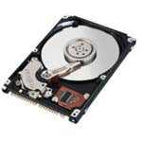
Swap Files
What happens to the page that we choose to evict?
Depends on what kind of page it is and what state it's in!
OS maintains one or more swap files or partitions on disk
Special data format for storing pages that have been swapped out
Virtual address space
Physical Memory
Swap files on disk
(Reserved for OS)‏
“Zero page”
Program
executable

Slide 26
Swap Files
How do we keep track of where things are on disk?
Recall PTE format
When V bit is 0, can recycle the PFN field to remember something about the page.
But ... not all pages are swapped in from swap files!
What about executables?
Or “zero pages”?
How do we deal with these file types?
V bit
5 bits
24 bits
0
Swap file index
Swap file offset
Swap file (max 2^24 pages = 64 GB)‏
Swap file table
(max 32 entries)‏

Slide 27
VM map structure
OS keeps a “map” of the layout of the process address space.
This is separate from the page tables.
In fact, the VM map is used by the OS to lay out the page tables.
This map can indicate where to find pages that are not in memory
e.g., the disk file ID and the offset into the file.
(Reserved for OS)‏
Stack
Heap
Uninitialized vars
(BSS segment)‏
Initialized vars
(data segment)‏
Code
(text segment)‏

Slide 28
Page Eviction
How we evict a page depends on its type.
Code page:
Just remove it from memory – can recover it from the executable file on disk!
Unmodified (clean) data page:
If the page has previously been swapped to disk, just remove it from memory
Assuming that page's backing store on disk has not been overwritten
If the page has never been swapped to disk, allocate new swap space and write the page to it
Exception: unmodified zero page – no need to write out to swap at all!
Modified (dirty) data page:
If the page has previously been swapped to disk, write page out to the swap space
If the page has never been swapped to disk, allocate new swap space and write the page to it

Slide 29
Physical Frame Allocation
How do we allocate physical memory across multiple processes?
What if Process A needs to evict a page from Process B?
How do we ensure fairness?
How do we avoid having one process hogging the entire memory of the system?
Local replacement algorithms
Per-process limit on the physical memory usage of each process
When a process reaches its limit, it evicts pages from itself
Global-replacement algorithms
Physical size of processes can grow and shrink over time
Allow processes to evict pages from other processes
Note that one process' paging can impact performance of entire system!
One process that does a lot of paging will induce more disk I/O

Slide 30
Working Set
A process's working set is the set of pages that it currently “needs”
Definition:
WS(P, t, w) = the set of pages that process P accessed in the time interval [t-w, t]
“w” is usually counted in terms of number of page references
A page is in WS if it was referenced in the last w page references
Working set changes over the lifetime of the process
Periods of high locality exhibit smaller working set
Periods of low locality exhibit larger working set
Basic idea: Give process enough memory for its working set
If WS is larger than physical memory allocated to process, it will tend to swap
If WS is smaller than memory allocated to process, it's wasteful
This amount of memory grows and shrinks over time

Slide 31
Estimating the working set
How do we determine the working set?
Simple approach: modified clock algorithm
Sweep the clock hand at fixed time intervals
Record how many seconds since last page reference
All pages referenced in last T seconds are in the working set
Now that we know the working set, how do we allocate memory?
If working sets for all processes fit in physical memory, done!
Otherwise, reduce memory allocation of larger processes
Idea: Big processes will swap anyway, so let the small jobs run unencumbered
Very similar to shortest-job-first scheduling: give smaller processes better chance of fitting in memory
How do we decide the working set time limit T?
If T is too large, very few processes will fit in memory
If T is too small, system will spend more time swapping
Which is better?

Slide 32
Page Fault Frequency
Dynamically tune memory size of process based on # page faults
Monitor page fault rate for each process (faults per sec)‏
If page fault rate above threshold, give process more memory
Should cause process to fault less
Doesn't always work!
Recall Belady's Anomaly
If page fault rate below threshold, reduce memory allocation

Slide 33
When to Evict/Page-Out Pages
On page fault, when a free page is required
In a loaded system most requests need replacement algorithm to work.
When replacement requires I/O, task needs to sleep.
Performance of tasks reduces, replacement time is added.
Solution: Page Daemon (or swap daemon)
Watches system free memory. Start replacing pages as free memory drops below a threshold.
Maintains a pool of free memory all the time so tasks requiring a new page can find a new page instantly.
It sleeps when there is plenty of memory. Adaptively wake ups more often and replaces more pages as system is low on memory.
In extreme cases, it starts replacing whole memory of tasks (trashing)

Slide 34
Paging and swapping
However, on heavily-loaded systems, memory can fill up
To achieve good system performance, must move “inactive” pages out to disk
If we didn't do this, what options would the system have if memory is full???
What constitutes an “inactive” page?
How do we choose the right set of pages to copy out to disk?
How do we decide when to move a page back into memory?
Swapping
Usually refers to moving the memory for an entire process out to disk
This effectively puts the process to sleep until OS decides to swap it back in
Paging out/in
Refers to moving individual pages out to disk (and back)
We often use the terms “paging out” and “swapping” interchangeably

Slide 35
Trashing
As system becomes more loaded, spends more of its time paging
Eventually, no useful work gets done!
System is overcommitted!
If the system has too little memory, the page replacement algorithm doesn't matter
Solutions?
Change scheduling priorities to “slow down” processes that are thrashing
Identify process that are hogging the system and kill them?
Is thrashing a problem on systems with only one user?
Trashing
CPU utilization
Number of processes

Slide 36
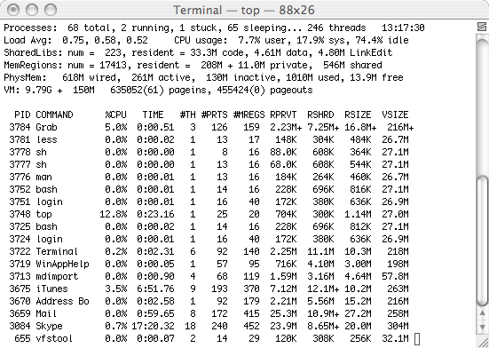
Benefits of sharing pages
How much memory savings do we get from sharing pages across identical processes?
A lot! Use the “top” command...

Slide 37
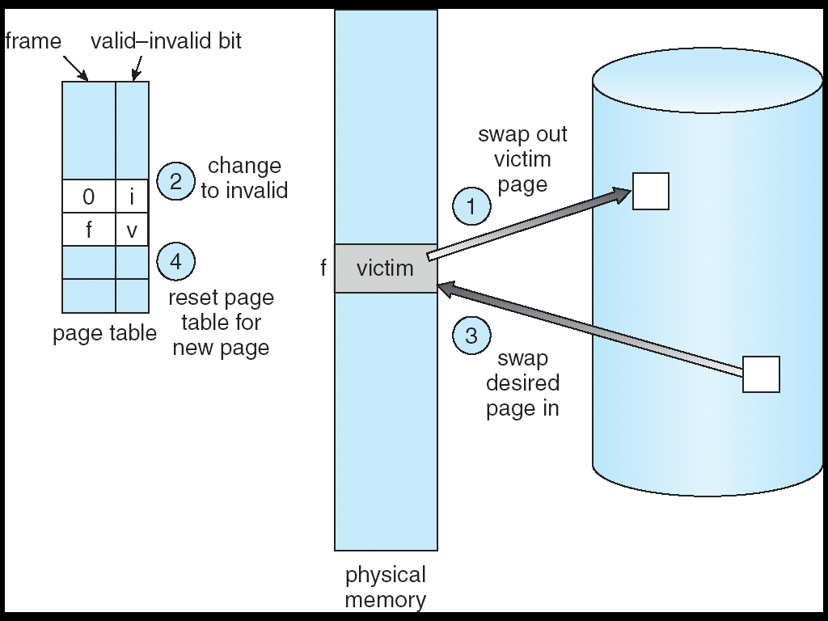
Page Replacement
0
VPN
PPN
V
PTE
9
8
7
6
5
4
3
2
1
0
0
Disk Block= 12
M
3
2
1
0
Zero Page
Physical
Memory
0
Page
Table
1
PPN=1
1
PPN=0
U
0
Zero Page
1
PPN=2
0
Disk Block=7
1
PPN=3
12
T
U
15
7
E
Disk

Slide 38
VM map structure
OS keeps a “map” of the layout of the process address space.
This is separate from the page tables.
In fact, the VM map is used by the OS to lay out the page tables.
This map can indicate where to find pages that are not in memory
e.g., the disk file ID and the offset into the file.
(Reserved for OS)‏
Stack
Copy-on-write of zero page or
page in from swap (if page was previously modified)‏
Heap
Uninitialized vars
(BSS segment)‏
Initialized vars
(data segment)‏
Page in from executable or swap
(if page was previously modified)‏
Code
(text segment)‏
Page in from executable file

Slide 39
Approximating LRU: Additional-Reference-Bits
Use the PTE reference bit and a small counter per page
(Use a counter of, say, 2 or 3 bits in size, and store it in the PTE)
Periodically (say every 100 msec), scan all physical pages in the system
If the page has not been accessed (PTE reference bit == 0), increment (or shift right) the counter
If the page has been accessed (reference bit == 1), set counter to zero (or shift right)
Clear the PTE reference bit in either case!
Counter will contain the number of scans since the last reference to this page.
PTE that contains the highest counter value is the least recently used
So, evict the page with the highest counter

Slide 40
LRU example
0
0
0
0
0
0
0
0
0
0
0
0
0
0
0
time
Accessed pages
in blue
0
1
1
1
0
0
1
1
0
1
0
1
1
0
0
Increment counter
for untouched pages
0
1
1
1
0
0
1
1
0
1
0
1
1
0
0
0
2
0
0
0
1
2
2
0
0
1
0
2
1
0
These pages have
the highest counter
value and can be
evicted.

