Slide 1
File System Design and Implementation

Slide 2
Disk Organization
File systems are usually created on regions of disks called Partitions.
MBR: Master Boot Record, first sector that loads the boot loaders in partitions.
Partition table: Configuration of partitions on disk. A disk can have 1 or more partitions.
Partition table marks start and end blocks of partitions, partition type, if partition is bootable etc.
Each partition may be formatted as a different file system.
OS loads the partition table and interprets each partition as a different disk device.
MBR
Partition
Table
Partition 1
Partition 2
Partition 3
Partition 4

Slide 3
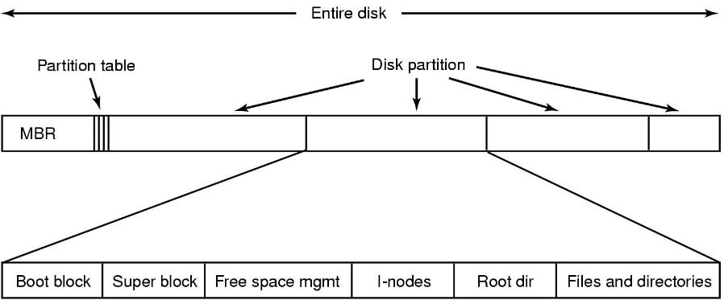
File System Layout
A possible file system layout with a Unix partition

Slide 4
Disk Space Organization
Disk can be partitioned
  Each partition can have a different OS and/or different file system
  One partition can be swap space for main memory
First block of disk has master boot record specifying primary partition
Each partition has
  Boot block (loads OS in kernel space)
  Superblock (contains key info about file system which is read into memory at boot time)
  Free space management
  List of I-nodes (or other data structure) giving info about all files
  Directories and Files

Slide 5
Common File Systems
FAT
  by Windows and some embedded sytems
UFS
  Unix based: UFS, FFS, Ext2,3,4
NTFS
  by Windows
HFS
  Plus by Mac OS
ISO9660
  for CDROM/DVROM
JFFS2
  on Android
New generation Unix: zfs, btrfs

Slide 6
File Allocation Table (FAT)
Originally designed for floppy disks (360KB to 1.4MB)
  For MSDOS
Uses File Allocation Table as an array of pointers to store free block list and file linkage.
FAT is a linked list implemented on an array.
  Index of a pointer represents the disk block number. i^{th} block information is stored on FAT_{i} as the next block, either as next free block or next block in the file
File attributes are kept in directory blocks.
  No inode block.
  Identifier of a file is the number of the first block in FAT.

Slide 7
FAT File System Layout
Boot Sector:
  volume name,
  #bytes/sec,
  #sectors/cluster,
  #clusters,
  #FAT copies
FAT: array of data block Pointer
Root directory block (FAT32 keeps in data, keep id in Boot)
Boot Sector
Extra FS info (FAT32)+ Reserved
FAT 1
FAT 2 (optional copies of FAT)
Root Dir (FAT12 and FAT16 only)
Data Area

Slide 8
FAT: Table entries
 | FAT
0 | R
1 | R
2 | 0
3 | 0
4 | 0
5 | 0
6 | 0
7 | 0
8 | 0
9 | 0
10 | 0
11 | 0
12 | 0
13 | 0
14 | 0
15 | 0
FAT entries depend on FAT implementation:
  FAT12: 12bits (3 bytes per 2 entries),
  FAT16: 16 bits,
  FAT32: 28 bits per entry.
Initially all clusters are marked as free (0).
First two entries reserved (FAT-ID, etc ) .
-1 (or MAX unsigned integer) used as end of list marker.
Allocate a cluster: linearly search for an entry == 0.

Slide 9
FAT: Finding data blocks
 | FAT
0
1
2 | 7
3 | 0
4 | 0
5 | 10
6 | 13
7 | 6
8 | 0
9 | 0
10 | 11
11 | 12
12 | -1
13 | -1
14 | 0
15 | 0
FAT keeps file blocks linkage. For example:
  Free = 3,4,8, 9, 14, 15,... are free clusters
  File A = 2 2, 7,6, 13 (-1 terminates)
  File B = 5 5, 10, 11, 12 (-1)
Find n’th block of a file
Expensive when FAT is on disk!!!
FAT needs to be working in main memory to be efficient.
getblock(f,n):
for (; n > 0 ; n--) {
if (f == -1)
return -1 ; /* error */
f = FAT[n];
}
return f;

Slide 10
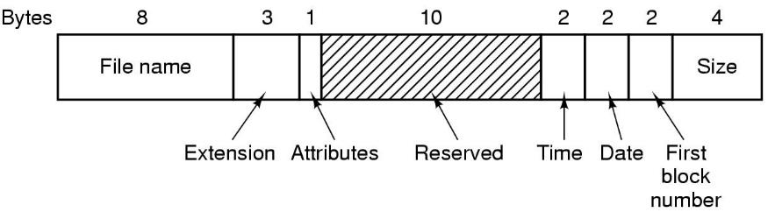
FAT Directories
32-byte directory entries.
Filenames are limited to 8+3 characters.. Smaller ones are left justified and padded with space.
Attributes: read-only, archive, hidden, system
Time of date represented with 2 bytes: correct upto +-1 second
Date: Counts in three fields: day (5 bit), month (4 bits), year (7 bits).
  year-since-1980 hence
    Contains: Y2108 problem!
File size: 2 bytes. Puts a 4GB limit.
10 bytes reserved for future use.

Slide 11
FAT: Directory Structure
FAT directories are stored in data blocks as an array of file entries in the form:
First cluster of the file = starthi << 16 & start.
For the rest, follow FAT.
struct fat_dir_entry {
uint8 name[8] ; /* file name */
uint8 ext[3] ; /* file extension */
uint8 attr; /* attributes, RO, Hidden, System, Subdir */
uint8 lcase; /* Case for base and extension */
uint8 ctime_cs; /* Creation time, centiseconds (0-199) */
uint16 ctime; /* Creation time */
uint16 cdate; /* Creation date */
uint16 adate; /* Last access date */
uint16 starthi; /* High 16 bits of cluster in FAT32 */
uint16 time, date; /* time, date */
uint16 start; /* first cluster */
uint32 size; /* file size (in bytes) */
}

Slide 12
FAT: Directory Structure
First byte of name field marks:
  End of directory table (0x00)
  Deleted file, entry can be reused (0xE5)
Deleting a file:
  deallocate its FAT chain, set: name[0] = 0xE5
For file names longer than 8+3, VFAT adds dummy entries (1 per 13 characters) preceding original entry (LFN, Long File Name)
Directory table grows like a file.
  If all entries are deleted in a cluster, directory table may shrink as well.
File lookup:
fat_directory_entry D[MAXENT];
for (all clusters “D” of directory) {
for (i = 0; i < MAXENT; i++) {
if D[i] is invalid continue;
if (D[i].name[0] == 0)
return -1 ; /* not found */
if (strcmp(filename == D[i].name))
return D[i];
} }

Slide 13
Block/Cluster Size
Block size affects and is affected by:
  Storage device native block size. (no smaller read, smaller writes require, read, update in mem, write
  VM page size (caching)
Filesystems may choose a cluster of blocks as unit to support larger disks and file sizes.
Large cluster size → Internal fragmentation
Small cluster size bad → locality.

Slide 14
FAT: Performance
File random access → Linear scan of FAT
Changing attributes of a file → change directory entry
FAT limits disk size.
  Solution: increase cluster size
Large clusters → internal fragmentation
Small clusters → small file system, large FAT
Size field in directory entry is 32 bits.
  Largest possible file size is 4GB.
FAT gets “fat” :) , even in memory, difficult to manage.

Slide 15
FAT versions
FAT limits disk size.
  Solution: increase cluster size:
  Large clusters → internal fragmentation
  Small clusters → small file system, large FAT
Size field in directory entry is 32 bits. Largest possible file size is 4GB.
FAT gets “fat” :) , even in memory, difficult to manage.
 | Max FAT entries | Max FAT size in memory | Max volume for 512B cluster | Max volume for 16KB clusters | Max volume for 32KB clusters
FAT12 | 4K | 12KB | 2MB | 64MB | 128M
FAT16 | 64K | 128KB | 64MB | 2GB | 4GB
FAT32 | 256M | 1GB | 512GB | 16TB | 32TB

Slide 16
More info about FAT
https://en.wikipedia.org/wiki/File_Allocation_Table
https://www.win.tue.nl/~aeb/linux/fs/fat/fat-1.html

Slide 17
UFS: Organization
Boot blocks: reserved for second stage boot loaders
Super Block: FS meta data,
Cylinder Group Header: Cylinder Group Description
inode blocks: Blocks containing i-nodes
Data blocks: Blocks containing file and indirect pointer data
Boot area
Super Block
Super Block Copy
Cylinder Group Header
Inode Blocks
Data Blocks
Super Block Copy
Cylinder Group Header
Inode Blocks
Data Blocks
…
Super Block Copy
Cylinder Group Header
Inode Blocks
Data Blocks
Cylinder Group 1
Cylinder Group 2
Cylinder Group N

Slide 18
UFS: Organization
Super Block:
  Disk geometry.
  number of CG’s, inode and data blocks per CG.
  FS mount statistics and state.
  It is replicated in each CG for recovery (in case of a bad block)
Cylinder Groups (CG) :
  Provide spatial locality for hard disks. Minimize head moves.
  UFS tries to allocate inodes and data, directories and inodes in the same cylinder group if possible.
  Each CG has a bitmap for block allocation. N inodes M data blocks: N+M/8/BLOCKSIZE blocks.
  Bitmap blocks are followed by i-node blocks and data blocks.
  Alert! The number of inodes and data blocks are fixed at FS creation.

Slide 19
UFS: inode structure
inode:
  Each file has an inode block.
  Multiple inode blocks fit in a single block (typical value: 128bytes).
  Inode contains all file attributes and pointers to data blocks.
  Data block pointers are kept as a tree like structure.
struct inode {
uint16 mode; /* file type and permissions */
uint16 nlinks; /* number of hard links */
uint16 uid, gid; /* owner and group ids */
uint64 size; /* total file size */
timeval atime, mtime, ctime; /* last access, modification, change timestamps */
fs32 direct[UFS_NDIRECT]; /* pointers to direct data blocks (12) */
fs32 indirect; /* pointer to indirect index data block */
fs32 double_indirect; /* pointer to double indirect index block */
fs32 triple_indirect; /* pointer to triple indirect index block */
uint32 flags; /* file flags, append only etc */
uint32 blocks; /* number of blocks used */
…
}

Slide 20
UFS: uid/gid and mode
Uid/gid: who owns the file? User/group
Permissions: which type of accesses granted for different groups.
  Traditional Unix: 12 bits: ugtrwxrwxrwx
    a rwx for owner, same group, and other processes
  ACL and Windows: Each file has an Access Control List where each user/group can be granted or revoked access.
Timestamps: Last access, modification and attribute change times of the file

Slide 21
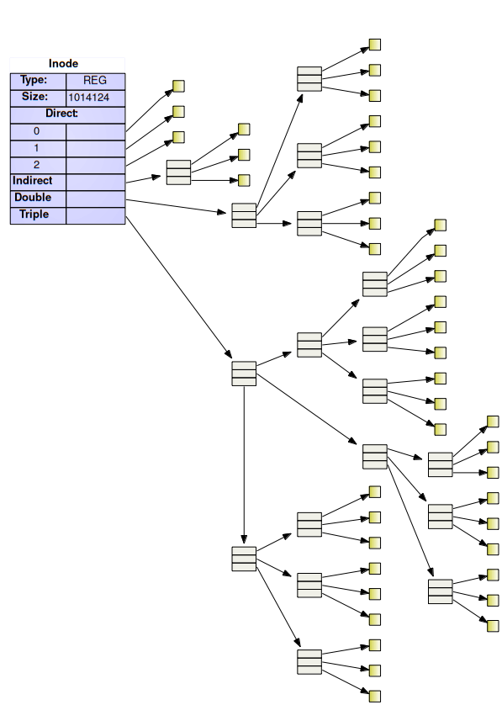
UFS: inode data blocks
For small data, direct blocks are used
An indirect block contains an array of data block pointers
If file is larger, double indirect block contains array of pointers to indirect blocks
For larger files, triple indirect pointers contains pointers to double indirect pointers
For 4K block size, 4 byte block pointers and 12 direct blocks. Maximum file size is:
  Direct: 12 blocks
  Indirect: 4K/4 = 1K blocks
  Double: 1K*1K = 1M blocks
  Triple: 1K*1K*1K = 1G blocks
  Total: 4,402,345,721,856 bytes

Slide 22
UFS: File block mapping
fs32 indblk[1024];
if N < NDIRECT then
return inode->direct[N]
N = N-NDIRECT
if N < 1K then /* It is an indirect pointer */
read inode->indirect to indblk /* read indirect block */
return indblk[N]
N = N-1024
if N < 1K*1K /* it is a double indirect pointer */
read inode->double_indirect to indblk /* read D.Ind. block */
read indblk[N/1024] to indblk /* read indirect block */
return indblk[N % 1024]
N = N – 1024*1024
read inode->triple_indirect to indblk /* read T. Ind. block */
read indblk[N/(1024*1024)] to indblk /* get D.ind. block */
read indblk[N%(1024 * 1024)/1024] to indblk /* get indirect block */
return indblk[N%(1024 * 1024) % 1024]

Slide 23
UFS
A 0 value on block pointer indicates that block is not used.
Indirect pointers are not allocated if they are not used.
Largest possible file requires 1+ (1+1K)+(1+1K+1K*1K) indirect blocks besides data blocks.
Smallest file uses no data blocks (direct pointers are NULL)

Slide 24
UFS: Holes
Supports holes in filesystem. There can be NULL data blocks inside the file. Try:
File size is 1G however only 1 data block and indirect blocks in the path are used.
fd = open(“newfile.txt”, O_RDWR);
lseek(fd, 1024*1024*1024, SEEK_SET);
write(fd, “hello\n”, 6);

Slide 25
UFS: Directory Structure
Directory is nothing but a sequence of filename+inode values. Records size is not fixed.
struct dirent {
uint32 d_inode;
uint16 d_reclen;
uint16 d_namelen;
char d_name[MAXLEN+1;
}; /* record size is truncated at d_reclen bytes */
144123 |  |  |  | 12 |  | 1 |  | . |  |  |  | 542332
12 |  | 2 |  | . | . |  |  | 21401231 |  |  |  | 16 |  | 7
D | e | s | k | t | o | p |  | 1231441 |  |  |  | 16 |  | 5
h | w | 2 | . | c |  |  |  | 454342 |  |  |  | 20 |  | 17
c | e | n | g | 3 | 3 | 4 | - | f | i | l | e | . | p | p | t
x |  |  |  | 4341121 |  |  |  | 12 |  | 3 |  | h | w | 2
ls –I output
. 144123
.. 542332
Desktop 2140123
Hw2.c 1231441
ceng334-file.pptx 454342
hw2 4341121

Slide 26
UFS: Lookup
File lookup in a directory requires sequential traversal of full directory content.
Reads/updates of a directory are mostly carried out in cache but still expensive for directories with large number of files.
Deleting a file is similar to deleting a line from a text file.
OS keeps a directory cache, mapping from vnode+filename to new vnode to increase the performance.

Slide 27
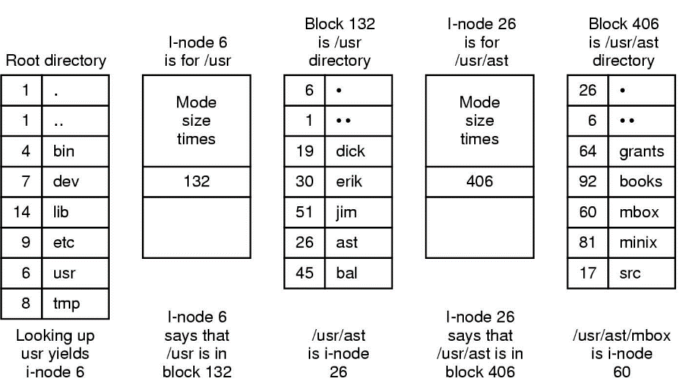
Traversing Unix Directory Structure
The steps in looking up /usr/ast/mbox

Slide 28
Traversing Unix Directory Structure
Suppose we want to read the file /usr/ast/mbox
Location of a i-node, given i-number, can be computed
i-number of the root directory known, say, 2
Read in the i-node 2 from the disk into memory
Find out the location of the root directory file on disk, and read the directory block in memory
  If directory spans multiple blocks, then read blocks until usr found
Find out the i-number of directory usr, which is 6
Read in the i-node 6 from disk
Find out the location of the directory file usr on disk, and read in the block containing this directory
Find out the i-number of directory ast (26), and repeat

Slide 29
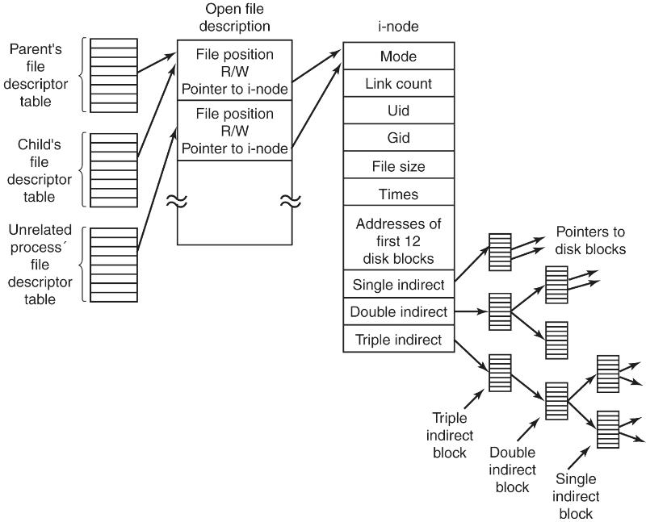
The Big picture: Accessing a File in UNIX

Slide 30

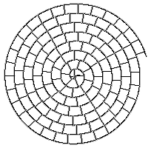
CD-ROM and the ISO 9660 filesystem
The CD has one single track, starts at the center of the disk and spirals out to the circumference of the disk
This track is divided into sectors of equal size
The base standard defines three levels of compliance
Level 1 limits file names to 8+3 format. Many special characters (space, hyphen, equals, and plus) are forbidden
Level 2 and 3 allow longer filenames (up to 31) and deeper directory structures (32 levels instead of 8)
Level 2 and 3 are not usable on some systems, like MS-DOS

Slide 31
ISO 9660 Extensions
Rock Ridge
  Extensions to ISO-9660 file system
  Favored in the Unix world
  Lifts file name restrictions, but also allows Unix-style permissions and special files to be stored on the CD
  Machines that don't support Rock Ridge can still read the files because it's still an ISO-9660 file system (they won't see the long forms of the names)
  UNIX systems and the Mac support Rock Ridge
  DOS and Windows currently don't support it
Joliet
  Favored in the MS Windows world
  Allows Unicode characters to be used for all text fields (including file names and the volume name)
  Disk is readable as ISO-9660, but shows the long filenames under MS Windows
HFS (Hierarchical File System)
  Used by the Macintosh in place of the ISO-9660, making the disk unusable on systems that don't support HFS

Slide 32
NTFS
Introduced in Windows NT and used in Windows systems as default file system for hard disks.
All metadata of FS is kept in Master File Table
  A B tree on disk.
MFT stores a record per file.
  Each record is like an inode, contains file attributes and data block
  positions.
MFT records have fixed size but can grow by
extends, additional records.
${Mft} master file table, content of files and directories
$(Bitmap} Allocation information of clusters
Attributes are not fixed, new attributes can be
added.
Allocation information is stored in MFT as a bitmap
by a Special filename $Bitmap.
NTFS supports: hard links, sparse files, journal ($LogFile),
encryption, compression, alternate data streams.
Maximum partition size 256TB, maximum file size 16TB.
Boot Sector
MFT
Data Area

Slide 33
Log Structured File System (LSFS)
Hard disk:
  read/write direct access.
DVD’s:
  read direct, write sequential,
  requires full erase in order to write again
SSD/Flash disks:
  read direct access,
  write direct for empty blocks,
  not allowed for non-empty blocks,
  erase work in large segments.
  Segments have a limited lifetime for erase cycles.

Slide 34
Log Structured File System
Traditional filesystems: Meta-data is updated frequently.
Log structured file systems do not overwrite blocks but keep a log of new versions of blocks.
Each new write is appended at the end of the log.
Latest written version of a block is the valid data

Slide 35
Log Structured File System
File 0
Block 0
Inode 0
File 0
Block 1
Inode 0
File 1
Block 0
Inode1
File 0
Block 0
Inode 0
When new data block written, inode also changes.
  inode is written too.
Data block is overwritten.
  Writes a new version. Old block is not valid.
New inode version written.
  Old is invalid. Keep up-to-date versions of inode. In memory?
Keep an inode map, inode num. to block mapping. Write that too.
File 0
Block 0
Inode 0
imap
File 0
Block 1
Inode 0
imap
File 1
Block 0
Inode1
imap
File 0
Block 0
Inode 0
imap

Slide 36
Log Structured File System
Further enhanced by segment summaries to find inode maps correctly.
On mount:
  Traverse all segment summaries for complete segments
  Traverse all incomplete segments (only a few)
What happens when disk is full?
  Need to erase blocks: Completely obsoleted segments
Garbage collector passes over oldest segments, copies valid blocks to new areas and free whole segments.
Some embedded systems and mobile systems working on flash uses LSFS based file systems
  like JFFS2, F2FS, YAFFS2 on Android.

Slide 37
Network and Distributed File Systems
Transparent access to files in one or more remote hosts.
Not a secondary storage data structure problem anymore. Network protocols are involved.
Server utilities works on remote hosts to serve FS requests. Client is the OS and utilities making files available.
Scenarios get complicated since network, server, and client may fail.
Commonly used ones: NFS, SMBFS, Lustre, Google File System, AndrewFS.

Slide 38
Network File System (NFS)
Popular in simple Unix/Linux configuration works in many OS.
NFS works stateless.
  Server does not keep states of clients.
  Each client requests contains offset and size of the block to read/write.
  Open looks up file path on remote server and gets a handle.
  All following operations use same handle.
If handle known in advance, I/O can be done without opening the file.
Stateless operation does not need crash recovery when one of the peers reboot.
Client OS, file system dependent layer plays the client role and converts I/O requests into network requests.

Slide 39
Multi-Filesystem Support
Most OS’s support multiple filesystems.
Linux supports:
  adfs affs afs autofs4 befs bfs btrfs ceph cifs coda configfs ecryptfs efivarfs efs exofs ext4 f2fs fat freevxfs fscache fuse gfs2 hfs isofs jbd2 jffs2 jfs minix ncpfs nfs nilfs2 nls ntfs ocfs2 omfs overlayfs pstore qnx6 reiserfs romfs squashfs sysv ubifs udf ufs xfs
  Some designed for special storage requirements,
  some are vendor specific, some exists for historical reasons.
Systems may require multiple filesystems/partitions active in the same system.

Slide 40
Mounting a Filesystem
Files may be organized into distinct filesystems.
  E.g. system files vs. user files.
  Files on a USB flash vs files on network.
Purpose: logical isolation and providing filesystem grow (adding storage etc.)
Unix/Linux support a mount operation for this isolation.
Windows uses volume label, C:, D:, E:, ….
  Newly attached filesystem gets a new label.

Slide 41
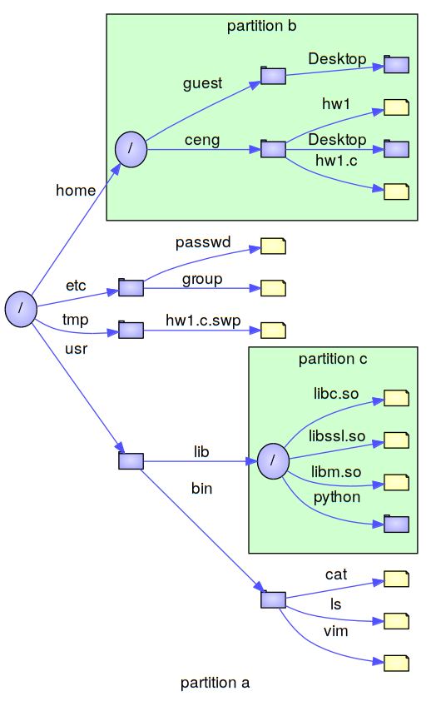
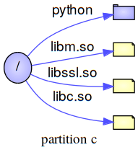
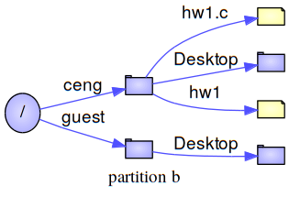
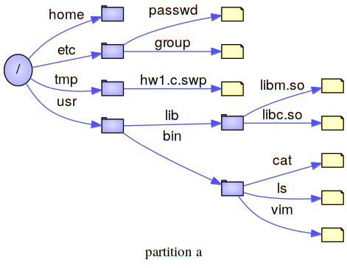
Mount
Making another filesystem available under a directory in current file hierarchy.
Existing content of directory is hidden and all accesses to that directory follow new filesystem transparently.

Slide 42
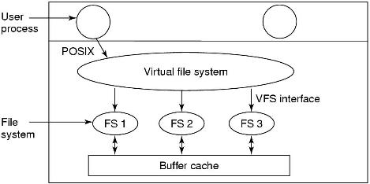
Virtual File System (VFS)
Multiple supported filesystems bring a challenge to OS. Each file can be handled differently based on its filesystem type.
Solution is an abstraction layer. Kernel calls filesystem independent parts, filesystems implement a uniform interface and file operations are mapped in this interface based on file system.

Slide 43
Virtual File System
VFS translates the POSIX calls to the calls of the filesystems under it.
  Filesystem independent part : for processes implementing POSIX interface
  Filesystem dependent part : for concrete file systems

Slide 44
Virtual File System
Manages kernel level file abstractions in one format for all file systems.
Receives system call requests from user level (e.g. write, open, stat, link)
Interacts with a specific file system based on mount point traversal
Receives request from other parts of the kernel, mostly from memory management.

Slide 45
VNode
In core structure for a file. System wide structure per file kept in kernel memory.
Created when a file is opened by any process for the first time. All following open() operations by any processes use same vnode.
Typically a pointer indirection in vnode is used to access filesystem dependent part.
PCB
File Descriptor
Table
struct file
vnode
mode
RW
VFS specific information per system-wide file
0
nrefs
1
1
offset
10
…
vnode
n

Slide 46
VFS: Specific FS calls
vnode points to a struct of function pointers keeping entry points of each actual FS operation
Specific Filesystem Code
int fat_open(…) {
...
}
int fat_read(…) {
...
}
int fat_write(…) {
...
}
int fat_seek(…) {
...
}
struct vnode
struct vnodeops
…
..
v_ops
…
..
...
…
open
read
write
seek
…
..
Filesystem Independent call:
PCB->fdtable[1]->vnode->v_ops->read(…);

Slide 47
Each filesystem supported introduces its own set of implementations for file operations and operations structure.
When a file of this filesystem type is accessed file operations structure is set to this structure.

Slide 48
VFS: The Big picture
PCB
File Descriptor
Table
struct file
struct vnode
Specific Filesystem Code
int fat_open(…) {
...
}
int fat_read(…) {
...
}
int fat_write(…) {
...
}
int fat_seek(…) {
...
}
mode
RW
VFS specific information per system-wide file
struct vnodeops
0
nrefs
1
1
offset
10
…
vnode
…
..
n
v_ops
open
PCB
read
struct file
struct vnode
write
mode
R
VFS specific information per system-wide file
seek
nrefs
2
offset
0
…
..
vnode
File Descriptor
Table
v_ops
struct file
0
mode
W
1
nrefs
1
…
offset
10
n
vnode

Slide 49
VFS- 2
At boot time, the root filesystem is registered with VFS.
When other filesystems are mounted, they must also register with VFS.
When a filesystem registers, it provides the list of addresses of the functions that the VFS demands, such as reading a block.
After registration, when one opens a file:
open(“/usr/include/unistd.h”, O_RDONLY)
VFS creates a v-node and makes a call to the actual filesystem implementation to return all the information needed.
The created v-node also contains pointers to the table of functions for the concrete filesystem that the file resides.

Slide 50
Crash Recovery
Performance of most File System designs rely on caching of metadata.
  Such as FAT/allocation bitmaps, inodes.
Caching helps a lot in speed but improper shutdown causes data kept in memory not written on disk.
In addition to data, integrity of file system can be lost.
Cached I/O of operations may end up in missing any subset of the operations above on disk in time of a crash.
Problems as getting a garbage on disk to a dangling directory entry will be observed

Slide 51
UFS: Filesystem operations a closer look
Deletion of a file:
  Clear data blocks to 0 (for security)
  Mark data blocks as free on bitmap
  Mark inode as free on bitmap
  Delete directory entry referring the inode
Creation of a file of 1 block size:
  Mark a data block allocated in allocation table
  Write its content
  Allocate an inode block in allocation table
  Write inode content
  Update directory block to get a reference to new inode
In the absence of crashes the order these steps taken do not matter.
In the presence of crashes, however, it does!
  Note that due to I/O scheduling on the disk, the order of execution varies.

Slide 52
UFS - crash case 1
Deletion of a file:
  Clear data blocks to 0 (for security)
  Mark data blocks as free on bitmap
  Mark inode as free on bitmap
  Delete directory entry referring the inode
not completed
completed
The inodes and file blocks will not be accessible from any file yet they will not be available for reassignment.

Slide 53
UFS - crash case 2
Deletion of a file:
  Clear data blocks to 0 (for security)
  Mark data blocks as free on bitmap
  Mark inode as free on bitmap
  Delete directory entry referring the inode
The directory node will point to an invalid inode or (if the inode is reassigned) point to a different file.
The blocks of the file will not be available for reassignment.

Slide 54
UFS - crash case 3
Deletion of a file:
  Clear data blocks to 0 (for security)
  Mark data blocks as free on bitmap
  Mark inode as free on bitmap
  Delete directory entry referring the inode
The blocks of the file will be available for reassignment.
The content of the file may get overwritten since its blocks may be used as data blocks for other files.

Slide 55
UFS - crash case 4
Deletion of a file:
  Clear data blocks to 0 (for security)
  Mark data blocks as free on bitmap
  Mark inode as free on bitmap
  Delete directory entry referring the inode
File content is lost. All zeros.

Slide 56
Crash Recovery
Data loss is usually inevitable. It is a crash after all.
File system integrity is a more serious problem.
OS should reboot properly.
Accessing a file should not end up another crash.
3 solutions:
  Consistency check in reboot and try to recover (fsck, repair)
  Soft updates (order disk operations such that consistency check is minimal and done at background)
  Journalling (File system operations are written on a synchronous journal, recovery is done by replaying it)

Slide 57
Consistency Check
A consistency check utility like fsck is executed on boot to check if file system is unmounted properly.
Otherwise it makes a consistency check:
  All inodes and indirect blocks refer allocated data blocks
  All directory entries refer allocated inodes.
  Hard link count of inodes match total number of directory entries to that inode.
fsck repairs filesystem by:
  Mark data blocks allocated/truncated files (former may cause garbage data)
  If inode contains valid data mark it as allocated, otherwise delete file.
  Update inode hard link count. If no directory refers an allocated inode create a dummy file in /lost+found
fsck is too slow. Significantly slows down reboot time.

Slide 58
Filesystem repair
Two tables, each containing a counter initialized to 0
  Blocks in use: How many times a block is present in a file
    Read all the inodes using a raw device (not through the filesystem calls)
    For each block that is referenced in the inode structure, increment the corresponding block use counter by one.
  Free blocks:
    Examine the free block list of free block bitmap structure
    Each appearance of a free block increments the counter by one

Slide 59
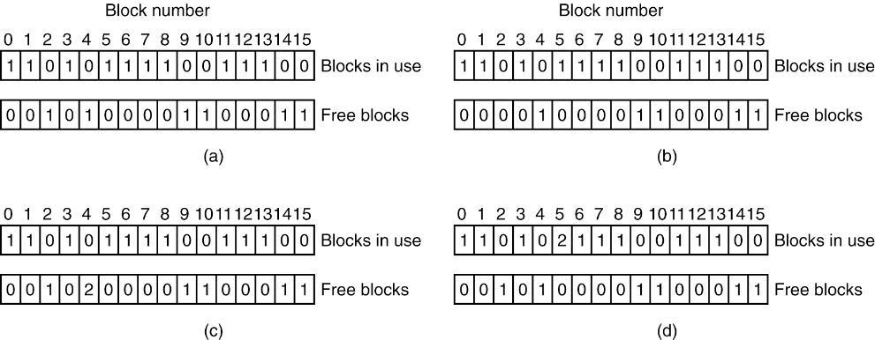
Filesystem repair
File system states. (a) Consistent. (b) Missing block. (c) Duplicate block in free list. (d) Duplicate data block.
Tanenbaum, Modern Operating Systems 3 e, (c) 2008 Prentice-Hall, Inc. All rights reserved. 0-13-6006639

Slide 60

Filesystem repair : Missing block
Harmless but wastes space
Action: Add the missing block to the free list.
Tanenbaum, Modern Operating Systems 3 e, (c) 2008 Prentice-Hall, Inc. All rights reserved. 0-13-6006639

Slide 61

Filesystem repair : Duplicate block in free list
Can only occur in linked list representation. Bitmap representation does not have this problem.
Action: Rebuild the free list.
Tanenbaum, Modern Operating Systems 3 e, (c) 2008 Prentice-Hall, Inc. All rights reserved. 0-13-6006639

Slide 62

Filesystem repair : Duplicate data block
The worst thing that can happen! A data block appears in two different files..
Action:
  Allocate a free block
  Copy the contents into the new block.
  Change the links such that each copy appears once in each file.
  For sure, the contents of one of the files is garbled.
  The filesystem is made to be consistent.
  The user is informed.
Tanenbaum, Modern Operating Systems 3 e, (c) 2008 Prentice-Hall, Inc. All rights reserved. 0-13-6006639

Slide 63
Filesystem repair: Directory fix
Uses a table of counters per file (rather than per block)
Starts from the root and traverses the tree
  For each inode, it increments the corresponding counter for that file
    Remember due to hard links, a file can appear more than once
  It then checks the link counts stored in the inodes to these values.
  If the link count > counter
    Even if the file is deleted by from all the directory entries, it will continue to exist.
    Solution: correct the link count
  If the counter > link count
    Although the file is linked from, say, two directories, removal from one would cause the inode deleted leaving the other one invalid.
    Solution: correct the link count
  Special case: link count is 0, no directory refers it. Create a new file in a directory (lost+found)

Slide 64
Soft Updates
Also called ordered writes
Device driver is forced to follow a specific write order for file system data:
  Never point to a structure before it has been initialized
    e.g., an inode must be initialized before a directory entry references it.
  Never re-use a resource before nullifying all previous pointers to it
    e.g., an inode’s pointer to a data block must be nullified before that disk block may be re-allocated for a new inode.
  Never reset the old pointer to a live resource before the new pointer has been set
    e.g., when renaming a file, do not remove the old directory entry for an inode until after the new directory entry has been written.
Consistency problems reduce mostly to garbage. System may boot safely when fsck works in background to collect the garbage.

Slide 65
Journalling
Implemented by most of the contemporary file systems.
Metadata (allocation bitmaps, inodes and directories) are important for integrity, so their operations are written on a special area called journal synchronously.
Journal is forced in disk with some periods and cleaned up.
On crash boot, journal is replayed to provide integrity.
Journaling data is expensive, most file system implementations provide only metadata journal by default (recently written data blocks may be lost)

Slide 66
Other Features of File Systems
Compression:
  File system stores data on disk in compressed form
Encryption:
  Data blocks are encrypted for privacy of user
User and Group Quotas:
  File system tracks per user and per group usage of disk and reject exceeding the limit.
Logical volume management:
  File system can grow or shrink by adding new disk devices or removing them
Snapshots:
  Administrators can get snapshot of the file system.
  Later that snapshot can be rolled back or mounted.
Copy on Write:
  File systems can use a base file system and only keep modified files/directories on device transparently.
Multiple streams and/or attributes:
  File systems can keep multiple streams of a file (i.e. revisions) and/or dynamic set of attribute-value pairs per file to keep extra information.

