Slide 1
Synchronization
Condition Variables and Monitors
Some of the slides are adapted from Matt Welsh’s.

Slide 2
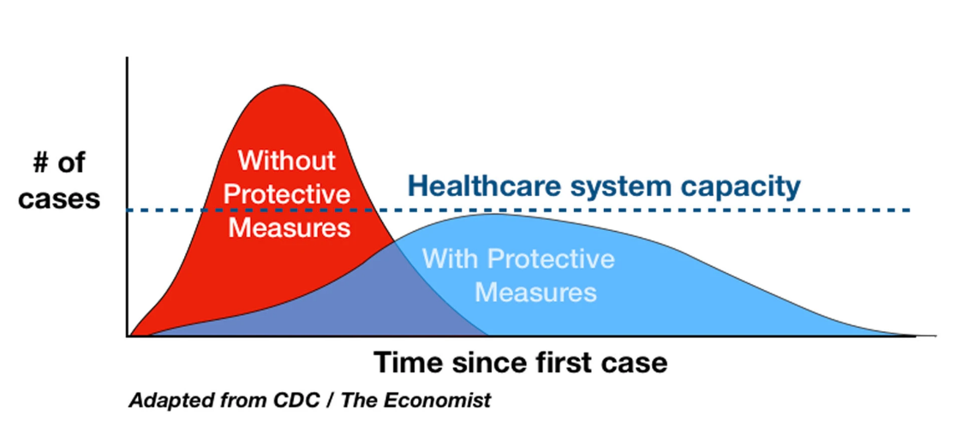
Announcements - COVID-19
COVID-19 will be with us within the near future: Need to adapt new ways of life on all fronts, including education
As a society, we need to slow down the spreading rate of the pandemic to allow our health system cope with it under limited capacity.
https://www.washingtonpost.com/graphics/2020/world/corona-simulator/
https://www.nytimes.com/2020/03/11/science/coronavirus-curve-mitigation-infection.html?auth=login-google1tap&login=google1tap

Slide 3
Announcements - COVID-19
What you can do?
  Wash your hands frequently
  Social distancing (will use this term within the lecture and hence make sure you get a good grasp of it!)
    Stay away from other people, and public places
  Stay away from elderly!
    Yes, you will survice, but by approaching them you may be getting them infected and cause their DEATH!
  The fact that you, as a young person, will be OK, should not be an excuse not to obey the precautions listed above.
    You may infect your parents, your grandparents, and may cause their death!
      Don’t‘ forget that people over 80 have a 15% of death if they get infected!
  INFORM others!
    You are the educated elite of this society and convince your immediate relatives about the dangers ahead. And hence you bear that responsibility!

Slide 4
How will we proceed within the course?
My guess: You will not be returning back until summer.
Continue with Asynchronous on-line education
  We will record videos such as this one
    You will watch them at home, take notes
  We will hold Question and Answer sessions in a Webinar session, to be held at the “lecture hours”!
Homeworks
  Will be announced and submitted online as usual
    Recitations will be held via Webinar
Exams: How do we deal with it?
  Still have no clear answer. Discussions at the department/university/country/world level are ongoing.
  Will make announcements as we get clarifications.
Give us feedback on our asynchronous on-line education.
  It’s our first time

Slide 6
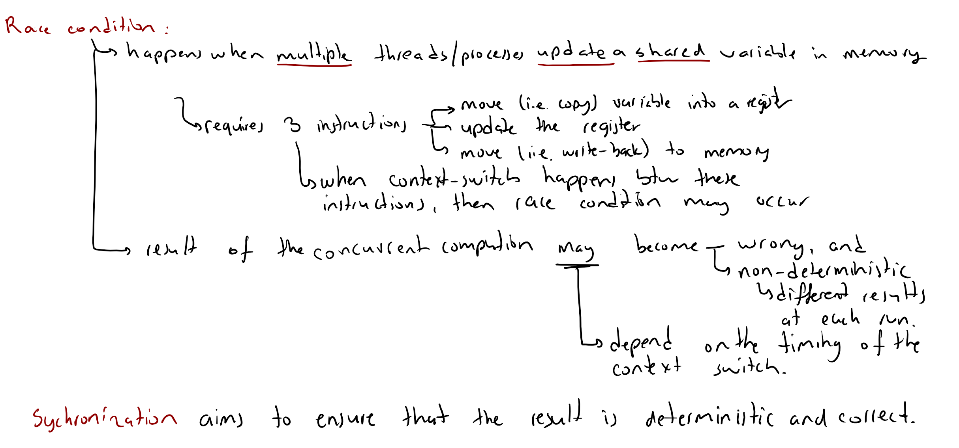

Slide 7
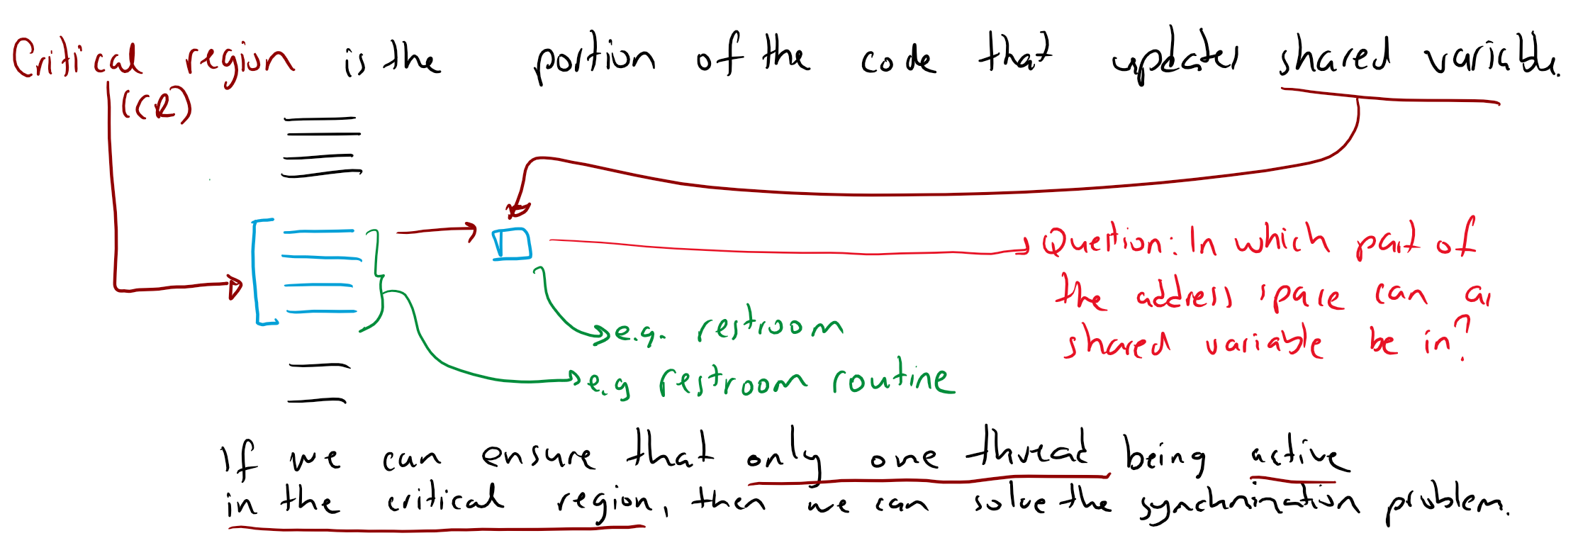

Slide 8
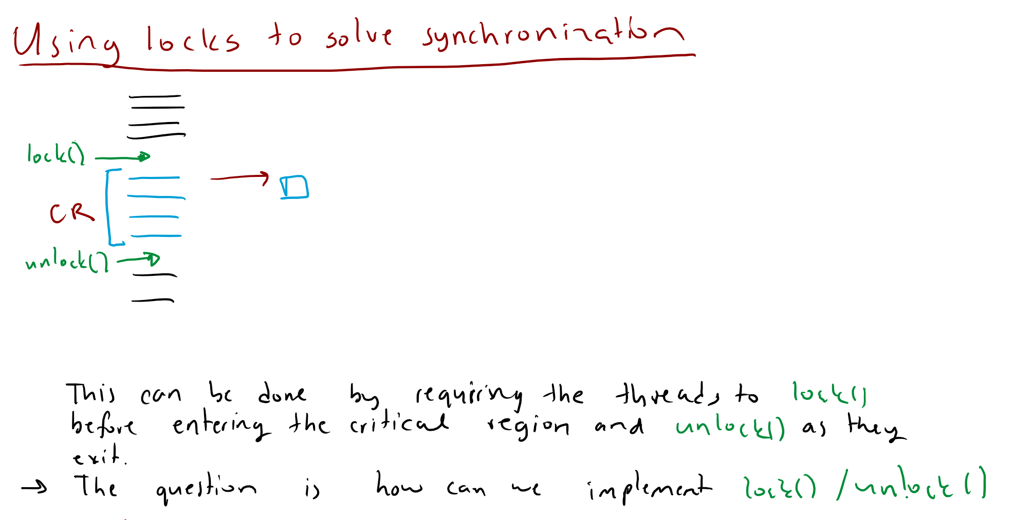

Slide 9
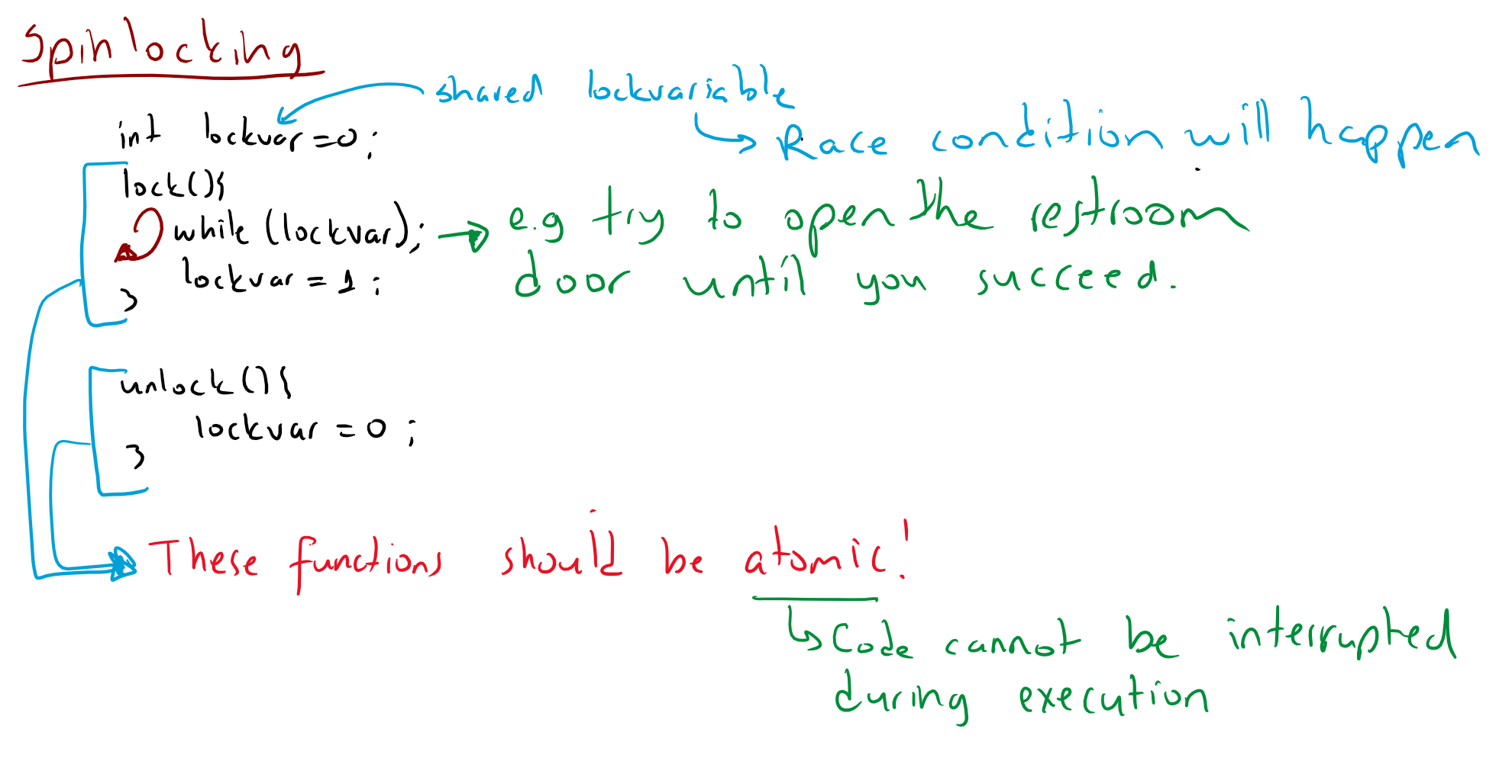

Slide 10
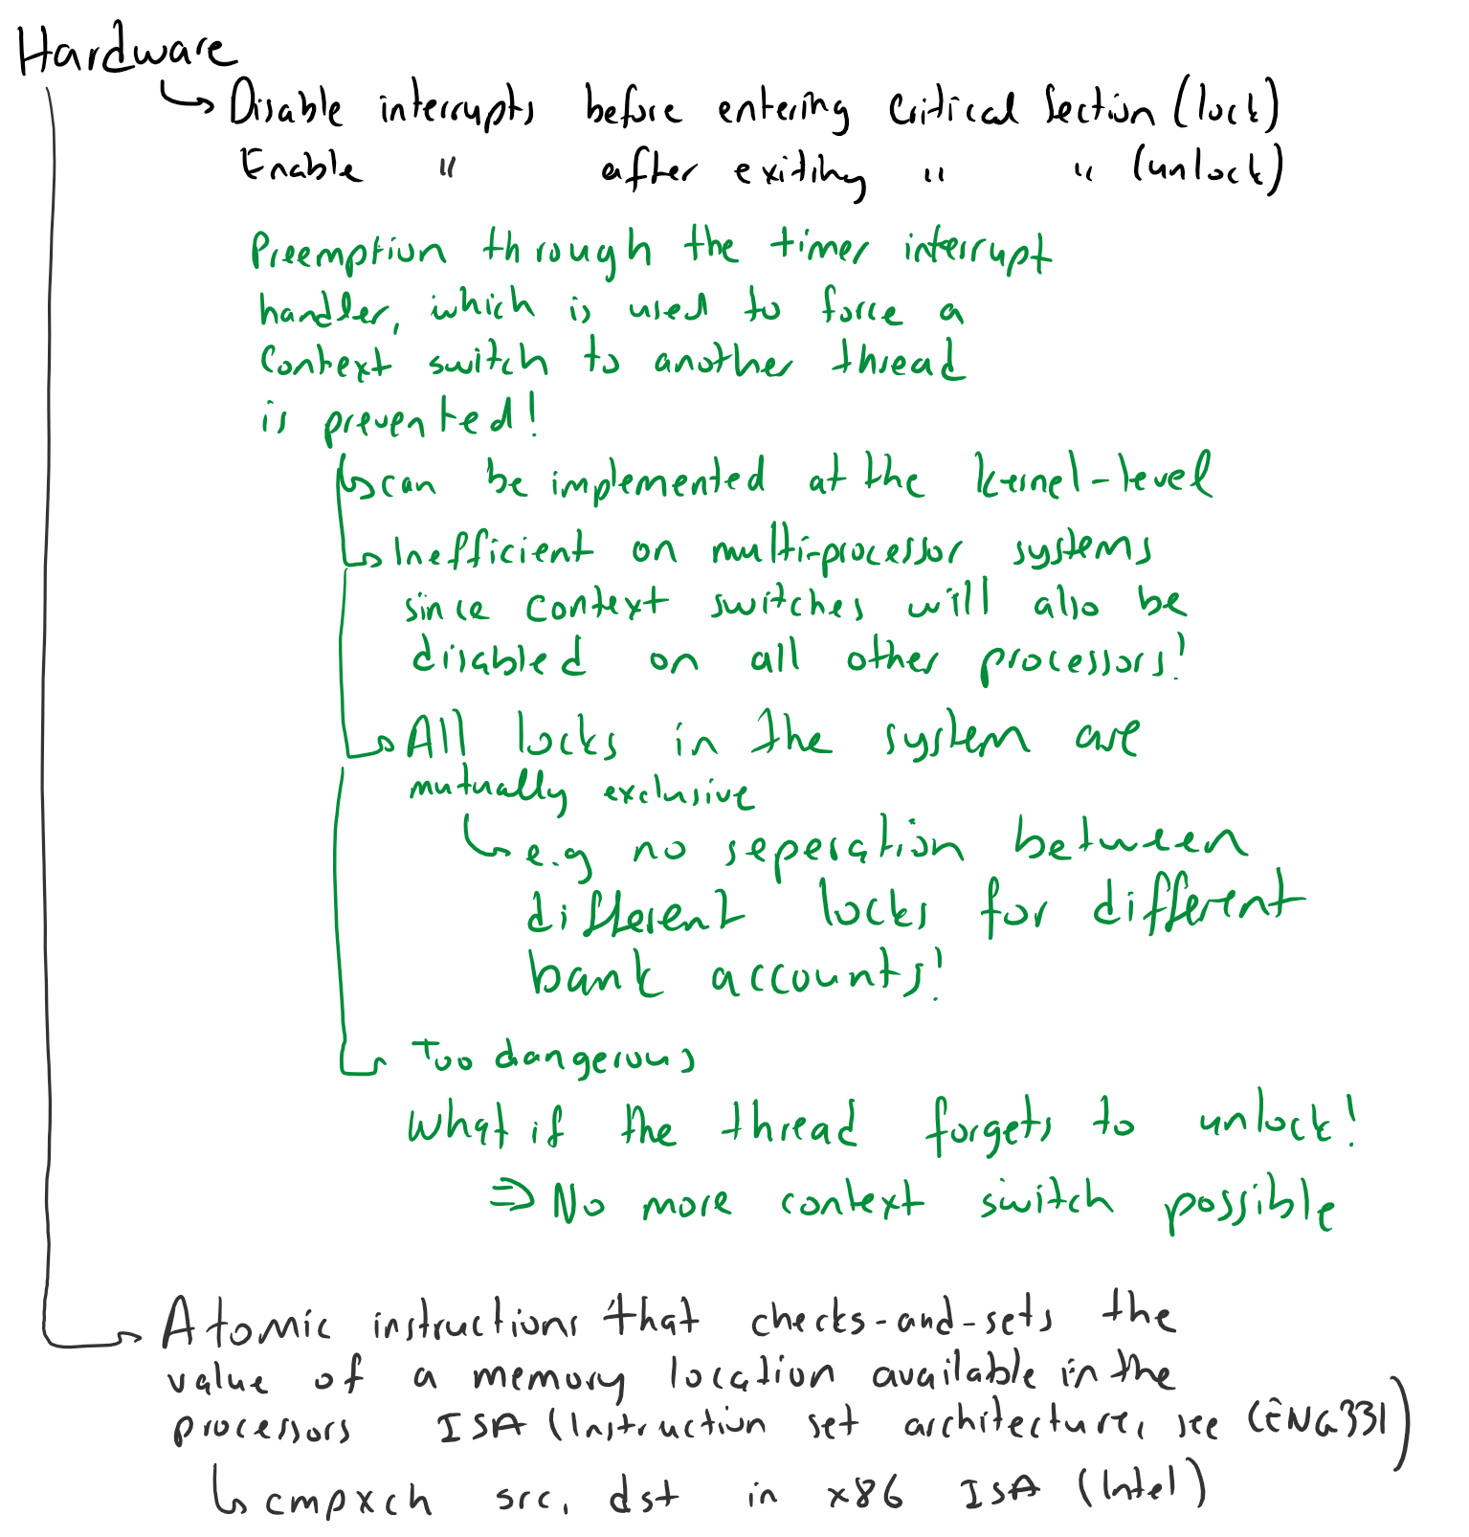

Slide 11
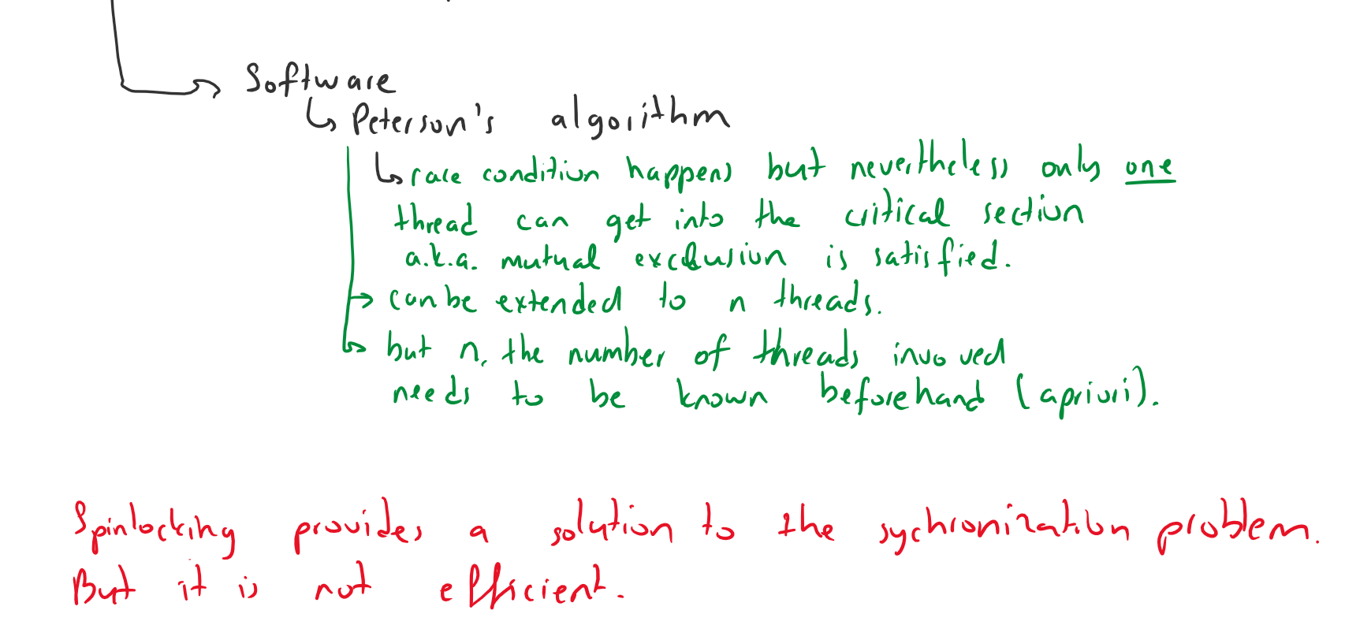

Slide 12
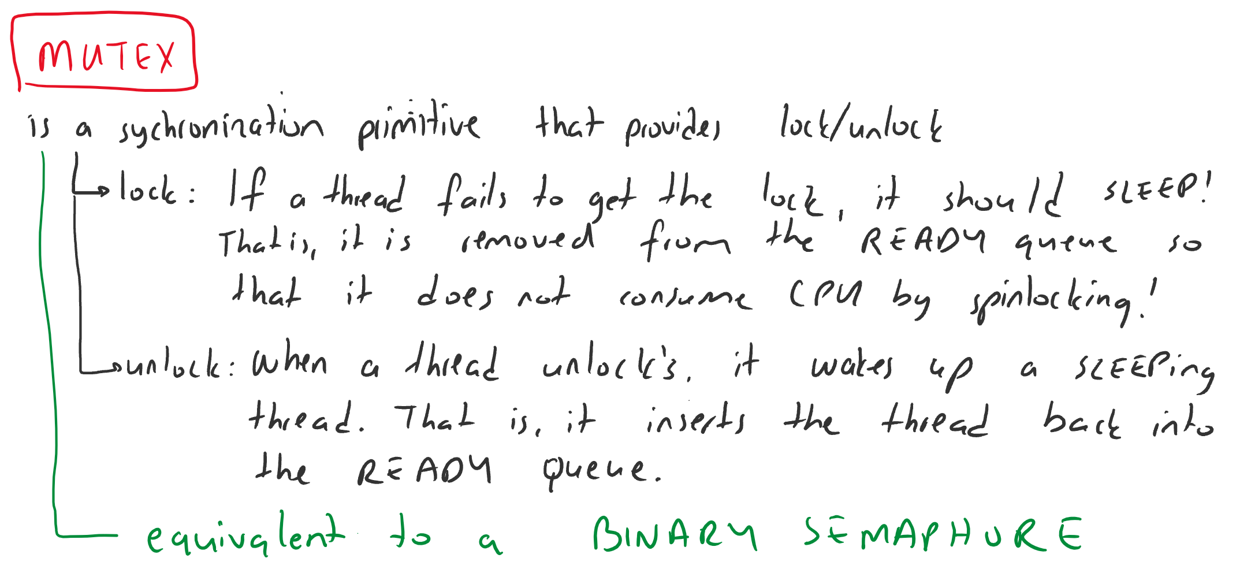

Slide 13
Semaphores
Higher-level synchronization
construct
  Designed by Edsger Dijkstra in the
  1960's.
Semaphore is a shared counter.
  Initialized
Two operations on semaphores:
P() or down() or wait()
  From Dutch “proeberen”, meaning “test”
  Atomic action:
    Wait for semaphore value to become > 0, then decrement it
V() or up() or post() or signal()
  From Dutch “verhogen”, meaning “increment”
  Atomic action:
    Increments semaphore value by 1.

Slide 14
Semaphore initialized with 1.
Semaphore

Slide 15
Thread 1 calls wait() and proceeds
Thread 1
wait()
Semaphore
Semaphore value
before: 1
Semaphore value
after: 0

Slide 16
Thread 2 calls wait() and blocks
Thread 2
wait()
Z
z
z
Semaphore
Semaphore value
before: 0
Semaphore value
after: -1

Slide 17
Thread 3 calls signal()
Thread 3
signal()
Z
z
z
Thread 2
wait()
Semaphore
Semaphore value
before: -1
Semaphore value
after: 0

Slide 18
Thread 4 calls signal() and proceeds
Thread 4
signal()
Semaphore
Semaphore value
before: 0
Semaphore value
after: 1

Slide 19
Issues with Semaphores
Much of the power of semaphores derives from calls to
wait() and signal() that are unmatched
  E.g. barrier example!
Unlike locks, acquire() and release() are not always paired.
This means it is a lot easier to get into trouble with semaphores.
  “More rope”
Would be nice if we had some clean, well-defined language support for synchronization...
  Java does!

Slide 20
Monitors
A monitor is an object (data + methods encapsulated into one) intended to be used safely by more than one thread.
  Methods are executed with mutual exclusion.
    At each point in time, at most one thread may be executing any of its methods.
  Condition Variables (CVs) proposed for threads to temporarily give up exclusive access, in order to wait for some condition to be met,
    before regaining exclusive access and resuming their task.
  Use CV’s for signaling other threads that such conditions have been met.
Shared data
Methods accessing
shared data

Slide 21
Condition Variables
Conceptually a condition variable (CV) is a queue of threads, associated with a monitor, upon which a thread may wait for some assertion to become true.
  The thread waiting list of a semaphore is essentially a CV.
Threads can use CV’s
  to temporarily give up exclusive access, in order to wait for some condition to be met,
  before regaining exclusive access and resuming their task.
  for signaling other threads that such conditions have been met.
Shared data
Methods accessing
shared data
zzZ...

Slide 22
Monitors
This style of using locks and CV's to protect access to a shared object is often called a monitor
  Think of a monitor as a lock protecting an object, plus a queue of waiting threads.
Shared data
Waiting threads
At most one thread in the monitor at a time
Methods accessing
shared data
How is this different than a lock???

Slide 23
Monitors
unlocked
Shared data
Methods accessing
shared data

Slide 24
Monitors
locked
Shared data
zzzz...
Methods accessing
shared data
zzzz...
Sleeping thread no longer “in” the monitor.
(But not on the waiting queue either! Why?)

Slide 25
Monitors
Monitor stays locked!
(Lock now owned by
different thread...)
locked
Shared data
notify()
Methods accessing
shared data
zzzz...

Slide 26
Monitors
locked
Shared data
notify()
Methods accessing
shared data

Slide 27
Monitors
locked
Shared data
Methods accessing
shared data
No guarantee which order threads get into the monitor.
(Not necessarily FIFO!)

Slide 28
TL
Shared data
deposit()
withdraw()
Methods accessing
shared data
Conditional
variable
haveTL

Slide 29
Bank Example
monitor Bank{
int TL = 1000;
condition haveTL;
void withdraw(int amount) {
if (amount > TL)
wait(haveTL);
TL -= amount;
}
void deposit(int amount) {
TL += amount;
notify(haveTL);
}
}

Slide 30
Bank Example
monitor Bank{
int TL = 1000;
condition haveTL;
void withdraw(int amount) {
while (amount > TL)
wait(haveTL);
TL -= amount;
}
void deposit(int amount) {
TL += amount;
notifyAll(haveTL);
}
}

Slide 31
TL
USD
Shared data
deposit()
withdraw()
Methods accessing
shared data
Conditional
variable
haveTL
haveUSD

Slide 32
Hoare vs. Mesa Monitor Semantics
The monitor notify() operation can have two different meanings:
Hoare monitors (1974)
  notify(CV) means to run the waiting thread immediately
  Causes notifying thread to block
Mesa monitors (Xerox PARC, 1980)
  notify(CV) puts waiting thread back onto the “ready queue” for the monitor
  But, notifying thread keeps running

Slide 33
Hoare vs. Mesa Monitor Semantics
The monitor notify() operation can have two different meanings:
Hoare monitors (1974)
  notify(CV) means to run the waiting thread immediately
  Causes notifying thread to block
Mesa monitors (Xerox PARC, 1980)
  notify(CV) puts waiting thread back onto the “ready queue” for the monitor
  But, notifying thread keeps running
What's the practical difference?
  In Hoare-style semantics, the “condition” that triggered the notify() will always be true when the awoken thread runs
    For example, that the buffer is now no longer empty
  In Mesa-style semantics, awoken thread has to recheck the condition
    Since another thread might have beaten it to the punch

Slide 34
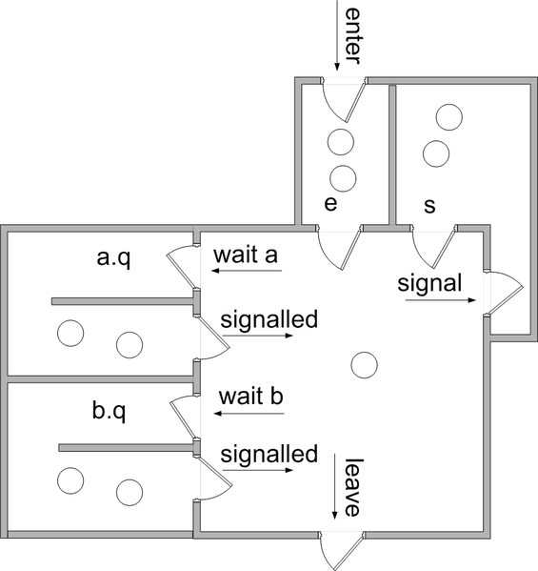
Hoare Monitor Semantics
Hoare monitors (1974)
  notify(CV) means to run the waiting thread immediately
  Causes notifying thread to block
The signaling thread must wait outside the monitor (at least) until the signaled thread relinquishes occupancy of the monitor by either returning or by again waiting on a condition.

Slide 35
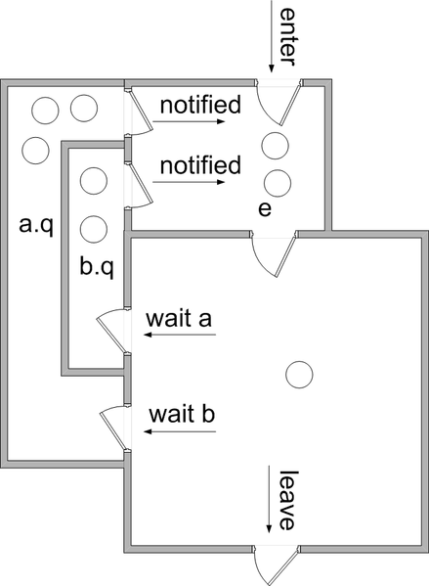
Mesa Monitor Semantics
Mesa monitors (Xerox PARC, 1980)
  notify(CV) puts waiting thread back onto the “ready queue” for the monitor
  But, notifying thread keeps running
Signaling does not cause the signaling thread to lose occupancy of the monitor. Instead the signaled threads are moved to the e queue.

Slide 36
Hoare vs. Mesa monitors
Need to be careful about precise definition of signal and wait. while (n==0) {
wait(not_empty); // If nothing, sleep
}
item = getItemFromArray(); // Get next item
  Why didn’t we do this?
if (n==0) {
wait(not_empty); // If nothing, sleep
}
removeItemFromArray(val); // Get next item
Answer: depends on the type of scheduling
  Hoare-style (most textbooks):
    Signaler gives lock, CPU to waiter; waiter runs immediately
    Waiter gives up lock, processor back to signaler when it exits critical section or if it waits again
  Mesa-style (Java, most real operating systems):
    Signaler keeps lock and processor
    Waiter placed on ready queue with no special priority
    Practically, need to check condition again after wait

Slide 37
Revisit: Readers/Writers Problem
Correctness Constraints:
  Readers can access database when no writers
  Writers can access database when no readers or writers
  Only one thread manipulates state variables at a time

Slide 38
Revisit: Readers/Writers Problem
Correctness Constraints:
  Readers can access database when no writers
  Writers can access database when no readers or writers
  Only one thread manipulates state variables at a time
State variables (Protected by a lock):
int NReaders=0; // Number of active readers
int WaitingReaders=0; // Number of waiting readers
int Nwriters=0; // Number of active writers
int WaitingWriters=0; // Number of waiting writers
Condition canRead = NIL;
Condition canWrite = NIL;

Slide 39
Readers and Writers
Monitor ReadersNWriters {
int WaitingWriters, WaitingReaders,NReaders, NWriters;
Condition CanRead, CanWrite;
Void BeginWrite()
{
if(NWriters == 1 || NReaders > 0)
{
++WaitingWriters;
wait(CanWrite);
--WaitingWriters;
}
NWriters = 1;
}
Void EndWrite()
{
NWriters = 0;
if(WaitingReaders)
Signal(CanRead);
else
Signal(CanWrite);
}
Void BeginRead()
{
if(NWriters == 1 || WaitingWriters > 0)
{
++WaitingReaders;
Wait(CanRead);
--WaitingReaders;
}
++NReaders;
Signal(CanRead);
}
Void EndRead()
{
if(--NReaders == 0)
Signal(CanWrite);
}

Slide 40
Readers and Writers
Monitor ReadersNWriters {
int WaitingWriters, WaitingReaders,NReaders, NWriters;
Condition CanRead, CanWrite;
Void BeginWrite()
{
if(NWriters == 1 || NReaders > 0)
{
++WaitingWriters;
wait(CanWrite);
--WaitingWriters;
}
NWriters = 1;
}
Void EndWrite()
{
NWriters = 0;
if(WaitingReaders)
Signal(CanRead);
else
Signal(CanWrite);
}
Void BeginRead()
{
if(NWriters == 1 || WaitingWriters > 0)
{
++WaitingReaders;
Wait(CanRead);
--WaitingReaders;
}
++NReaders;
Signal(CanRead);
}
Void EndRead()
{
if(--NReaders == 0)
Signal(CanWrite);
}

Slide 41
Readers and Writers
Monitor ReadersNWriters {
int WaitingWriters, WaitingReaders,NReaders, NWriters;
Condition CanRead, CanWrite;
Void BeginWrite()
{
if(NWriters == 1 || NReaders > 0)
{
++WaitingWriters;
wait(CanWrite);
--WaitingWriters;
}
NWriters = 1;
}
Void EndWrite()
{
NWriters = 0;
if(WaitingReaders)
notify(CanRead);
else
notify(CanWrite);
}
Void BeginRead()
{
if(NWriters == 1 || WaitingWriters > 0)
{
++WaitingReaders;
Wait(CanRead);
--WaitingReaders;
}
++NReaders;
Signal(CanRead);
}
Void EndRead()
{
if(--NReaders == 0)
notify(CanWrite);
}

Slide 42
Readers and Writers
Monitor ReadersNWriters {
int WaitingWriters, WaitingReaders,NReaders, NWriters;
Condition CanRead, CanWrite;
Void BeginWrite()
{
if(NWriters == 1 || NReaders > 0)
{
++WaitingWriters;
wait(CanWrite);
--WaitingWriters;
}
NWriters = 1;
}
Void EndWrite()
{
NWriters = 0;
if(WaitingReaders)
notify(CanRead);
else
notify(CanWrite);
}
Void BeginRead()
{
if(NWriters == 1 || WaitingWriters > 0)
{
++WaitingReaders;
Wait(CanRead);
--WaitingReaders;
}
++NReaders;
notify(CanRead);
}
Void EndRead()
{
if(--NReaders == 0)
notify(CanWrite);
}

Slide 43
Understanding the Solution
A writer can enter if there are no other active writers and no readers are waiting

Slide 44
Readers and Writers
Monitor ReadersNWriters {
int WaitingWriters, WaitingReaders,NReaders, NWriters;
Condition CanRead, CanWrite;
Void BeginWrite()
{
if(NWriters == 1 || NReaders > 0)
{
++WaitingWriters;
wait(CanWrite);
--WaitingWriters;
}
NWriters = 1;
}
Void EndWrite()
{
NWriters = 0;
if(WaitingReaders)
notify(CanRead);
else
notify(CanWrite);
}
Void BeginRead()
{
if(NWriters == 1 || WaitingWriters > 0)
{
++WaitingReaders;
Wait(CanRead);
--WaitingReaders;
}
++NReaders;
notify(CanRead);
}
Void EndRead()
{
if(--NReaders == 0)
notify(CanWrite);
}

Slide 45
Understanding the Solution
A reader can enter if
  There are no writers active or waiting
So we can have many readers active all at once
Otherwise, a reader waits (maybe many do)

Slide 46
Readers and Writers
Monitor ReadersNWriters {
int WaitingWriters, WaitingReaders,NReaders, NWriters;
Condition CanRead, CanWrite;
Void BeginWrite()
{
if(NWriters == 1 || NReaders > 0)
{
++WaitingWriters;
wait(CanWrite);
--WaitingWriters;
}
NWriters = 1;
}
Void EndWrite()
{
NWriters = 0;
if(WaitingReaders)
notify(CanRead);
else
notify(CanWrite);
}
Void BeginRead()
{
if(NWriters == 1 || WaitingWriters > 0)
{
++WaitingReaders;
Wait(CanRead);
--WaitingReaders;
}
++NReaders;
notify(CanRead);
}
Void EndRead()
{
if(--NReaders == 0)
notify(CanWrite);
}

Slide 47
Understanding the Solution
When a writer finishes, it checks to see if any readers are waiting
  If so, it lets one of them enter
  That one will let the next one enter, and so on..
Similarly, when a reader finishes, if it was the last reader, it lets a writer in (if any is there)

Slide 48
Readers and Writers
Monitor ReadersNWriters {
int WaitingWriters, WaitingReaders,NReaders, NWriters;
Condition CanRead, CanWrite;
Void BeginWrite()
{
if(NWriters == 1 || NReaders > 0)
{
++WaitingWriters;
wait(CanWrite);
--WaitingWriters;
}
NWriters = 1;
}
Void EndWrite()
{
NWriters = 0;
if(WaitingReaders)
notify(CanRead);
else
notify(CanWrite);
}
Void BeginRead()
{
if(NWriters == 1 || WaitingWriters > 0)
{
++WaitingReaders;
Wait(CanRead);
--WaitingReaders;
}
++NReaders;
notify(CanRead);
}
Void EndRead()
{
if(--NReaders == 0)
notify(CanWrite);
}

Slide 49
Understanding the Solution
It wants to be fair
  If a writer is waiting, readers queue up
  If a reader (or another writer) is active or waiting, writers queue up
  … this is mostly fair, although once it lets a reader in, it lets ALL waiting readers in all at once, even if some showed up “after” other waiting writers

Slide 50
Monitors, CV’s versus Semaphores
Condition variables != semaphores
  But they can be used to implement each other
Access to the monitor is controlled by a lock
  wait() blocks the calling thread, and gives up the lock
    Monitor: To call wait, the thread has to be in the monitor (hence has lock)
    Semaphore: wait just blocks the thread on the queue
  signal() causes a waiting thread to wake up
    Monitor: If there is no waiting thread, the signal is lost
    Semaphore: signal increases the semaphore count, allowing future entry even if no thread is waiting
    Condition variables have no history

Slide 51
Monitors in Java
Every object is/has a monitor
  At most one thread can be inside an object’s monitor
  A thread enters an object’s monitor by
    Executing a method declared “synchronized”
      Can mix synchronized/unsynchronized methods in same class
    Executing the body of a “synchronized” statement
Every object can be treated as a condition variable
    wait() : the current thread is suspended
    notify() : notifies an arbitrary thread (T) from the wait list.
      T must re- obtain the synchronization lock for the target object, which will always cause it to block at least until the thread calling notify releases the lock.
      It will continue to block if some other thread obtains the lock first.
    notifyAll() : notify all the suspended threads.

Slide 52
Monitors in Java - example
class Counter
{
private int count = 0;
public void synchronized increment()
{
int n = count;
count = n+1;
}
}
Counter c, d; /* shared objects */
Thread A
Thread B
…
c.increment();
…
…
c.increment();
…
When Thread B calls increment() while Thread A is executing increment(), it will blocked until Thread B exits the monitor.
A synchronized method is not the equivalent of a critical section!
  The synchronization is associated with the object instances, not the code.
  Hence c.increment() can be executed simultaneously with d.increment().

Slide 53
Producer/Consumer in Java
class Buffer {
private char [] buffer;
private int count = 0, in = 0, out = 0;
Buffer(int size) {
buffer = new char[size];
}
public synchronized void insert(char c) {
while(count == buffer.length) {
try { wait(); }
catch (InterruptedException e) { }
finally { }
}
System.out.println("Producing " + c + " ...");
buffer[in] = c;
in = (in + 1) % buffer.length; count++;
notify();
}
public synchronized char remove() {
while (count == 0) {
try { wait(); }
catch (InterruptedException e) { }
finally { }
}
char c = buffer[out];
out = (out + 1) % buffer.length; count--;
System.out.println("Consuming " + c + " ...");
notify();
return c;
}
}

Slide 54
Monitors and CV’s in C
Monitors are not provided
  But are implementable easily
Condition Variables are provided
  pthread_cond_t cond = PTHREAD_COND_INITIALIZER;
  int pthread_cond_init(pthread_cond_t *cond, pthread_condattr_t *cond_attr);
  int pthread_cond_signal(pthread_cond_t *cond);
    a.k.a. notify() in Java.
  int pthread_cond_broadcast(pthread_cond_t *cond);
    a.k.a. notifyAll() in Java.
  int pthread_cond_wait(pthread_cond_t *cond, pthread_mutex_t *mutex);
  int pthread_cond_timedwait(pthread_cond_t *cond, pthread_mutex_t *mutex, const struct timespec *abstime);
    If cond has not been signaled within the amount of time specified by abstime, the mutex mutex is re-acquired and pthread_cond_timedwait returns the error ETIMEDOUT.
  int pthread_cond_destroy(pthread_cond_t *cond);
    No threads must be waiting on the condition variable.

Slide 55
The Big Picture
The point here is that getting synchronization right is hard
How to pick between locks, semaphores, CVs, monitors?
Locks are very simple for many cases.
  Issues: Maybe not the most efficient solution
  For example, can't allow multiple readers but one writer inside a standard lock.
Condition variables allow threads to sleep while holding a lock
  Just be sure you understand whether they use Mesa or Hoare semantics!
Semaphores provide pretty general functionality
  But also make it really easy to botch things up.

Slide 56

Barbershop problem
A barber shop consists of a waiting room with N chairs, and the barber room containing the barber chair.
If there are no customers to be served, the barber goes to sleep.
If a customer enters the barber shop and all chairs are occupied, then the customer leaves the shop.
If the barber is busy, but chairs are available, then the customer sits in one of the free chairs.
If the barber is asleep, the customer wakes up the barber.

Slide 57
Monitor template
monitor BarberShop{
condition waitingForCustomers,
waitingForBarbers;
int waiting = 0; // number of waiting customers in chairs
void barber(){
………………….
cutHair();
……………….
}
void customer(){
………………….
getHairCut(); // may not be executed if all chairs are full.
………………
}
}
void barberThread(){
while(1)
BarberShop.barber();
}
void customerThread(){
BarberShop.customer();
}

Slide 58
Semaphore template
semaphore customer; init(customer,0); // number of customers waiting for service
semaphore barber; init(barber,0); // number of barbers waiting for customers
semaphore mutex; init(mutex,1); // for mutual exclusion
int waiting = 0; //customers who are sitting in chairs
void barberThread(){
while (1) {
……………….
cutHair();
…………….
}
}
void customerThread(){
………………..
getHairCut(); // may not be executed if all chairs are full.
………………
}

Slide 59
Checking your code
B: Does the Barber sleep when there are no customers.
BC: Does the first customer wake up the sleeping barber and have his haircut.
BCC: Does the second customer waits for the barber while he is giving a haircut to the first customer.
BCCCCCCC: Does the 7th customer (first customer having a haircut, the next 5 customers waiting), exits without getting a haircut?
BCCCCC: Does the barber wake up a waiting customer after finishing the haircut of the first customer?
Finally, is the solution efficient? Sending more notify signals than needed, or using more variables is not good practice.

