Slide 1
EFFICIENT RENDERING LARGE TERRAINS USING MULTIRESOLUTION MODELLING AND IMAGE PROCESSING TECHNIQUES
Ömer Nebil YAVEROĞLU
Department of Computer Engineering
Middle East Technical University
January 2010

Slide 2
Outline
Problem Definition
Literature Survey
  Level Of Detail (LOD) Algorithms
  Problems of LOD Algorithms
  Two solutions proposed for Terrain Rendering Problem
Methods
Results
Conclusion
Future Work
References

Slide 3
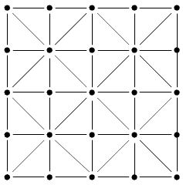
Problem definition
Aim is rendering a large terrain with height field data dynamically at run time.
Height Field data is provided as (2^{n} + 1) x (2^{n} +1) matrices which keeps height values in their cells.
Basically terrains can be generated by combining these points by triangles as shown in the right figure. (Direct Rendering)

Slide 4
Problem definition
The rendering process becomes problematic when the height field matrix gets larger.
There exists a need for reducing the number of triangles to be rendered to reduce the computational complexity of the rendering process.

Slide 5
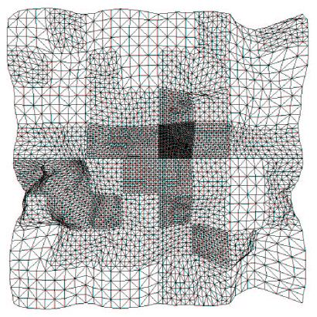
Problem definition
Multi resolution modeling (Level Of Detail – LOD Algorithms) can be used to reduce the number of triangles to be rendered.

Slide 6
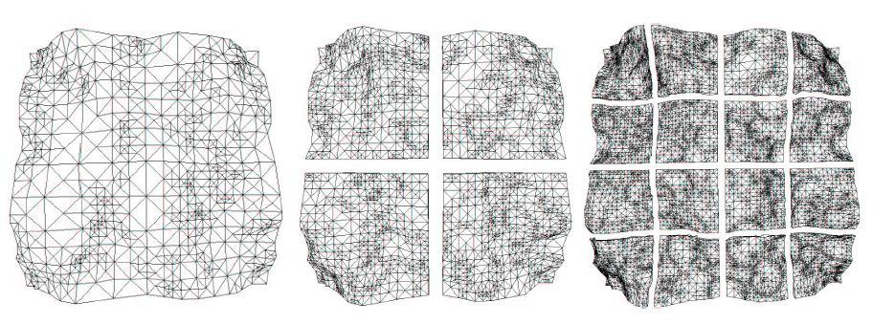
Level of detail (lod) algorithms
Surface Roughness
Distance to the Camera Position

Slide 7
Problems of lod algorithms
Correct level of detail
  Complex enough to not to reduce image quality
  Simple enough to reduce the number of triangles into an acceptable amount
Cracks
Popping

Slide 8
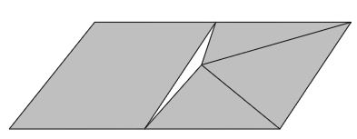
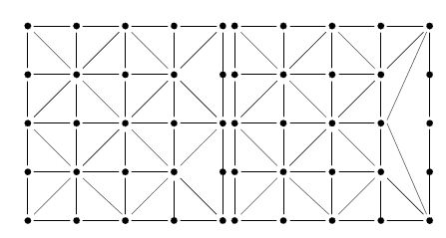
Problems of lod algorithms
Cracks are the gaps which occur at the borders of different level of details.
Different techniques for avoiding cracks exist such as:
  Crack Filling
  Mapping the higher resolution to lower resolution
  Changing the connectivity at the borders

Slide 9
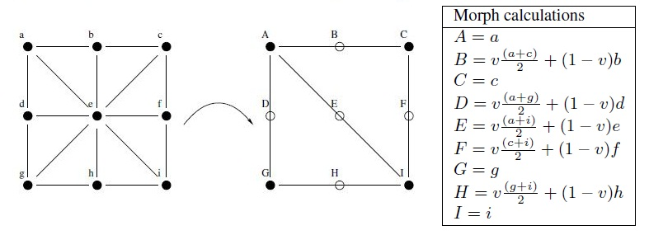
Problems of LOD algorithms
Popping occurs when a lower resolution region is mapped to a higher resolution.
This change occurs with an effect of a sudden change in geometry.
Solution to this problem is applying morphing.

Slide 10
Solution proposed by ulrich
Apply Chucked LOD Algorithm using quad trees to keep the height field data.
Use a complex error metric which includes the distance to camera position and surface roughness
Use crack filling for correcting the cracks.
Apply morphing for popping problem.

Slide 11
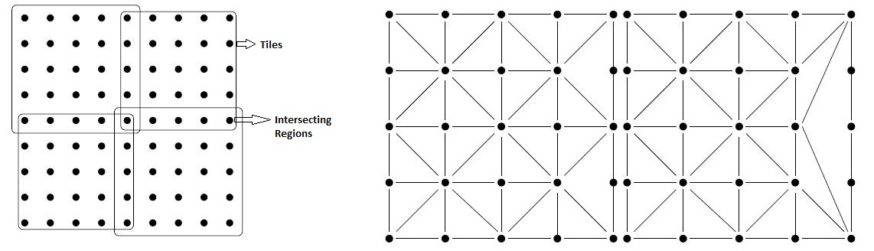
Solution proposed by
Larsen & Christensen
Divide the terrain into tiles of equal size
Allow these tiles to intersect at the borders in order to get over the cracking problem
Cracks are avoided by rearranging the triangles at these intersecting regions
Morphing is used to get over the popping problem

Slide 12
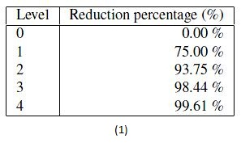
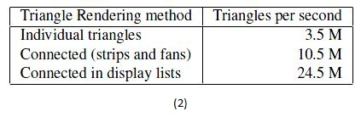
Solution proposed by
Larsen & Christensen
Two important points to keep in mind during implementation is mentioned in the paper:
  Usage of at most 5 levels of detail is enough for the purpose.
  Using display lists are much faster than using connected structures such as strips and fans. Also usage of connected structures are much faster than disconnected structures. This is a result of the working mechanisms of graphics cards.

Slide 13
Methods
Quad trees are used to keep the level information.
An error metric is defined to determine the detail level of a node in the quad tree.
Surface roughness and distance to camera position are used as parameters of this error metric.

Slide 14
Methods
Median filtering is applied on the height field data in order to decide on surface roughness.
Distance to camera position is used as a tolerance parameter for errors.
Cracks are eliminated by reordering the triangles forming a tile.
No solutions are proposed for popping.

Slide 15
Usage of quad trees
For each node …
Quad Size : 1024 x 1024
Quad Size : 512 x 512
Quad Size : 256 x 256
… decide whether to divide or not.

Slide 16


Deciding on dividing or not
If the errorMetric is less than or equal to 1, divide the quad into four.
Average Error and Average Quad Error is computed using Median Filtering.

Slide 17
Deciding on dividing or not
Median Filtering is a non-linear image processing technique often used to remove noise from images or other irregularities from image files.
3 | 3 | 2 | 5
1 | 1 | 3 | 4
2 | 2 | 0 | 2
3 | 3 | 3 | 3
3 | 3 | 2 | 5
1 | 1 | 3 | 4
2 | 2 | 0 | 2
3 | 3 | 3 | 3
3 | 3 | 2 | 5
1 | 2 | 3 | 4
2 | 2 | 0 | 2
3 | 3 | 3 | 3
3 | 3 | 2 | 5
1 | 2 | 2 | 4
2 | 2 | 0 | 2
3 | 3 | 3 | 3
Values In the Filter: 0,1,1,2,2,2,3,3,3
Median of Filter : 2
Values In the Filter: 0,2,2,2,2,3,3,4,5
Median of Filter : 2

Slide 18
Deciding on dividing or not
A 16 x 16 Median Filter is applied on the height field file to smooth the image.
A difference image is constructed by subtracting each pixel of the smoothed image from original image.
The difference image is used to determine the rough regions of the height field data.

Slide 19

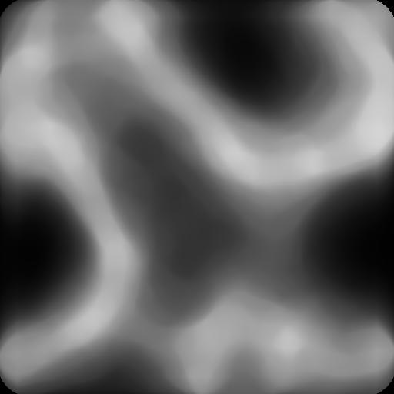

Deciding on dividing or not
a) Original Image
b) Smoothed Image
c) Difference Image

Slide 20
Deciding on dividing or not
Average Error of a quad is the average of the corresponding pixel values in difference image
Average Quad Error is nothing but the Average Error of the root of the quad tree.

Slide 21
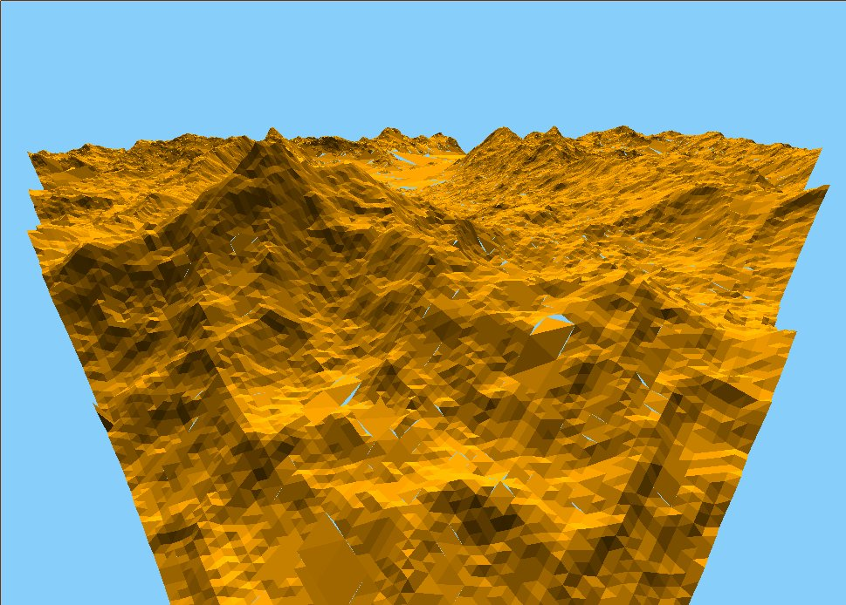
Crack Prevention

Slide 22
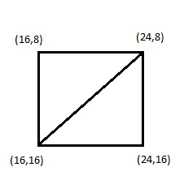
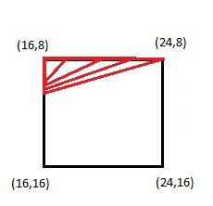
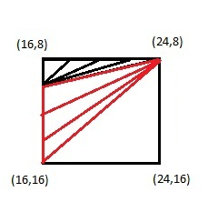
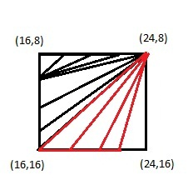
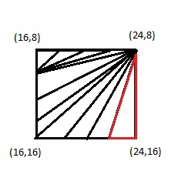

Crack Prevention
Cracking points are determined for each tile before they are rendered.
They are corrected by dividing the lower resolution tiles into triangles to generate a perfect matching of vertices.

Slide 23
Results
The algorithm is implemented on a PC with:
  512 MB Nvidia Geforce 9500 M graphics card
  Intel® Core™ 2 Duo CPU T9300 @ 2.50 GHz
  2013 MB memory
The implementation is done from the scratch using just OpenGL with C++.
Number of polygons required to generate the terrain and FPS values are measured for performance comparison

Slide 24
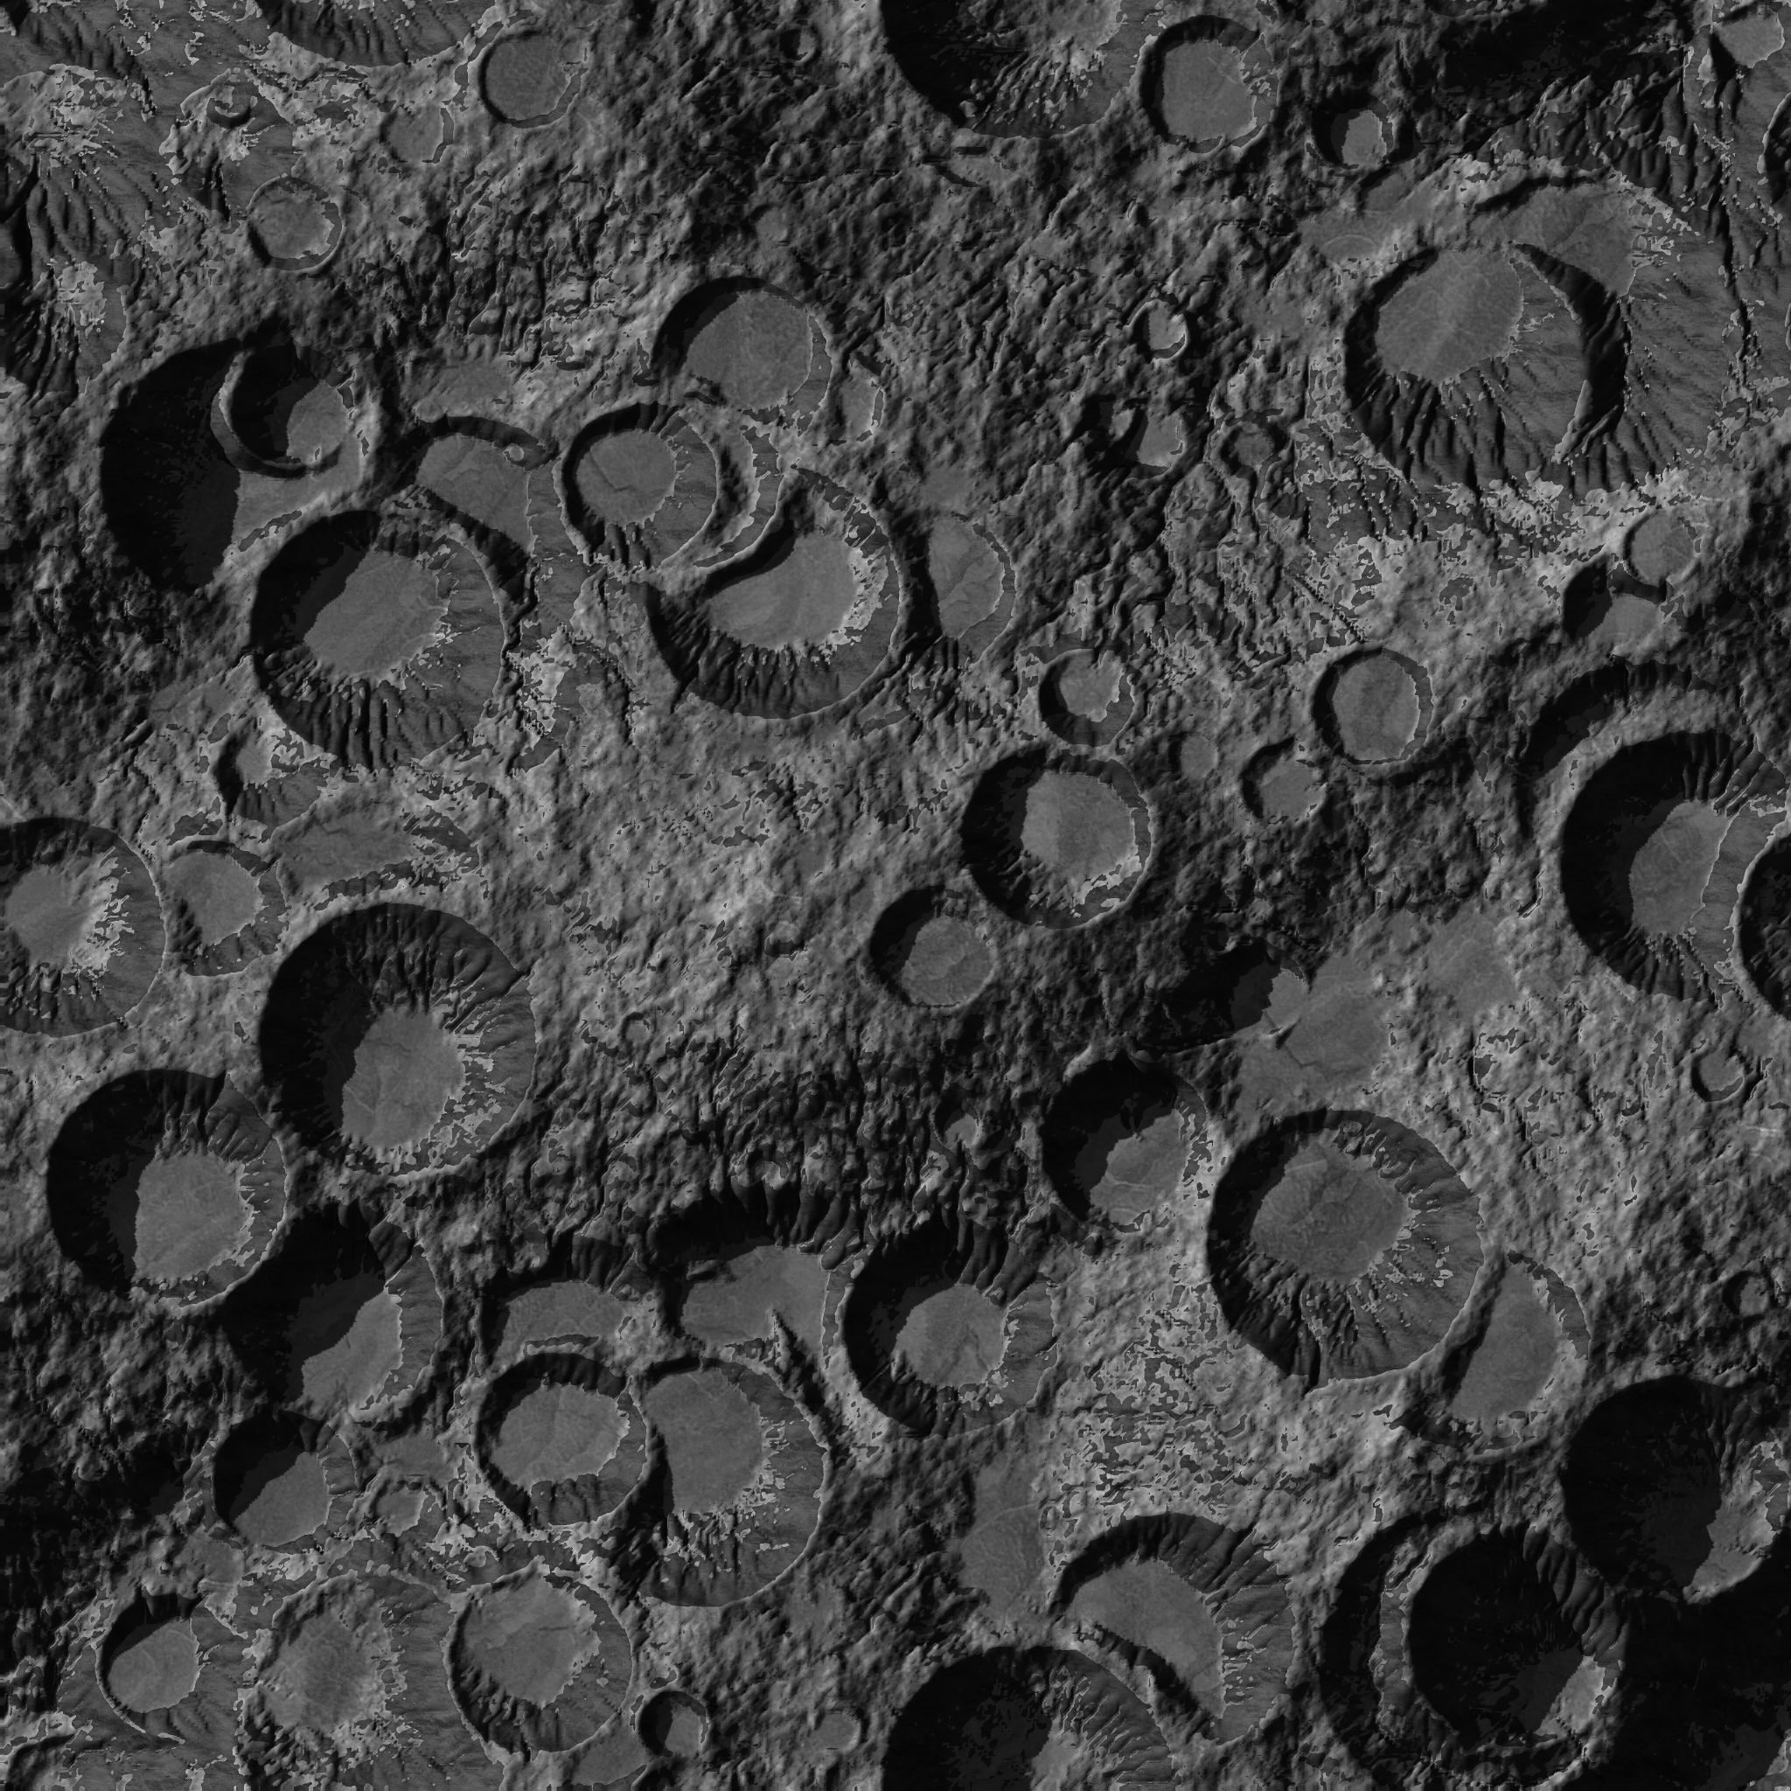
Results
Two different benchmark height field images are used for testing :
Smooth Terrain
Complex Terrain

Slide 25
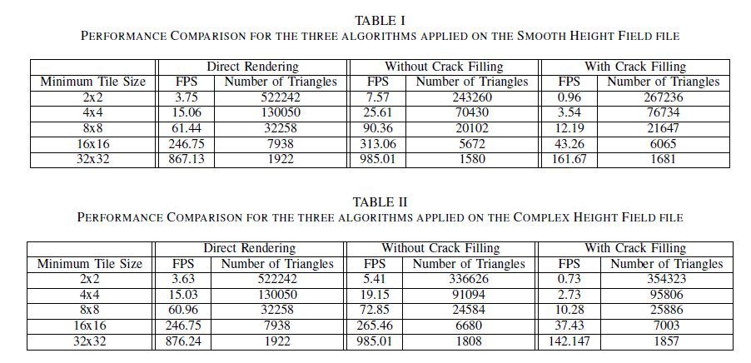
Results
Three different algorithms are tested for performance comparison:
  Direct Rendering of the Terrain
  Multi Resolution Rendering without Crack Filling
  Multi Resolution Rendering with Crack Filling

Slide 26
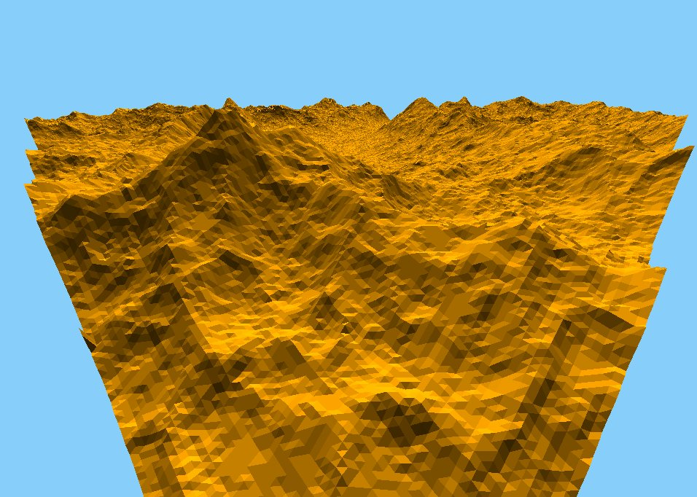
Results
(Direct Rendering)

Slide 27
Results
( Multi resolution modeling without crack filling)

Slide 28
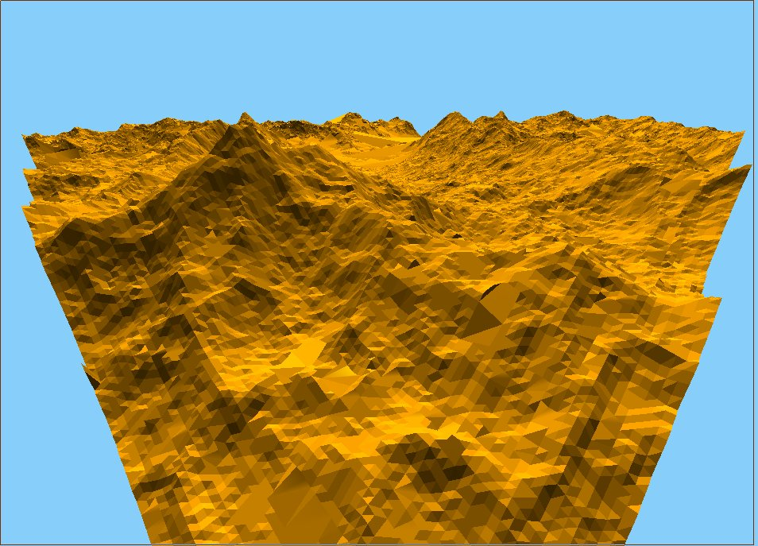
Results
( Multi resolution modeling with crack filling)

Slide 29
Results
The polygon count required to render the terrain is reduced up to 49%.
FPS Value is increased for the case without crack filling.
For crack filling case, since the cracks are determined prior to rendering, FPS values are reduced.

Slide 30
Conclusion
An efficient terrain rendering method is implemented.
Quad trees are used to define the level of detail.
Nodes are expanded depending on the distance of the node to the camera and the surface roughness at the position of the node.
Median Filtering is used to decide on surface roughness.

Slide 31
Conclusion
Distance to the camera position is used as a tolerance parameter for the error of the approximated quad.
The performance results show that the algorithm reduces the number of polygons required to render the scene up to 49%.
FPS values are also increased compared to the direct rendering with an exception of a small importance.

Slide 32
Future Work
First of all, the crack finding mechanism should be taken out of the display callback function with an increase of memory usage.
Program can be implemented using GPU and Parallel Programming.
The error function used for deciding the level of detail can be improved by the introduction of the new parameters for generating more realistic effects.

Slide 33
references
Boer, W. H. (2000). Fast Terrain Rendering Using Geometrical MipMapping.
Larsen, B. D., & Christensen, N. J. (2003). Real-time Terrain Rendering using Smooth Hardware Optimized Level of Detail. Journal of WSCG, Vol.11, No.1, ISSN 1213-6972. Plzen, Czech Republic: UNION Agency Science Press.
Martin Schneider, R. K. (2007). Efficient and Accurate Rendering of Vector Data on Virtual Landscapes. Journal of WSCG, 2007 .
Stefan Röttger, W. H.-P. (1998). Real-Time Generation of Continuous Levels of Detail for Height Fields. WSCG'98.
Szymon Rusinkiewicz, M. L. (2000). QSplat: A Multiresolution Point Rendering System for Large Meshes. SIGGRAPH 2000. New Orleans, LA, USA.
Ulrich, T. (2002). Rendering Massive Terrains using Chunked Level of Detail Control.

