Slide 1
Academic Text Organization
Sinan Kalkan

Slide 2
Text organization
Title
Abstract
Introduction
Related Work
The Body
Experiments
Conclusion
Future work
http://cs.stanford.edu/people/widom/paper-writing.html

Slide 3
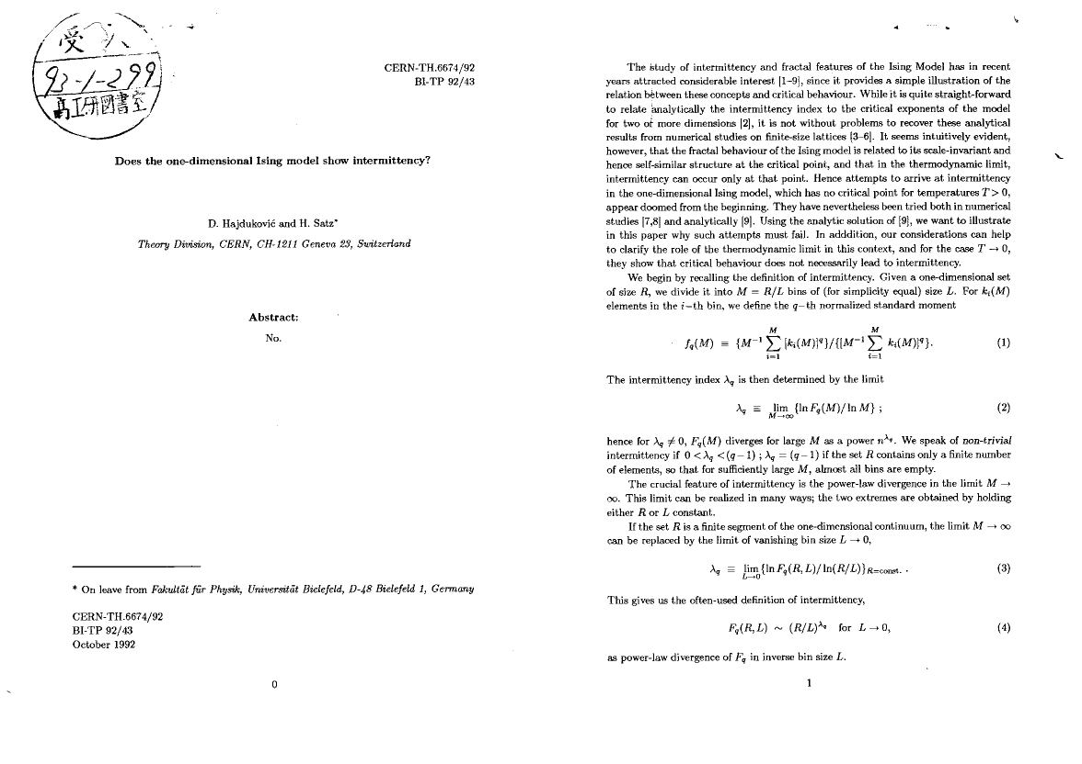
Abstract

Slide 4
Abstract
Describe:
  The problem,
  Your approach + solution
  Your contribution
  Your results
Include:
  Little background
Be factual but comprehensive
http://cs.stanford.edu/people/widom/paper-writing.html

Slide 5
Introduction
Stanford InfoLab's patented five-point structure for Introductions:
What is the problem?
Why is it interesting and important?
Why is it hard? (E.g., why do naive approaches fail?)
Why hasn't it been solved before? (Or, what's wrong with previous proposed solutions? How does mine differ?)
What are the key components of my approach and results? Also include any specific limitations.

Slide 6
Introduction
“Then have a final paragraph or subsection: "Summary of Contributions". It should list the major
contributions in bullet form, mentioning in which sections they can be found. This material doubles
as an outline of the rest of the paper, saving space and eliminating redundancy.”
http://cs.stanford.edu/people/widom/paper-writing.html

Slide 7
Related Work
“Should related work be covered near the beginning of the paper or near the end?
  Beginning, if it can be short yet detailed enough, or if it's critical to take a strong defensive stance about previous work right away. In this case Related Work can be either a subsection at the end of the Introduction, or its own Section 2.
  End, if it can be summarized quickly early on (in the Introduction or Preliminaries), or if sufficient comparisons require the technical content of the paper. In this case Related Work should appear just before the Conclusions, possibly in a more general section "Discussion and Related Work".”
http://cs.stanford.edu/people/widom/paper-writing.html

Slide 8
http://cs.stanford.edu/people/widom/paper-writing.html

Slide 9
Experiments
http://cs.stanford.edu/people/widom/paper-writing.html

Slide 10
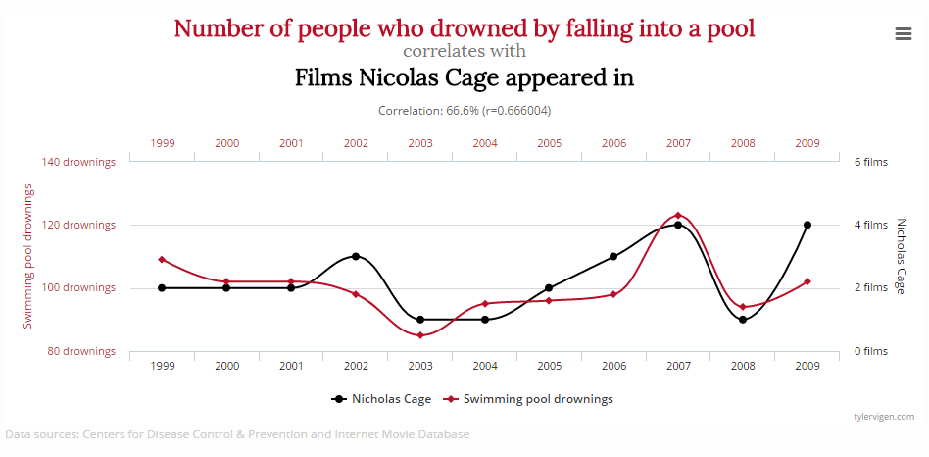
http://www.tylervigen.com/spurious-correlations

